Slide 1
REGION 4&5
10-11-2023

Slide 2
AGENDA
1. | ABOUT ATD
2. | MEINEKE YTD REVIEW
3. | WHY SELL TIRES
4. | PROGRAMS
5. | WHATS NEW

Slide 3
Mark has been with ATD over 2 years and his primary focus is servicing the nationwide network of Meineke dealers.
MARK WILSON
INSIDE ACCOUNT SPECIALIST (CORPORATE ACCTS.)
MWILSON@ATD.COM
704-565-0891
Tire program questions
Account set-up
Issue resolution
ATD Xpress
Billing questions
Tire Protection Program
Tire recycling set-up
Delivery questions
Inventory questions

Slide 4
ABOUT ATD

Slide 7
Meineke - YTD REVIEW
Thru Q2 23
$1.3 MM PURCHASES
10,645 UNITS (15%) YOY
$15,737 TIER PROGRAM PAYOUT Q1-Q2
~$1.50 PER UNIT

Slide 8
IS IT PROFITABLE TO SELL TIRES?
www.tirereview.com/i-love-tires/

Slide 9
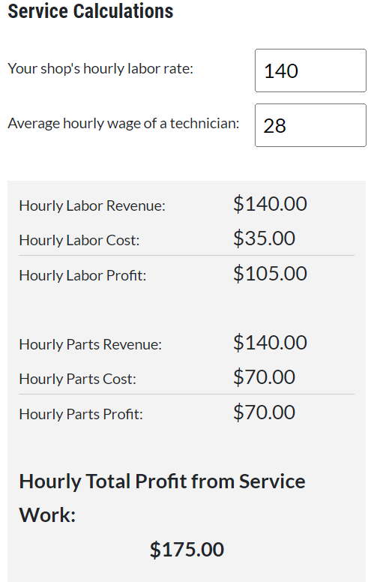
Service Calculations

Slide 10
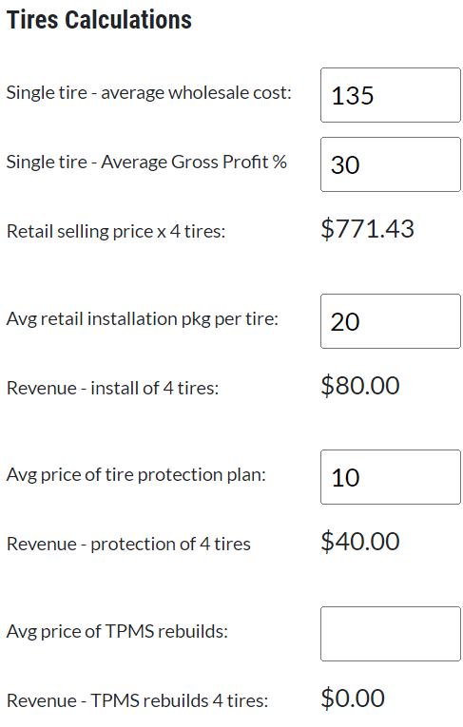
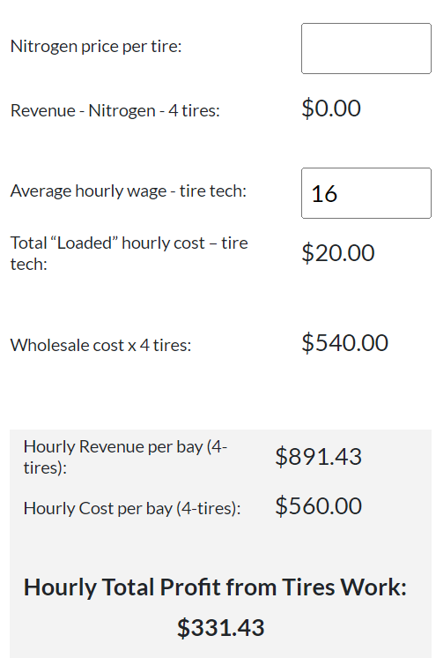
Tire Calculations
If the number below is black, you are making more money selling tires. If the number below is red, you are making more money selling service:
$158.57

Slide 11
FALKEN FANATIC PROGRAM

Slide 12
Meineke Falken Program
No monthly/quarterly/annual goals
Earn $6.00 per tire
Earn additional $2.00 per tire for premium lines
Earn additional $1.00 for streaming Falken TV (optional)
Earn Falken spiffs - $5.00 for Q2

Slide 13
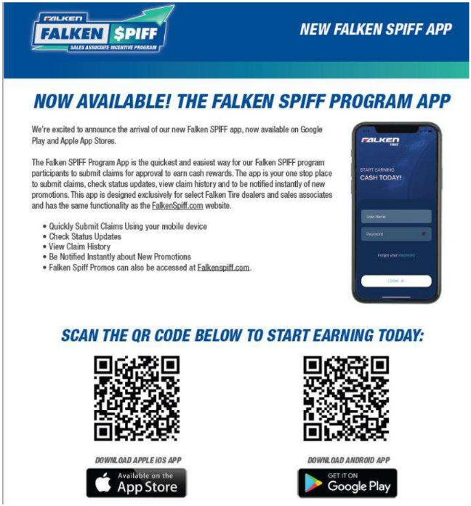
Falken Spiff and Spiff Ap

Slide 14
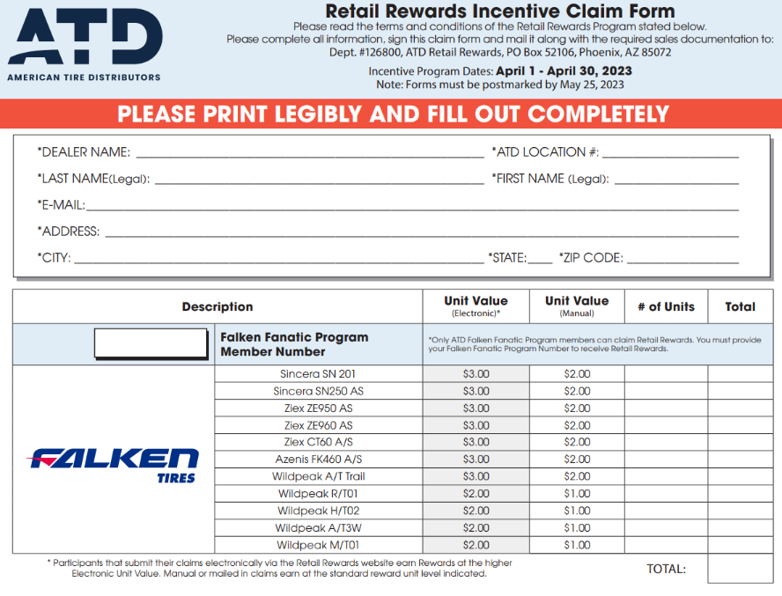
ATD EXCLUSIVE RETAIL REWARDS

Slide 15
Example Net Down
225/45R17 Azenis FK460
Invoice $111.78
Falken Rebate $6.00
Premium Line $2.00
Falken Spiff $5.00
ATD tier program $1.00
ATD Retail Rewards $3.00
TOTAL REBATES $17.00 OR 16% OFF INVOICE
Net Cost $94.78
Retail Price $145.31 (30%) $33.53 Profit
+ Rebates $17.00
TOTAL PROFIT PER TIRE $50.53

Slide 16
OTHER PROGRAM OPPORTUNITIES

Slide 17
ATD Exclusive 3 Tier Meineke Rebate Program Paid out to each location quarterly based on that locations purchases on the below brands.
Tier 1
$3.00 per tire
Tier 2
$2.00 per tire
Tier 3
$1.00 per tire
Yokohama - Toyo
General - BFG
Cooper - Nitto
Uniroyal – Falken
Martercraft - Ironman
Kumho – Nexen
Hankook - MT
Michelin
Continental
Pirelli

Slide 18
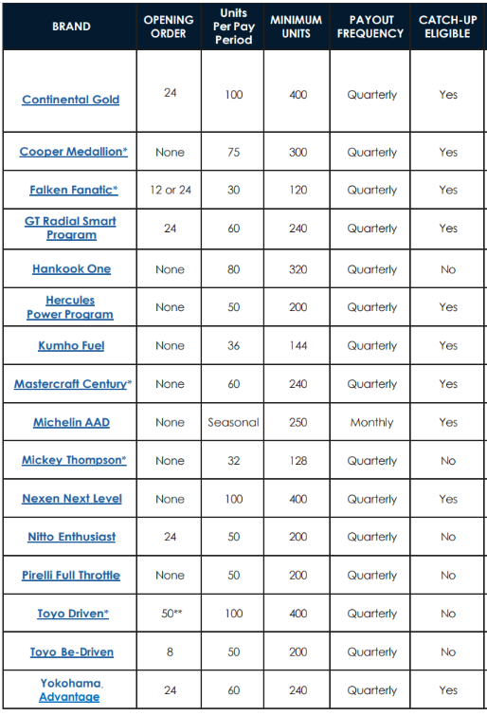
MANUFACTURE PROGRAMS

Slide 19
WHAT’S NEW

Slide 20
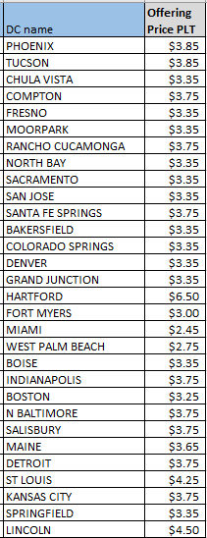
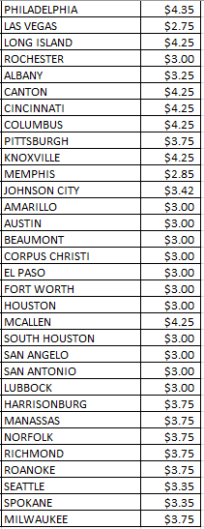
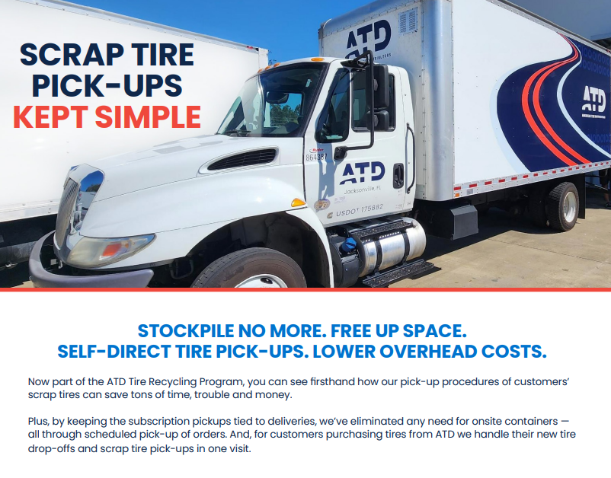

Slide 21
MANAGE WHEN, HOW, AND WHAT YOU PAY
MANAGE APPLICATION OF CREDITS
IMMEDIATE REAL-TIME POSTING OF PAYMENTS
REVIEW PREVIOUS ACCOUNT ACTIVITY
CALL 866-618-9866 TO ENROLL

Slide 22
ATD Mobile… get it at the Ap store

Slide 24
ATD Tire Protection Plan
Road Hazard
Flat Tire Assistance
Flat Repair
Support Network
Free replacement for 12 months/12,000 miles, whichever comes first.
After that period prorated down to a tread depth of 2/32” or a maximum of four years.
Available for 24 months from the date of purchase. Customer is eligible for claims in the period of up to $75 each.
Free Flat Repairs, Inspections, and Air Checks within network.
The Tire Protection Plan is supported by Automotive Business Solutions (ABS) with over 50,000 nationwide network members.
If a warranty issue arises within 25 miles of the original servicing location, they return to that dealer for warranty repairs and the dealer is responsible for that claim. Should the consumer be outside of the 25 miles radius they call ABS to find the nearest servicing location.

Slide 25
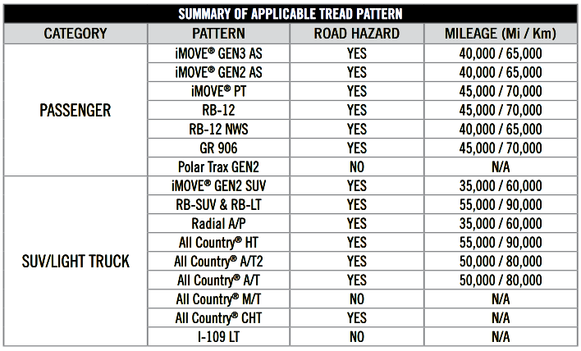

Slide 26
**Any Meineke location within 25 miles of an ATD DC is eligible for ATD Xpress Monday – Saturday at no cost.
Normal delivery time is 2 hours within 25 miles
Cut-off times as late as 3PM in most DC’s
Contact Mark Wilson Mwilson@atd.com to see if your store qualifies
** Store must be signed on a manufacture program with ATD as their primary, otherwise there is a $15 fee per delivery

