Slide 1

MDA CONFERENCE
Factory Motor Parts Presentation | 10.16.2023

Slide 2
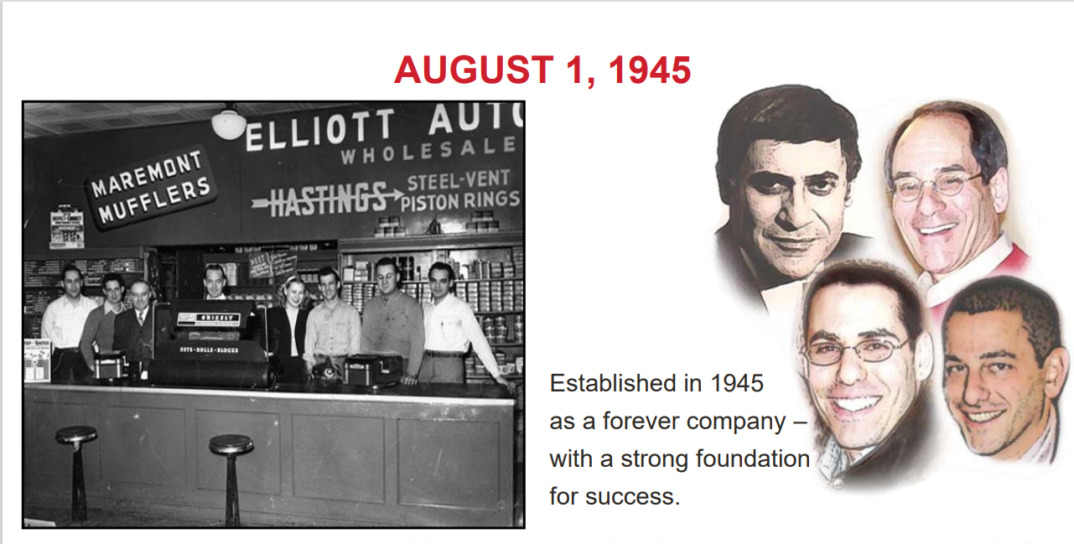

Slide 3
What Makes FMP Different?
Family Owned for over 78 years
FMP is B2B focus
We are growing in a way that allows to thrive in difficult times and stay focused on our goal to be “The Best Independent Automotive Aftermarket Company”
We care deeply about your company’s success and the success of your individual stores
We pride ourselves on partnerships at all levels within the business
Best Sales Team in the World that focuses on the Customer First
Consultative selling model, we want to help your business be successful

Slide 4

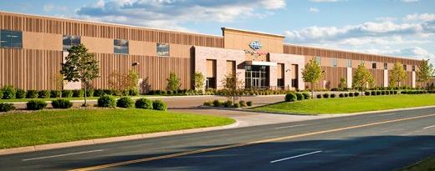

FMP COMPANY OVERVIEW
Privately-held automotive warehouse distributor and manufacturer with 368 distribution warehouses nationally
Largest ACDelco & Motorcraft distributor. Lending Aftermarket Brands products for the automotive aftermarket.
One of the largest and fastest growing distributor of automotive batteries in the U.S.
UNDER HOOD
Batteries
Belts
Antifreeze
Condensers
Chemicals & Lubricants
DEF – Diesel Exhaust Fluid
Fan Clutches
Water Pumps
Filters
Heater Cores
Ignition Coils
Motor Mounts
Power Steering Hoses
Radiators
Starters & Alternators
Timing Chains
Powertrain
UNDER CAR
Brake Calipers
Brake Drums & Rotors
Brake Hardware
Brake Master Cylinders
Brake Pads & Shoes
Catalytic Converters
Chassis
Drive Axles
U-Joints
Wheel Bearing & Hub Assemblies
SPLASH Products Inc.
Windshield Washer Fluids
RV & Marine Antifreeze
Gas Line Antifreeze
Ice Melt
Wiper blades
Factory Motor Parts Eagan, MN Distribution Center
Founded in 1945
Over 78 years experience serving FMP customers!
FMP - Confidential

Slide 5
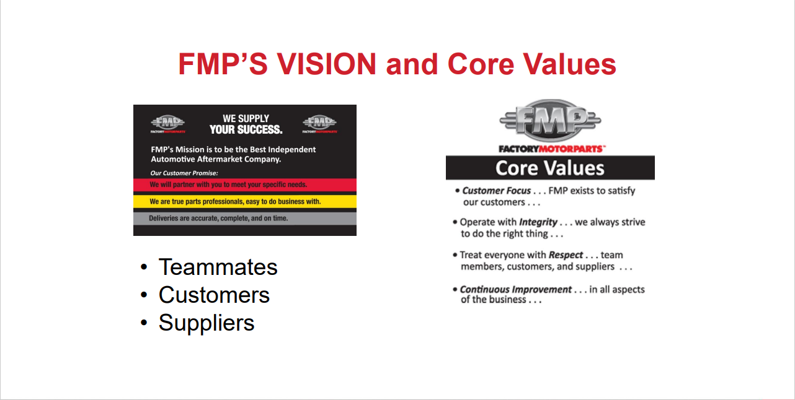

Slide 6
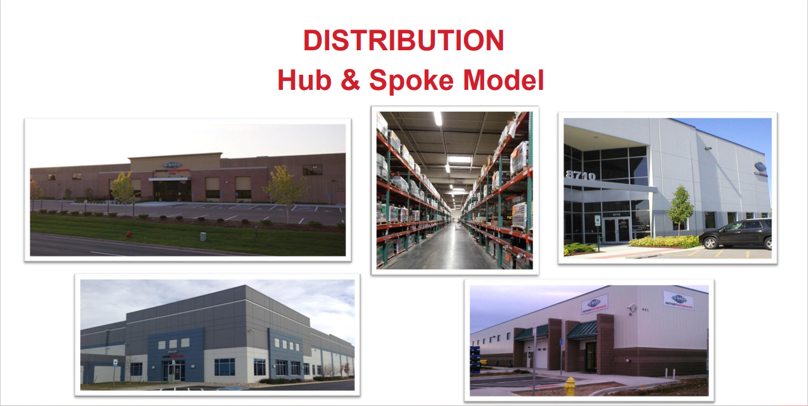

Slide 7


Slide 8
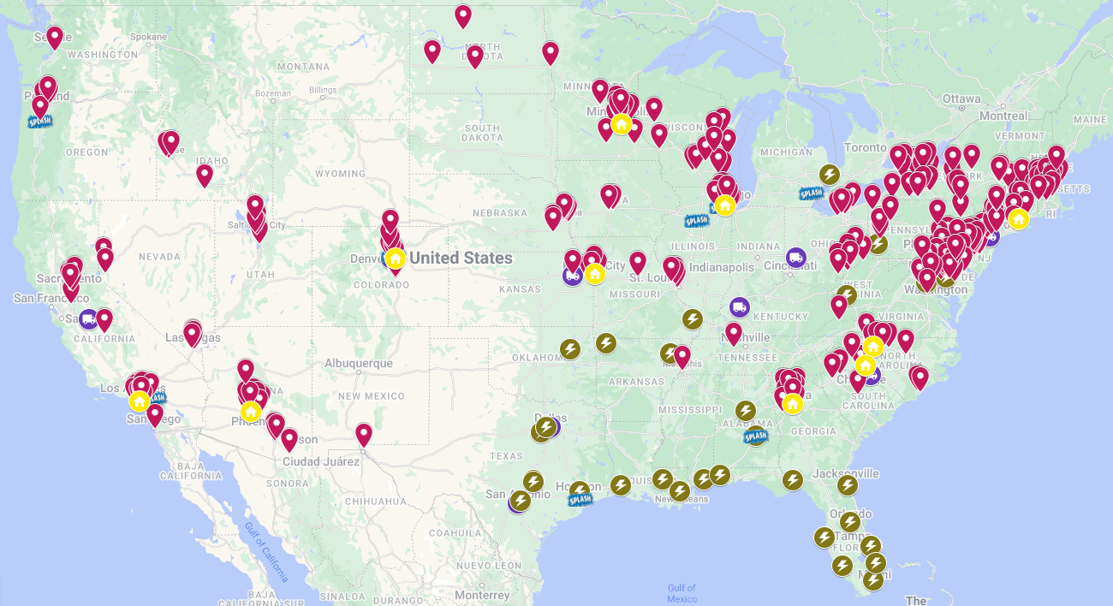
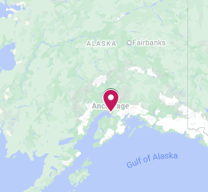
NATIONAL FOOTPRINT
FMP Hub Location
FMP Spokes
SPLASH Plants
DEF Plants
Battery Partner Locations
FMP - Confidential

Slide 9

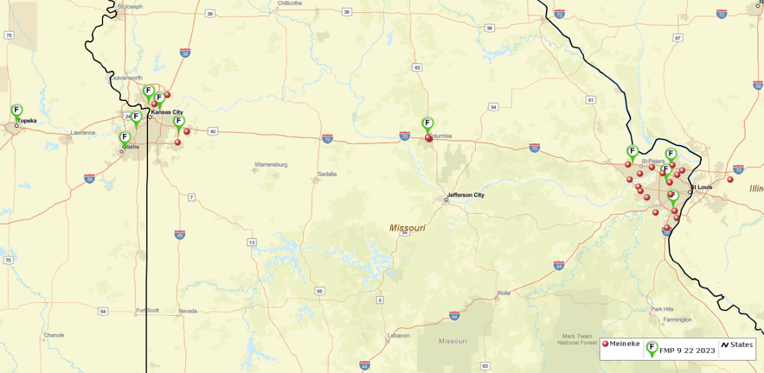
FMP’s Improved Footprint
Where are you on this map?

Slide 10
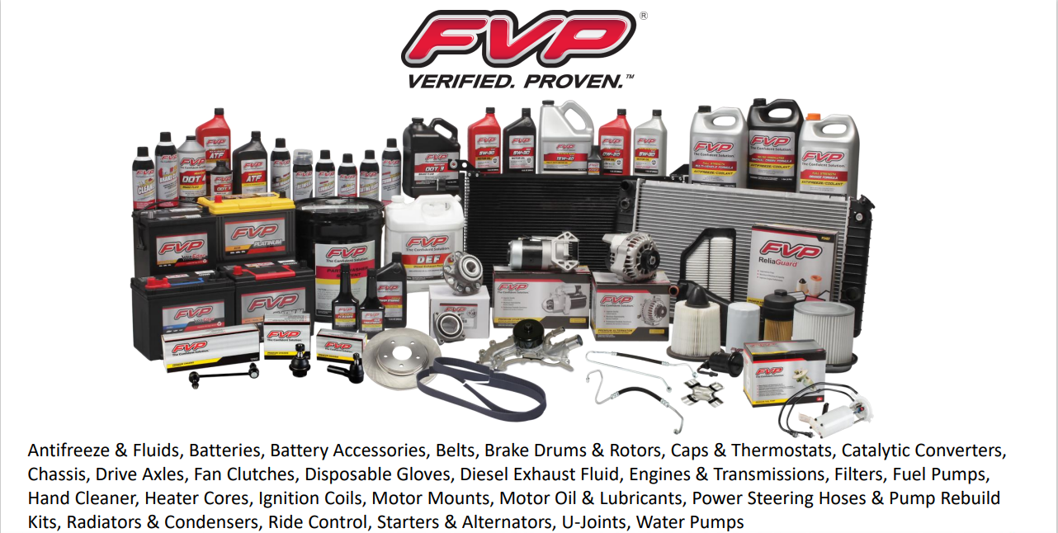

Slide 11


Slide 12
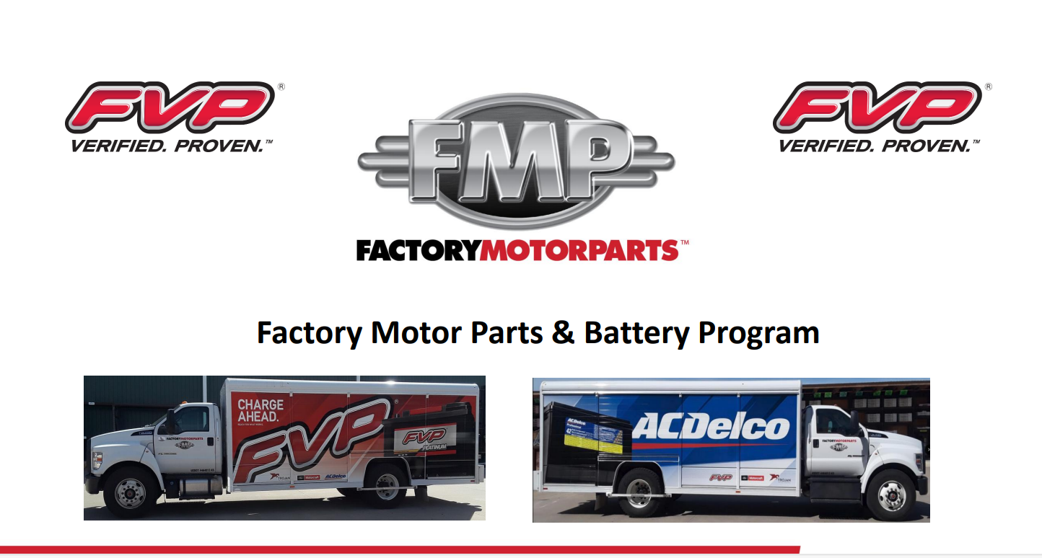
https://www.youtube.com/watch?v=rOcxhariH3s

Slide 13
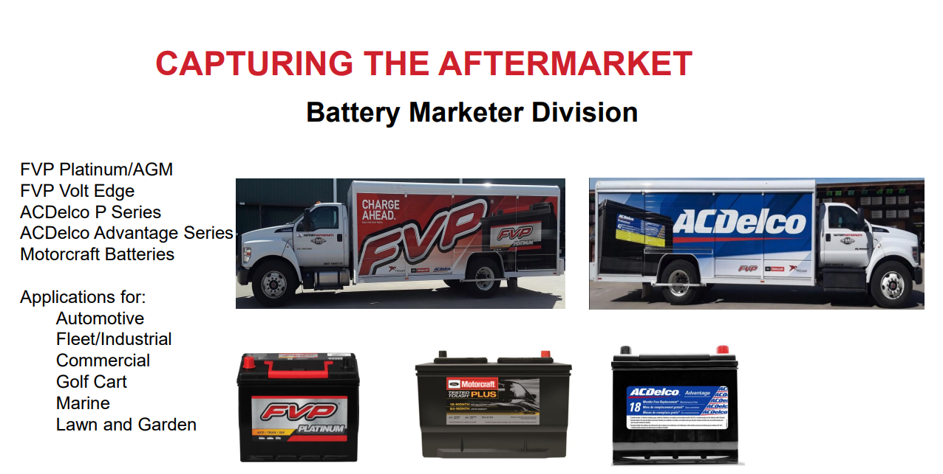

Slide 14
FVP Battery Recommendation
Recommendation:
  FVP Platinum Batteries
    On-Demand Program menu price for most batteries
    Additional volume incentives could be applied
  Tester Options:
    Solara
    Autel
    B2Q
      Integrated tools to help measure and manage battery testing
      Simplified tools to communicate test results to the customer

Slide 15
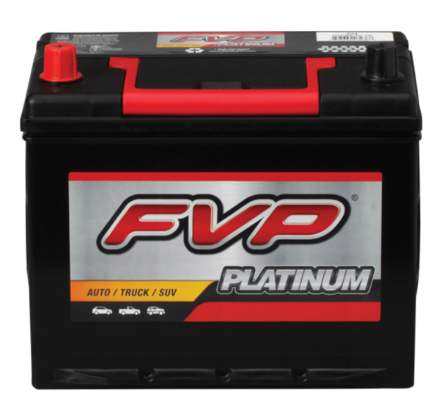
FVP Platinum
30 month free replacement warranty
22% more powerful than FVP VoltEdge*
High Cold Cranking Amps and Reserve Capacity Ratings
  Platinum has the power to start your vehicle and run all of the modern electronics found in today’s vehicles
Exceeds OEM Specs
  Properly balances CCA and RC to provide extra power when needed
New Calcium/Calcium Alloy
  Reduces self-discharge for long lasting durability
Industry leading performance
Menu Pricing Option
Manufactured by Atlas, a major supplier of General Motors batteries
*when comparing same BCI Group size

Slide 16

Nationwide Warranty Program
Positions FVP as a leader in warranty coverage
Nationwide warranty is effective during the warranty period of the battery
  VoltEdge – 24 month
  Platinum – 30 month
  Platinum AGM – 36 month
  Extended warranty – 5 year available
Most battery providers have a nationwide warranty program, ours goes above and beyond with our roadside assistance component
Makes FVP Batteries the “battery of choice” for Professional Installers

Slide 17

FMP Powertrain Program

Slide 18
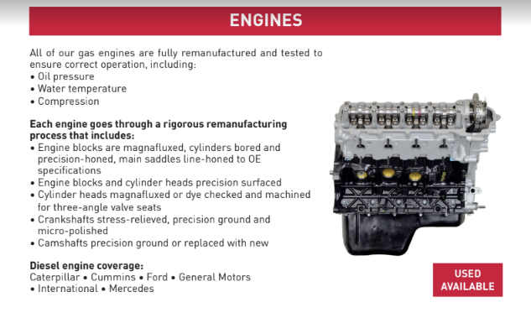
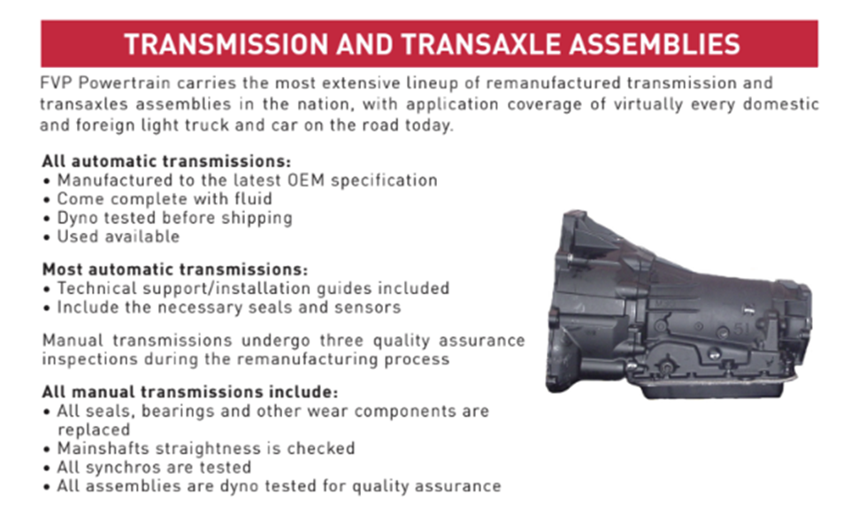
FVP Powertrain

Slide 19


Best Warranty in the Industry

Slide 20

Overall Incentive Program
  Monthly Rebate based on tiered purchases
  Initial 10% Rebate Thanks for the Opportunity Program
  FMP will provide aggressive bundle pricing including:
    FCS Complete Struts
    Brake Bundle pricing on FVP, Wagner, Centric, PowerStop, MTC and ACDelco
    Special bundle programs based on customer and region direction
    FVP Powertrain Program – Enhanced 36-month, Unlimited Mileage program opportunity
  Incremental Incentives (eligibility requirements apply)
    Up to 3% AC Delco GM Perks Program
    Up to 4% Motorcraft PSN Program
    Up to 4% Overdriv Program

Slide 21
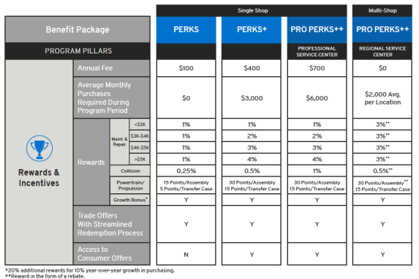
GM Perks Program
GM Perks

Slide 22
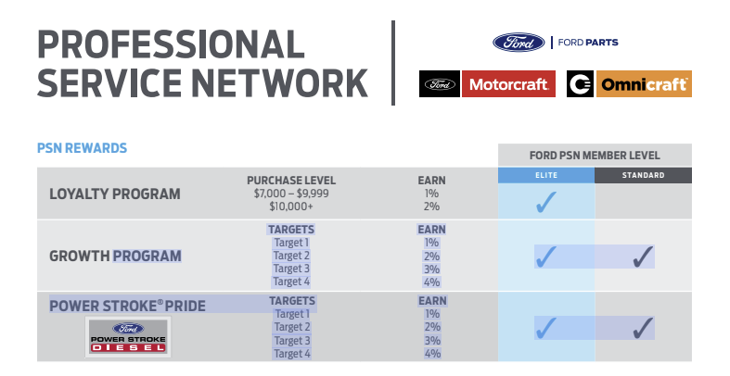
Motorcraft PSN Program

Slide 23


Slide 24
What does the FMP Partners Network offer?
Backs your repairs with a comprehensive warranty for just pennies per vehicle serviced
1
2
Provides the end consumer with increased satisfaction and the added value of Roadside Assistance
3
Drives repeat business and referrals to your shop
4
Gives your shop a “national” reach
5
Saves you hundreds of dollars annually on employee training costs and other member discount savings
6
Easy monthly payments with no long term contract

Slide 25





Program Components
Comprehensive Nationwide Warranty Coverage
Roadside Coverage for your Customer
FREE Classroom and Online Training
Marketing and Enhanced Customer Support
Discounted Member Services

Slide 26




FMP Training (Injectronics) Offering
Live Webinar Technical Training
  Ability to have up to 100 people on the webinar
  Interactive with ability to ask questions
  A certificate is available to print after the course
  Service writer and shop owner classes
Online prerecorded training
  Can access at any time
  Take a quiz and print a certificate at the end
  Ability to stop and go back to any part of the course
Classroom based technical training
  PDF Manuals for attendees
  FMP branded certificates of completion mailed after the courses
  Calendar is available through your sales rep and on the Training website
FMP Partners Network customers will receive ALL training offered by FMP Training and Product Vendors for free!

Slide 27

Fees of the Program
Perks plus members receive a $15/month discount on partners network membership!
12/12,000 warranty plan - $49.95/month
24/24,000 warranty plan - $69.95/month
Optional 12/12 Fleet coverage also available for $29.95/month
36/36,000 warranty plan - $89.95/month
FMP Partners Network Membership
1. Maintain a professional shop image
2. Have on the premises an employee that has ASE certification with a minimum of 1 ASE Certified Tech
3. Make FMP my preferred auto parts supplier, including the following:
        a. Stock selected FMP lines
        b. Make a minimum of $2,500/month in FMP purchases
        c. Maintain open account status in good standing
4. Comply with marketing standards developed by FMP for the Program, including the following:
a. Use of signage, promotional and marketing materials
b. Proper use of FMP Partners Network℠ service mark
5. Compliance with the Program requirements and terms of this Agreement

Slide 28

Questions?

