Slide 1


MDA Fall
Regional Meetings
2023

Slide 2
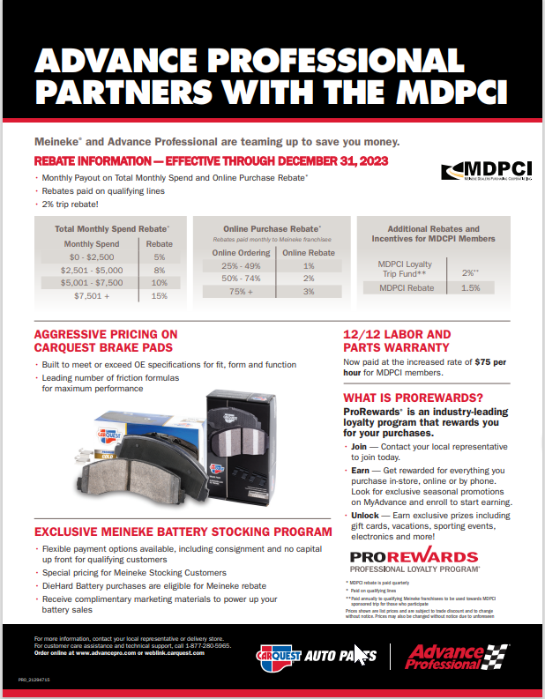


Slide 3

Worldpac Introduction
WORLDPAC covers all vehicle makes & models, including some models that span back 50 years
WORLDPAC stocks over 140,000 SKUs sourced from over 500 active suppliers located in over 20 different countries
speedDIAL, a B2B e-commerce platform, is fully integrated with WORLDPAC’s industry leading original equipment catalog and has over 19.6 Million Import and domestic multiple brand applications
400,000 additional SKUs are available through our Special Order & Cross Banner programs
Imports parts directly from the most respected worldwide OEM manufacturers, representing more than 70% of the inventory
100% Commercial (DIFM), No Retail (DIY)

Slide 4

































































Leading National Brands Available

Slide 5

Worldpac Genuine Parts Available
Why Dealership Parts?
WPAC buys OEM Parts 1st as the lead off offering for its customers
This is a huge investment, but this this separates WPAC from the rest
This OEM offering helps determine part failure and future stocking for troublesome parts

Slide 6


API / Worldpac Overview
Now Combined With Autopart International Private Label
Drive Industry leading parts information (cataloging)
First to market with late model applications (OEM 1st)
319 locations in US and Canada
6 US DC’s
3 Canada DC’s

Slide 7
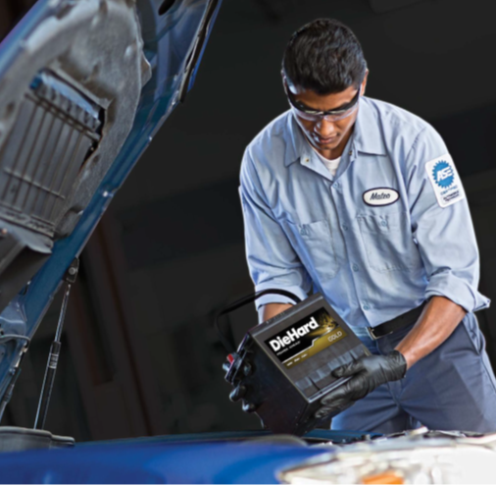
Winning Strategy
Best in Class Product – DieHard
Consignment Stocking Options
Special MDPCI Battery Stocking Pricing
Marketing Support
DieHard Assurance
Battery Tester Program

Slide 8
MDA/MDPCI Stocking Pricing
Most Silver Batteries* | $91.99
With MDPCI Max Rebates | $74.05
* 2-year free replacement
Most Gold Batteries* | $111.99
With MDPCI Max Rebates | $90.15
* 3-year free replacement
Most Platinum Robust Batteries* | $129.99
With MDPCI Max Rebates | $104.64
* 4-year free replacement
Most Platinum AGM Batteries* | $151.99
With MDPCI Max Rebates | $122.35
* 3-year free replacement

Slide 9

Complimentary Marketing Support
We’ve got you covered!!

Slide 10


DieHard Assurance
Protect your customers with industry-leading battery coverage
Included Marketing Materials
FREE Battery Replacement, and the following coverage up to $125:
24 months or 24,000 mile coverage
24-hour jump starts and towing
Travel coverage up to $250
No cost to you or your customer
Flat tire changes
Fluid delivery
Lock out assistance
Get FREE marketing materials to help increase your battery sales
Bi-Fold
Mirror Hanger
Counter Top Display
Counter Top Insert
Special resources for you and your customers
Learn more about DieHard Assurance

Slide 11
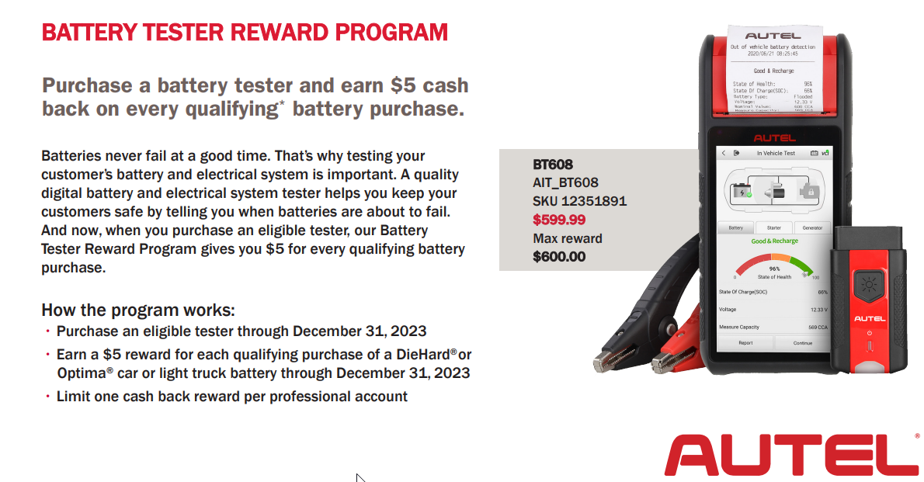
Battery Tester Program

Slide 12
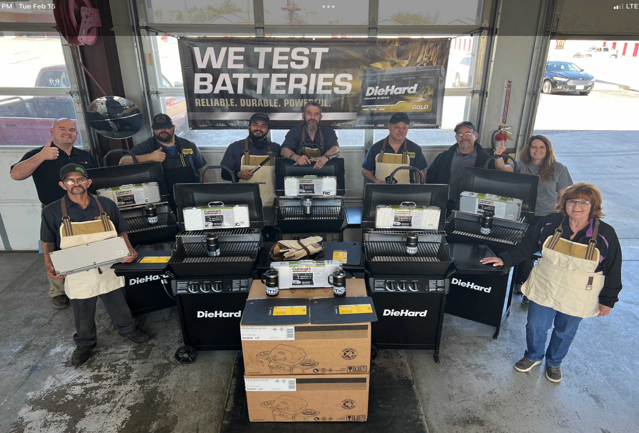

Slide 13

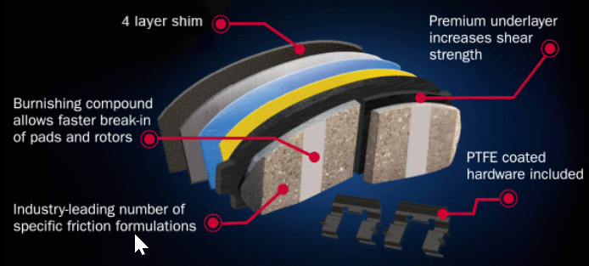
Meineke Exclusive Promo – April/May!
RTIC Cooler Winning Shops
Dave Repass – 1954 Lewes, DE
Russell Blake – 1151 Gardner, MA
Matt Gates – 1114 Portsmouth, NH
George Fuhr – 2013 Davenport, IA

Slide 14


Slide 15
MDA/MDPCI Autel Promo
Valid through 12/29/23
We are running several Items on special MDA/MDPCI pricing through the end of the year. There are also several bundle specials currently available. MUST BE ORDERED THROUGH PETE MASINI TO RECEIVE THE PROMO PRICING. pete.masini@advance-auto.com.
Autel Bundle Flyer
Promo Items 2023 | Promo Price | Retail
BT608ProBun | $564.21 | $729.99
KM100 | $408.54 | $549.99
ITS600 | $359.76 | $499.99
TS900 | $585.30 | $794.99
MS906ProTS | $1,350.00 | $1,999.99
MS906ProADAS | $1,890.24 | $2,599.99
CAB906ProTS | $3,657.32 | $4,999.99
Bundles | Bundle Price | Retail
MSULTRABT | $5,196.88 | $6,799.99
MS909BT | $3,190.63 | $4,499.99
EV909BT | $3,576.88 | $4,999.99
MS919BT | $4,459.38 | $5,899.99
CV909BT | $3,856.88 | $5,799.99
IMPROIIKM | $3,212.50 | $4,499.99
IM508SWATCHB | $893.75 | $1,299.99
IM508SWATCHW | $893.75 | $1,299.99

Slide 16
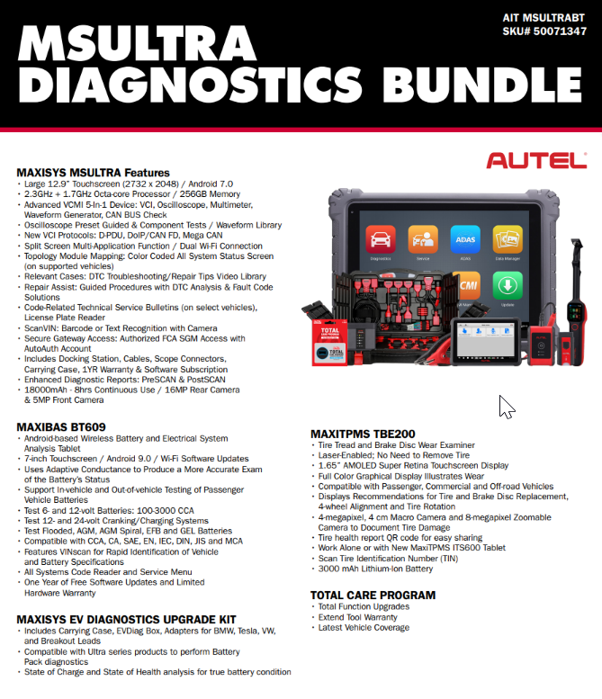

Slide 17
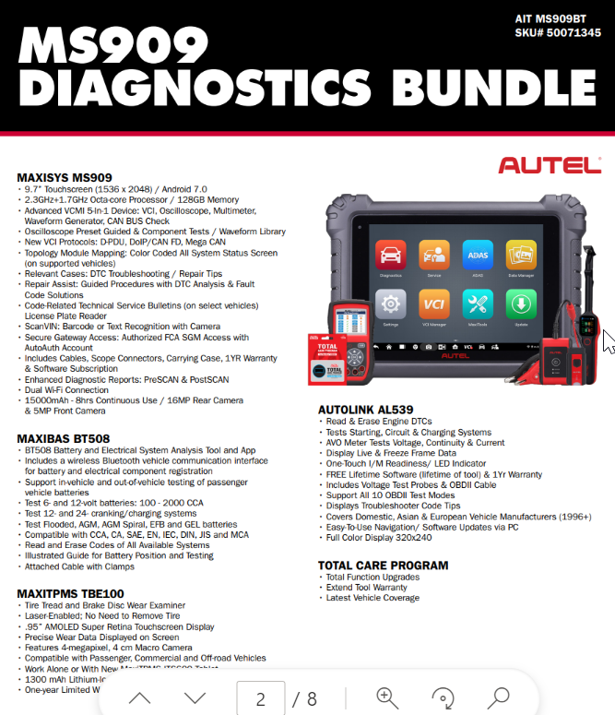

Slide 18
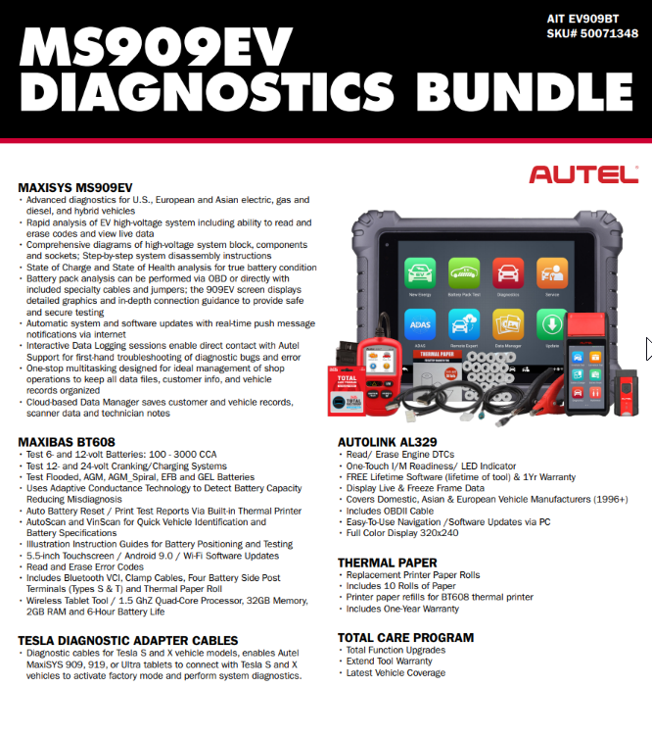

Slide 19
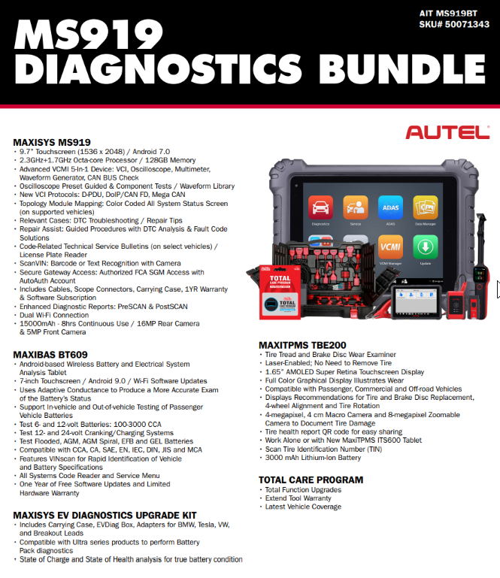

Slide 20
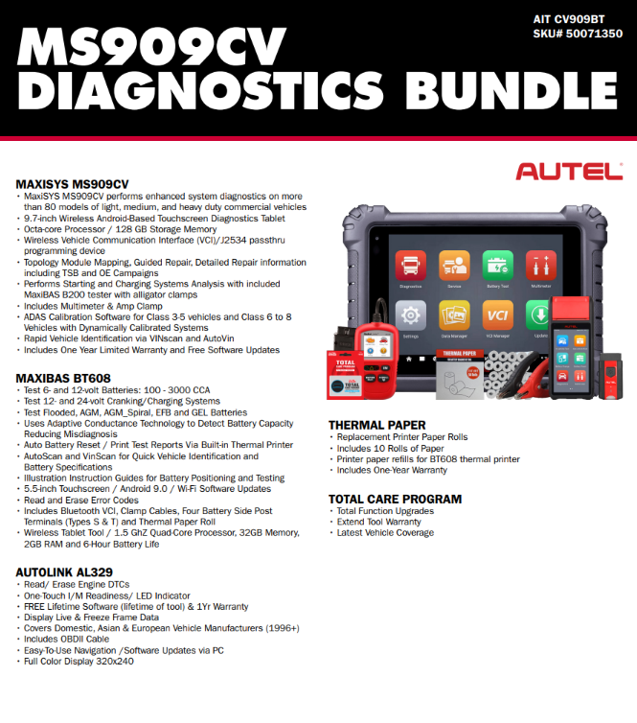

Slide 21
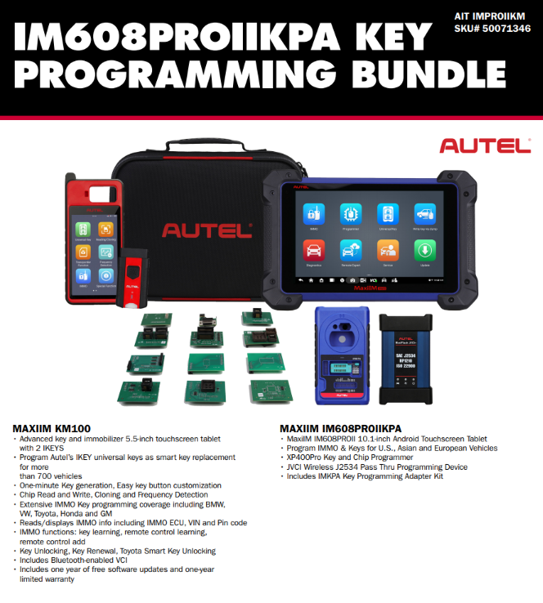

Slide 22
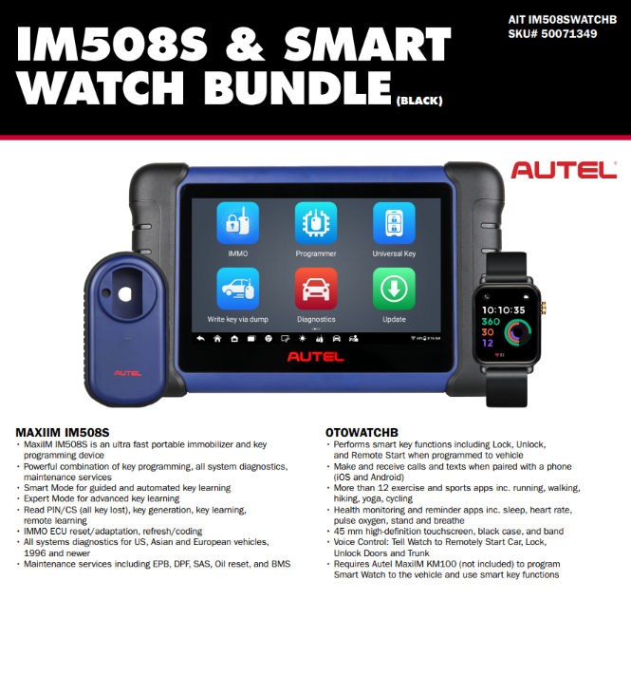

Slide 23
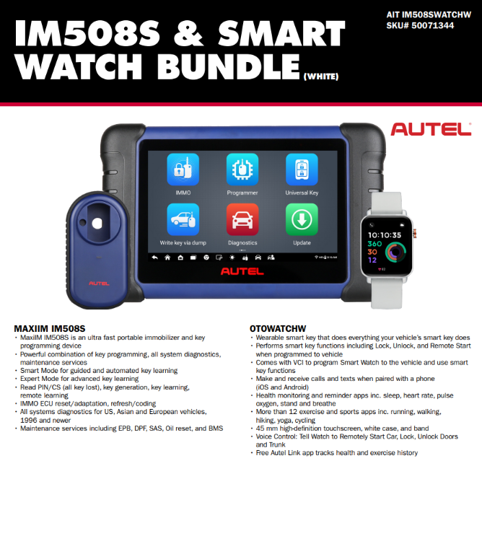

Slide 24
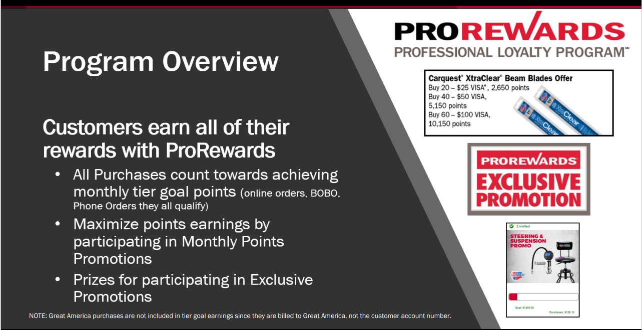

Slide 25

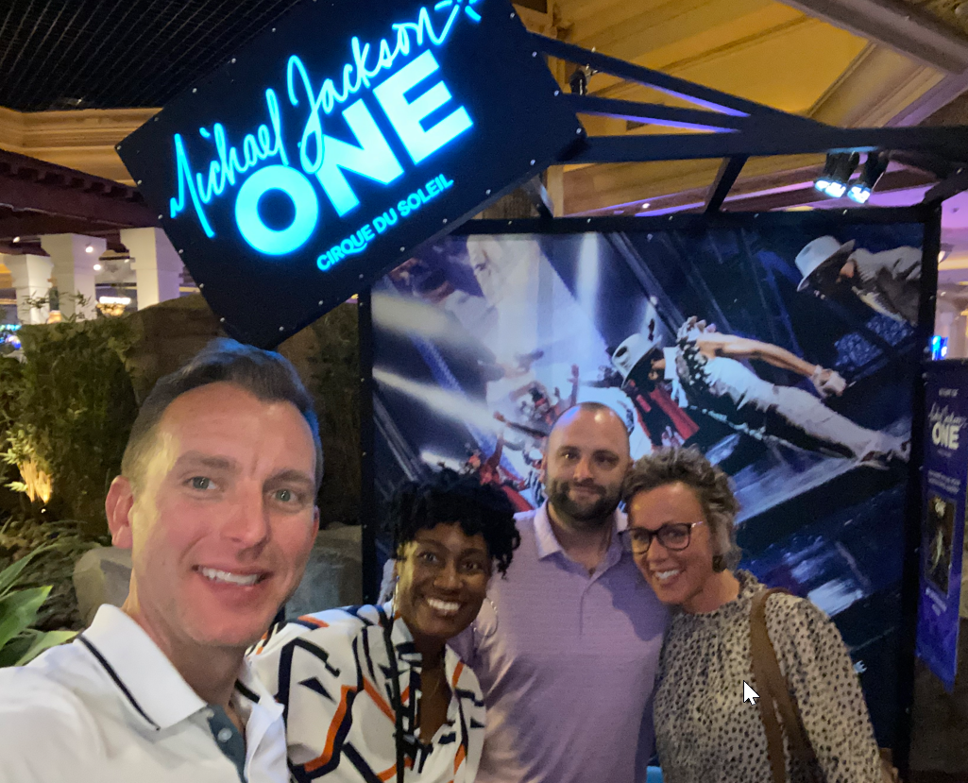
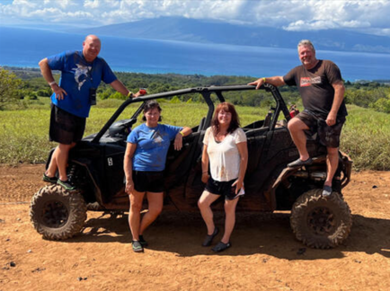
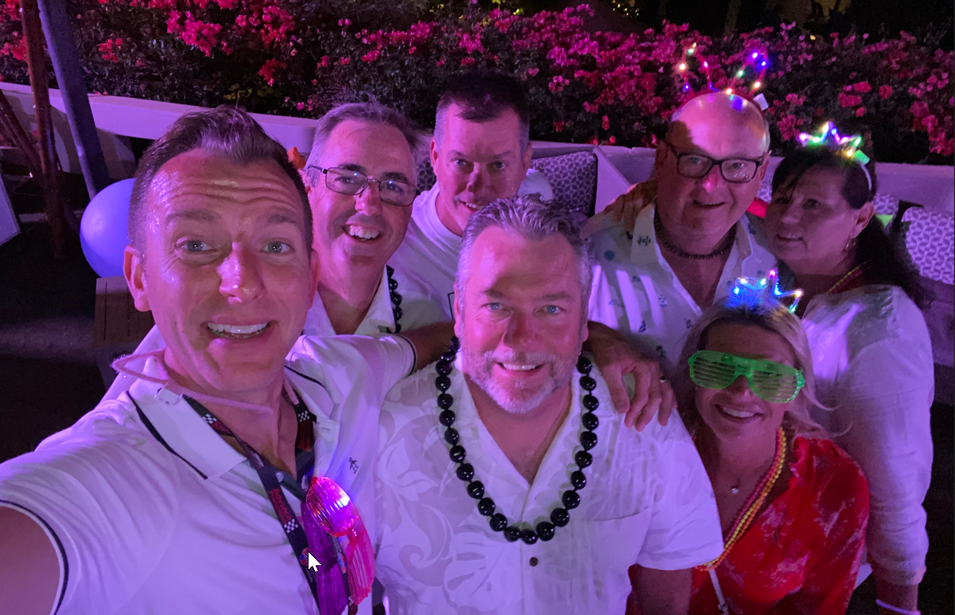

Slide 26


Slide 27
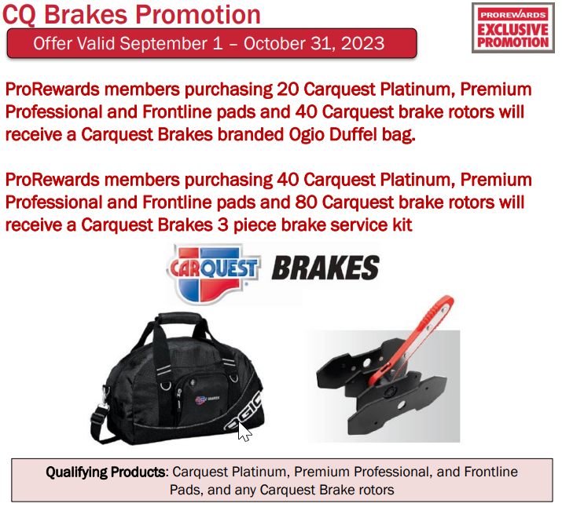

Slide 28
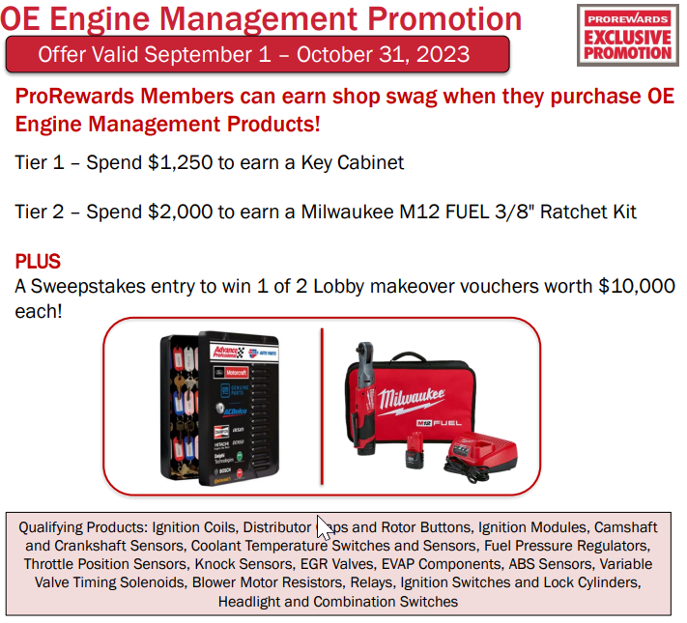

Slide 29


Slide 30


Slide 31


Slide 32

Meineke is excited to partner with Advance Professional’s Carquest Technical Institute (CTI) for training.
Online Training
Virtual Classroom
In Person Instructor Led Training
Notes:
$40 for Online courses
$69 for Virtual Classroom.

Slide 33

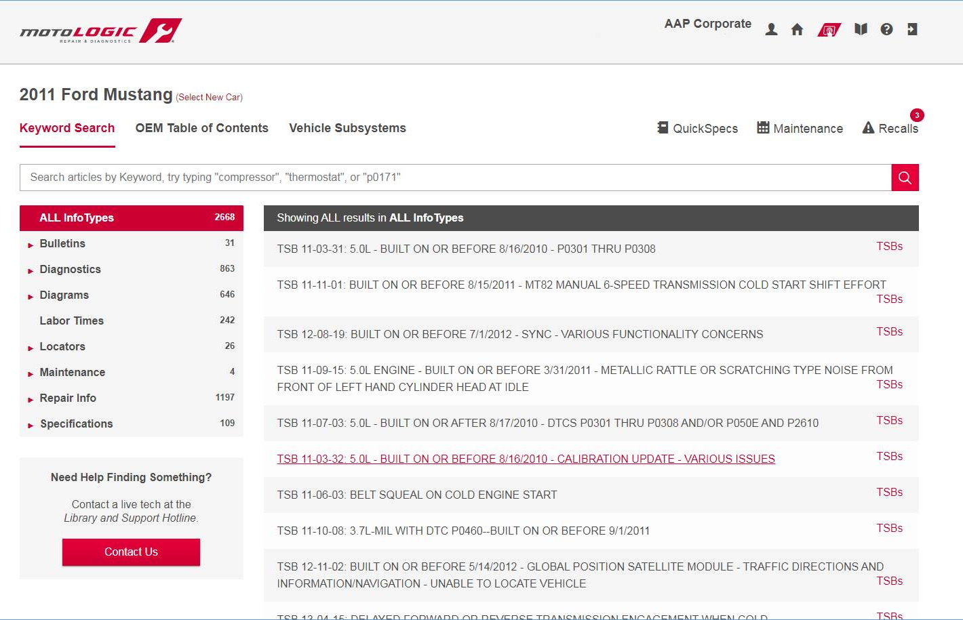
100 Unedited OE Information
Smarter Search Leading Coverage
Revolutionary Platform
More Features Shops Need
Notes:
$99

Slide 34

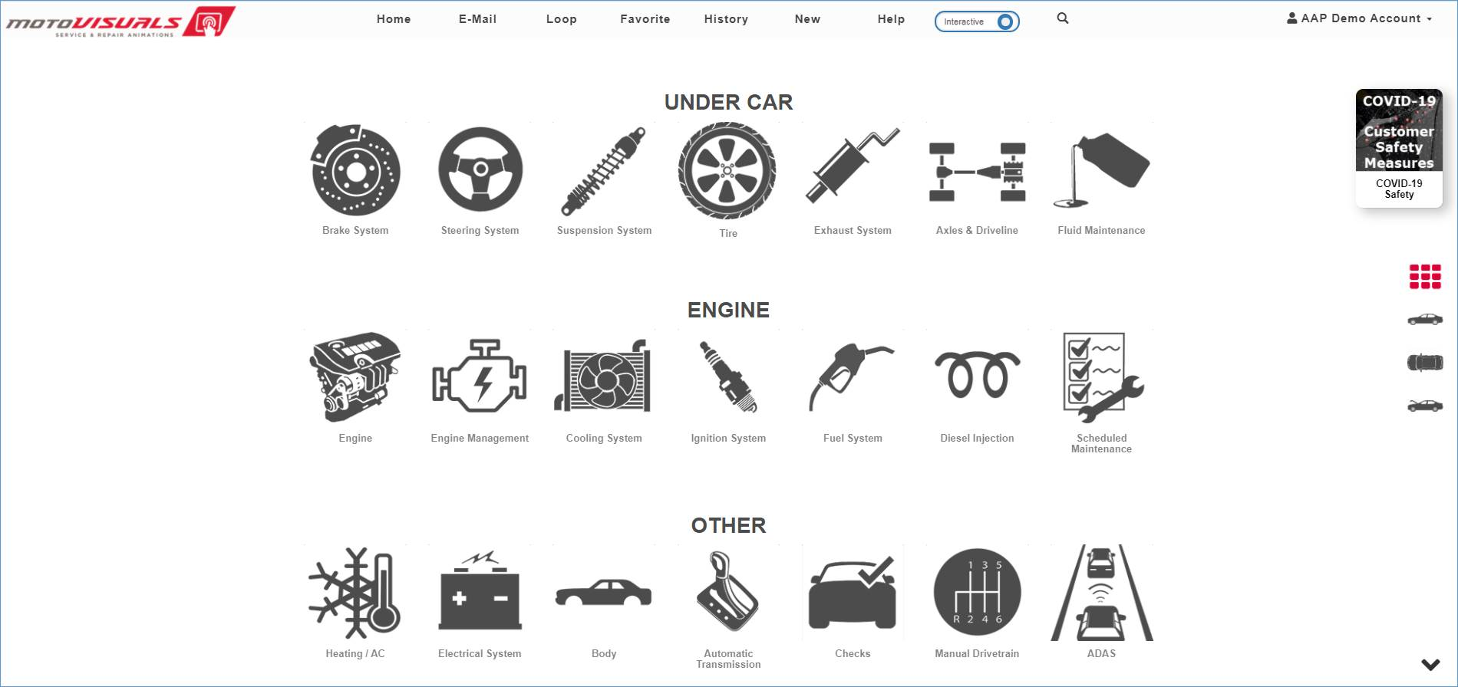
Explain Service and Repairs – Bring Service Recommendations to Life
Increase Customer Confidence –Many Ways to Share
Help Increase Your Close Rate
Notes:
$39

Slide 35
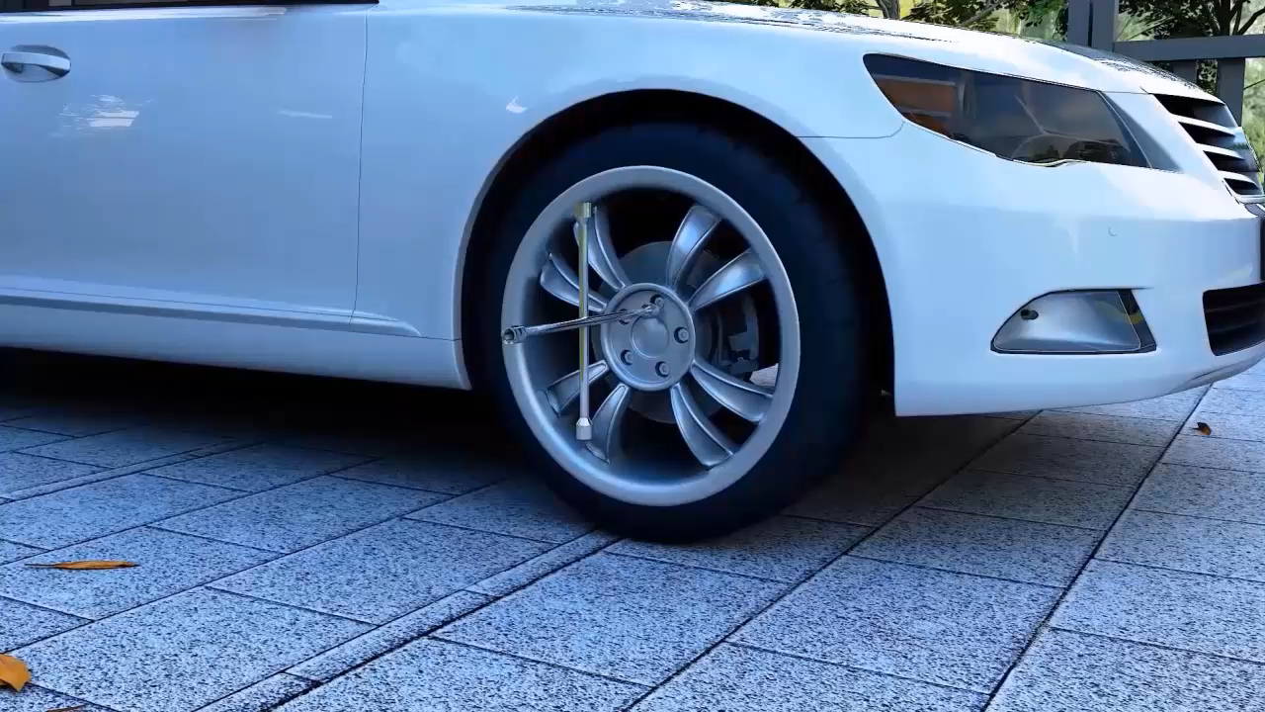

Slide 36
Pete Masini
Advance Professional
Director, Strategic Accounts
Cell: 708-714-7561
pete.masini@advance-auto.com
Rick Gianini
Advance Professional
Strategic Account Manager
Cell: 203-913-8964
rick.gianini@advance-auto.com
Dave Buska
Worldpac / Autopart International
Strategic Account Manager
Cell: 802-272-2951
david2b@worldpac.com

