Slide 1
360 Payments / Meineke
Partnership

Slide 2
Agenda
Get to know 360 Payments
Benefits for your shop
How to connect with us

Slide 3
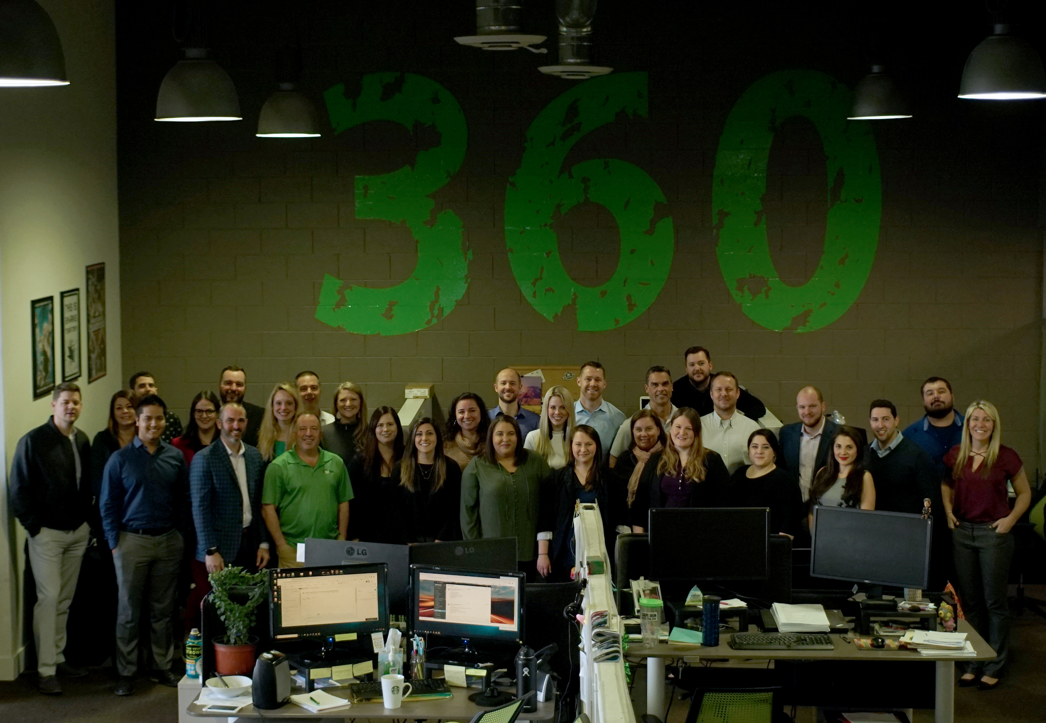
Who is 360 Payments?

Slide 4
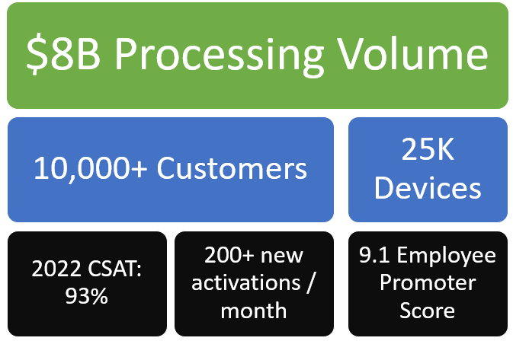
360 by the Numbers
The Leader in Automotive Payments
50+ Integrations and Automotive partnerships
Trusted by many national brands
Customized Technology for the Automotive Industry
96% Q2 2022 CSAT

Slide 5
A 360° Approach to the Auto Industry
We are a trusted brand in the Automotive industry for our honest pricing and white glove service!

Slide 6
Benefits of 360 Payments

Slide 7
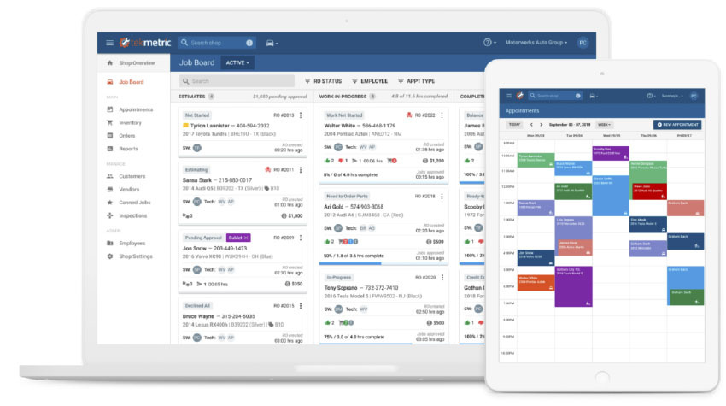
Key Features of Our SMS Integration
Cloud-based card present integration - Accept chip cards, Apple Pay, and all card types/brands
Signature Capture - Signature prints directly on the invoice
Easy Installation - No software download needed
Text-to-pay - Let your customer pay when convenient for them.

Slide 8
360 Payments Consumer Financing Platform (CFP) for Meineke
Notes:
Tool that brings in more customers and increases your average ticket and profitability

Slide 9
360 Consumer Financing Platform
Single Customer Application
Dealer Chooses Secondary Option
Notes:
How does it work?

Slide 10
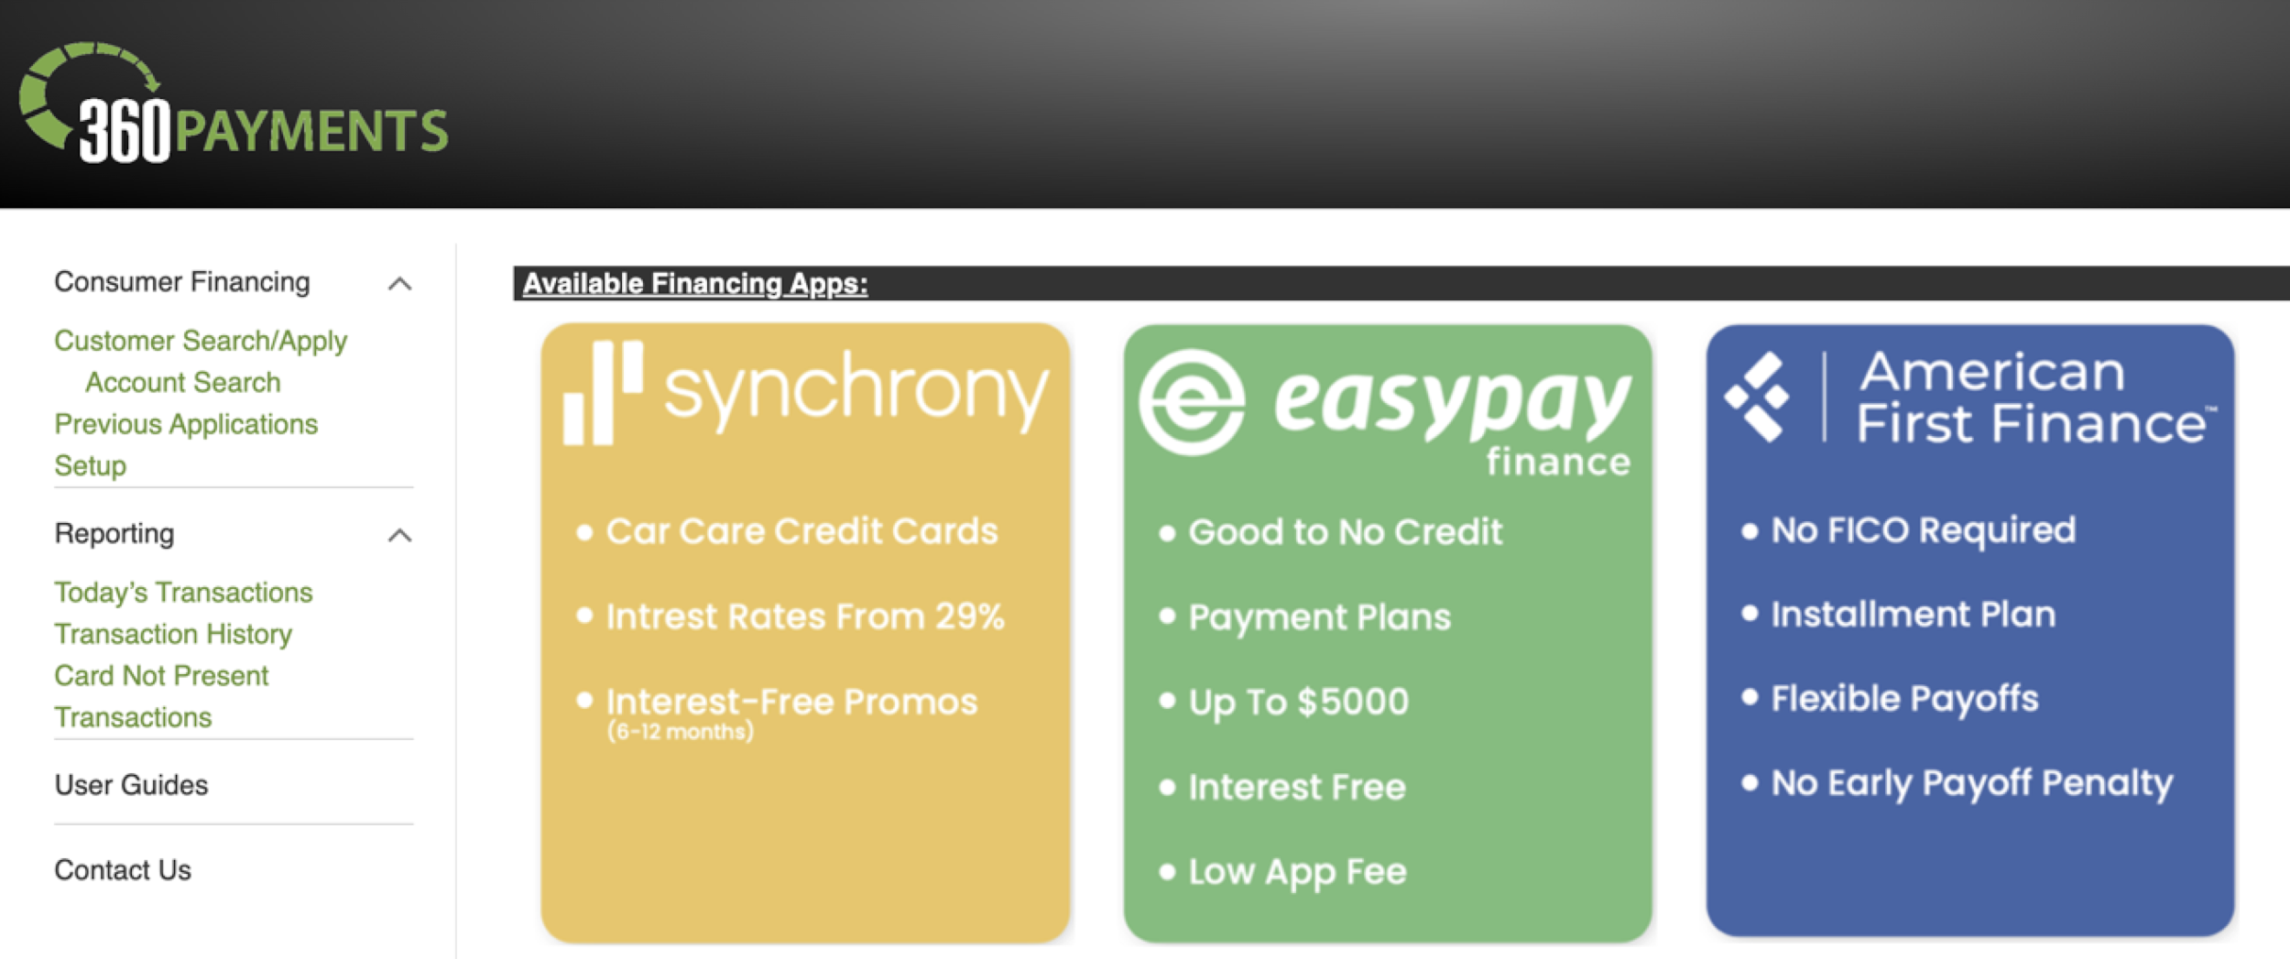
360 Consumer Financing Platform
Onboarding Screen To Setup Financing Options
Notes:
Waterfall walkthrough

Slide 11
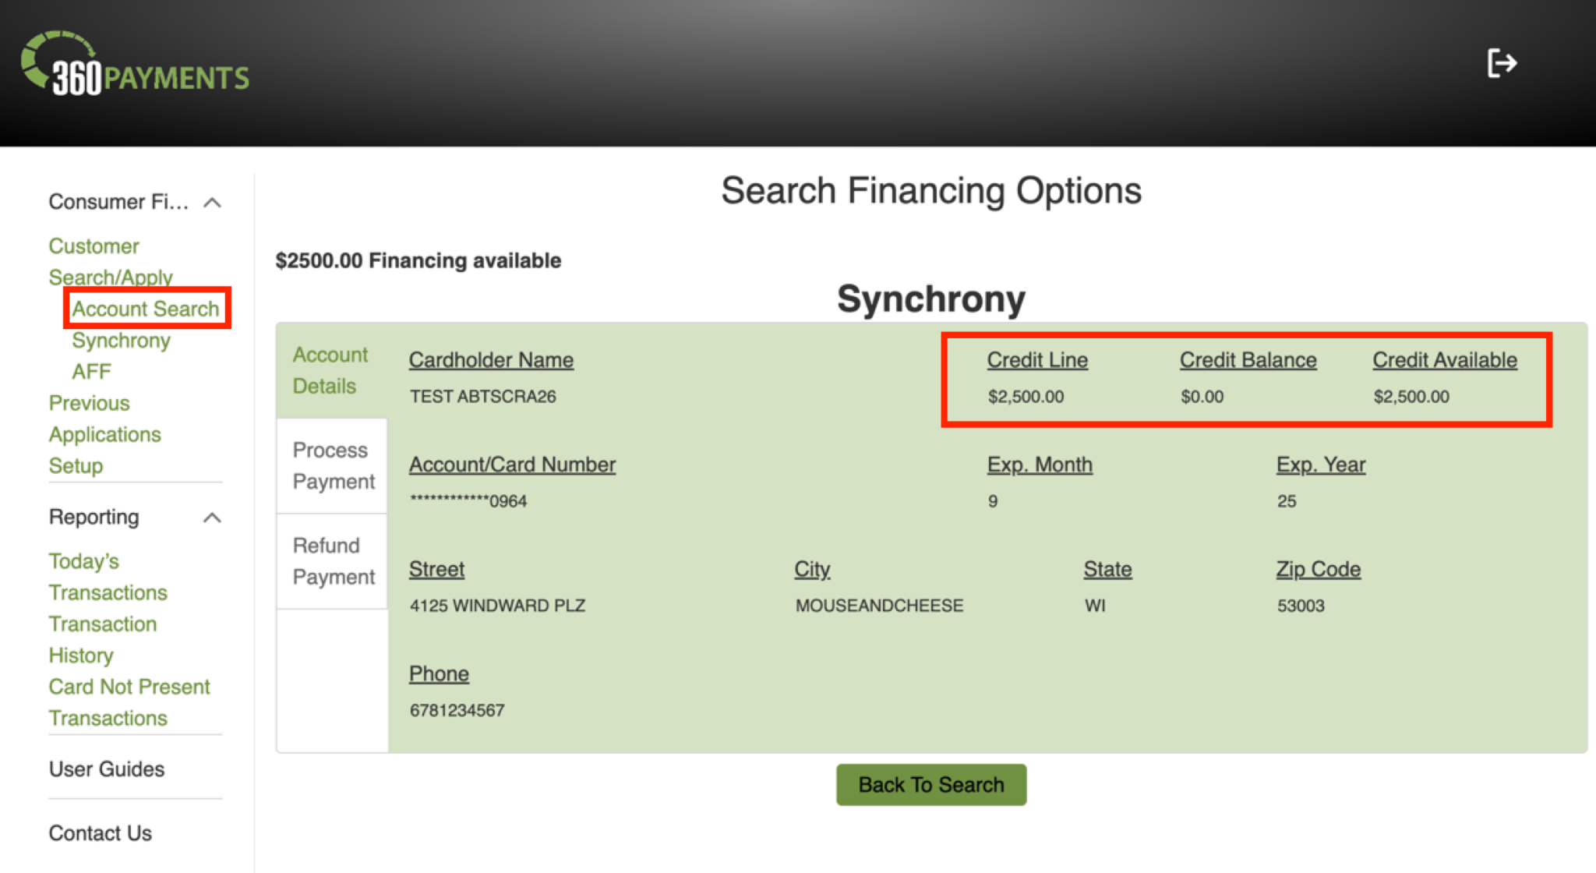
360 Consumer Financing Platform
Synchrony Existing Account Search
Notes:
Waterfall walkthrough

Slide 12
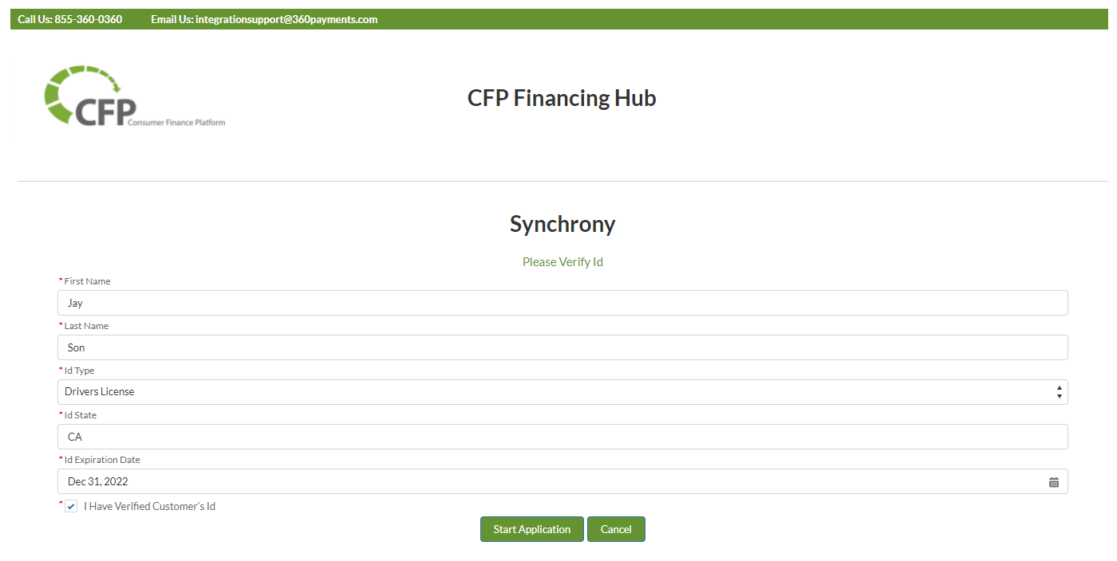
360 Consumer Financing Platform
Single Customer Application
Notes:
Waterfall walkthrough

Slide 13
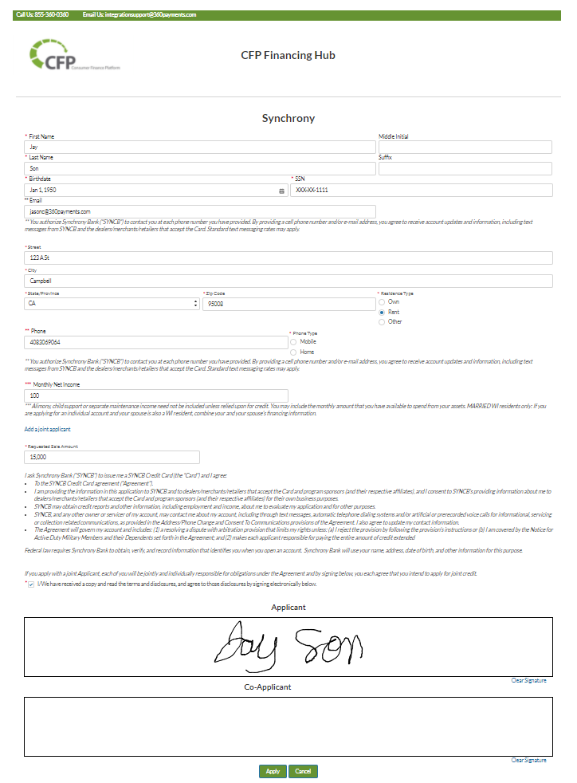
360 Consumer Financing Platform
Customer completes application with a digital signature and submits to apply
Notes:
Waterfall walkthrough

Slide 14
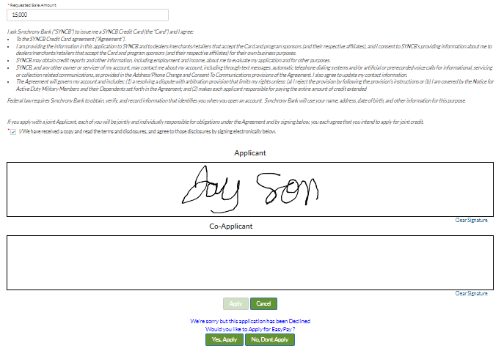
360 Consumer Financing Platform
If the customer is declined, one click pushes all their info to the secondary lender.

Slide 15
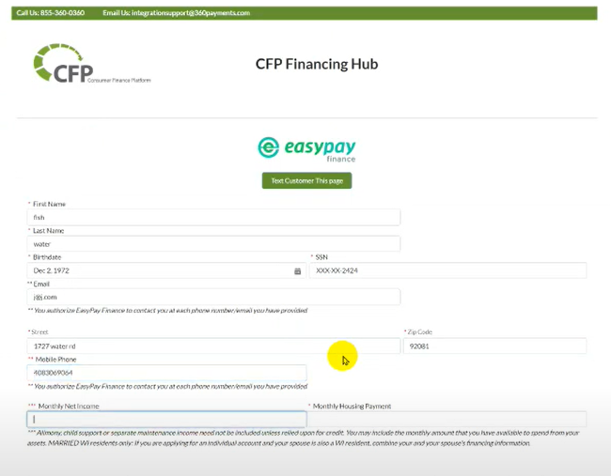
360 Consumer Financing Platform
When the customer clicks “Apply,” their information transfers into the secondary lender application automatically.

Slide 16
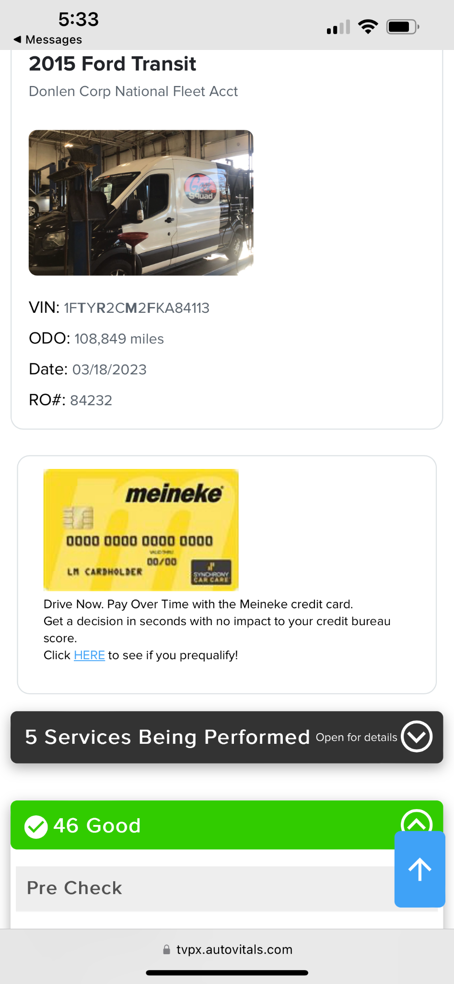
360 Consumer Financing Platform in Auto Vitals
(Coming soon)
Within Auto Vitals inspection you can embed the link for your CFP waterfall to have customers offered financing on every job.

Slide 17
Consumer Financing Done Right Increases ARO!

Slide 18
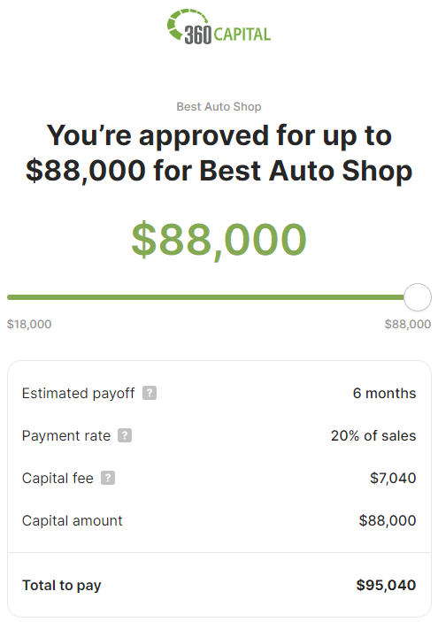
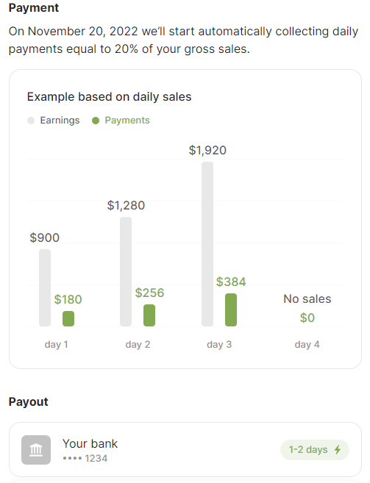
360 Capital- One Click Business Financing
No paperwork
No Interest or APR- one flat fee
Funded within 48 business hours.
Repayment runs in the background based on daily CC batches.
Funded over $40 Million since April of 2021 to 360 Customer

Slide 19
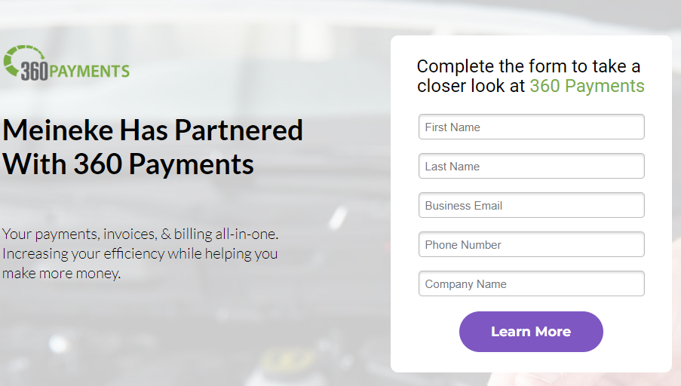
New 360 Customers
https://360payments.com/meineke
**To use CFP Dealers must be processing CC payments with 360 Payments**
Enter contact information
Click “Learn More” to submit your information

Slide 20
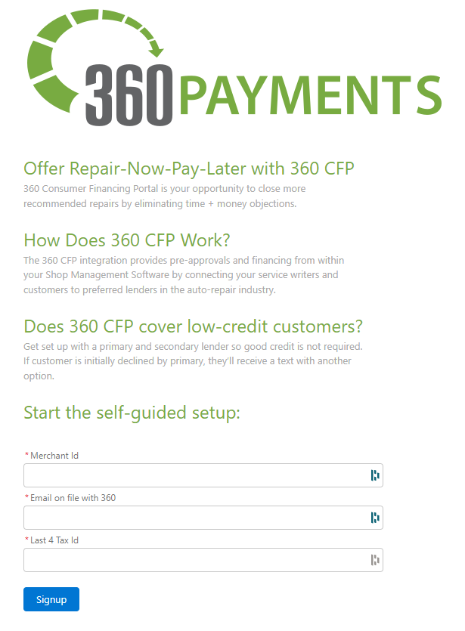
Existing 360 Customers Wanting CFP
Self Sign Up:
Enter merchant ID
Email address
Last 4 of tax ID
Or email support@360payments.com

Slide 21
Questions?
Jesse Meddaugh
VP of Business Development
408.637.1160
jesse@360payments.com

