Slide 1
Meineke Agenda
Meineke Regional Meeting Nashville, TN October 2023

Slide 2
Meineke Agenda
Business Overview Thru September
Pricing – Taking a decrease for the 4th Quarter in a Row.
CBP – Chevron Business Point ordering initiative
New Products
Synthetic Program update
EV overview

Slide 3
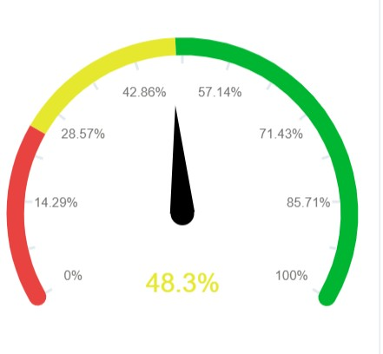
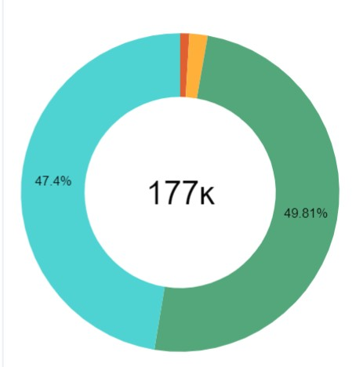
Business Overview Thru September
Conventional | 1,618
Syn Blend | 88,172
Synthetic | 83,900
Miscellaneous | 3,313
Totals | 177,003
There are a total of 181 Shops: 117 Transact & 64 Legacy
We have added 34 new shops in 2023 – All legacy
Premium sales are up 7.9%

Slide 4
2023 Price Decreases
After 2 years of constant increases, the tide changed in 2023.
Chevron lowered prices all 4 quarters in 2023.
$0.29 in Q1, $0.36 in Q2, $0.32 in Q3 and $0.12 in Q4
A total decrease of $1.09/gallon
There have been several base oil increases which will likely trigger Finished Lubes increases in 2024

Slide 5
CBP Online ordering initiative

Slide 6
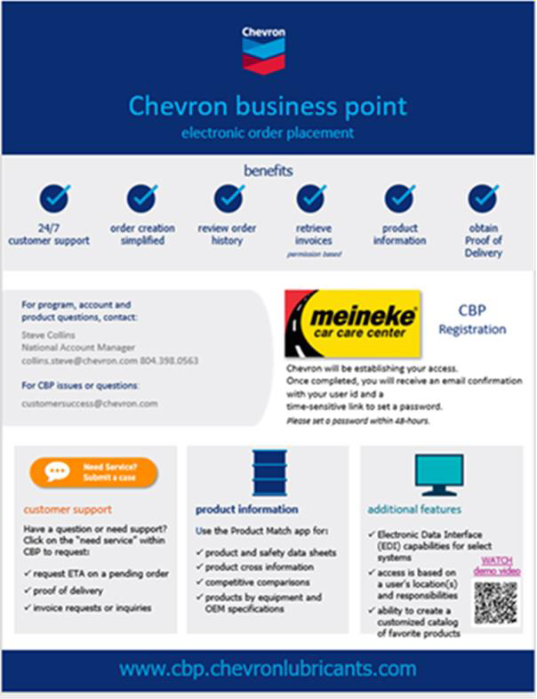
Meineke Online Ordering Initiative Chevron Business Point – CBP

Slide 7
email from Chevron and Meineke announcing the program
Initiative is underway. All Meineke dealers have received initial
Meineke Online Ordering Initiative Chevron Business Point – CBP
Brieonna Jackson has contacted all chevron customers and has registered the locations on CBP with user name and passwords
Shops will receive an additional 3 emails reminding them to use the new
ordering system
All accounts are expected to transition to actually using the system by the end of September.

Slide 8
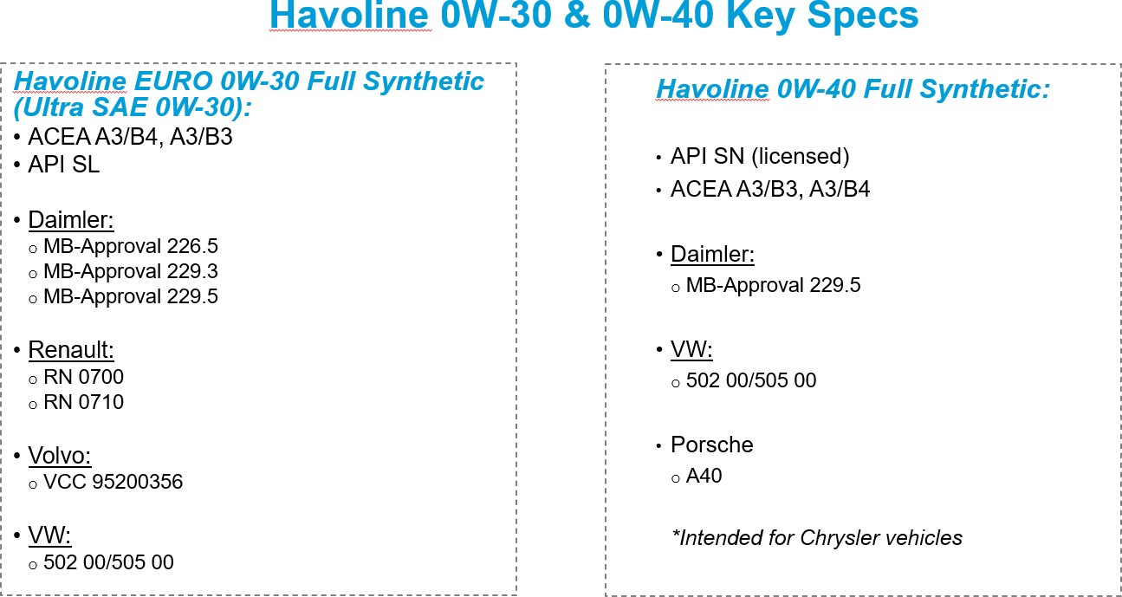
Havoline Euro 0w30 and 0w40
New Products
Expected availability date: November 1, 2023
Available in 6- gallon Pit Packs only

Slide 9
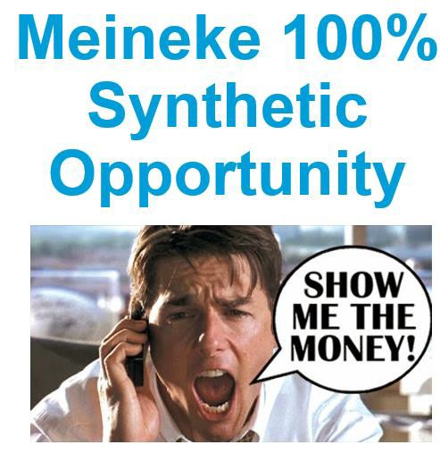
We have 2 Franchisees on the program
Jeff Hargraves in Wyoming #396
Joe & Bev Saelens 5 locations in WI
Very successful
I would encourage you to call them
Synthetic program Update

Slide 10
North America EV update

Slide 11
EV Movement
Over the past few years there has been much hype regarding the growth of Battery Electric Vehicle in the global market. Most notably by the worlds largest Consumer OEMs; Volkswagen, General Motors, Stellantis, Renault-Nissan, Hyundai / Kia as well as Toyota. Although Toyota has held steadfast to their faith in strong market Hybrid vehicle adoption
•
These early estimates claim that Battery-electric vehicles (BEV) will account for 20% of new light-vehicle sales worldwide by 2025, and 59%
by 2035 as government mandates begin and automakers roll out new models. Estimates also claim that Hybrid vehicles (PHEV, HEV) will to
about 19% of new car sales by 2025 then flattening out
Government regulation around emissions and Green initiatives including consumer rebates for BEVs continue to remain in place as a carrot in western markets, but markets such as China and India have shifted to a “stick” approach. Implementing RDE (real driving emissions) monitoring systems on vehicle and establishing Zero emission zones, typically with-in large metropolitan, congested city centers. These regulations as well as OEM manufacturing restraints have forced compliance by OEMs to increase production of full BEV units
•
Specific to the United States; the Biden administration has raised climate targets and set a goal of having half of all new-vehicle sales in the
country be zero-emission by 2030
© 2022 Chevron Corporation Confidential

Slide 12
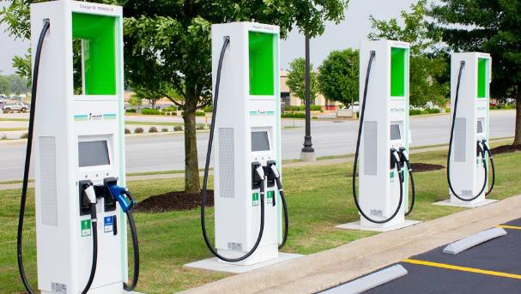
EV Movement
Over the past 12 months this picture has changed somewhat due to the reality of government implementation of
draconian demands on a market which continues to struggle with Power generation, including in the United States where
the shift to “green” sources has proven to be a problematic
Serious and Significant challenges include Power generation issues which have caused local government entities to advise
consumers to lower thermostats in the winter, raise them in the warmer months, and charge BEVs only during off peak
hours, and only to 50% of their charge.
Major supply-chain constraints, geopolitical uncertainty and increased demand
have pushed prices for lithium, nickel and other raw materials needed for battery production up significantly over the last
two years, leading to higher battery costs
An even larger issue is lack of infrastructure charging networks. It’s estimated that
the United States will need a minimum of 1.1 million public charging sites by 2025
and 2.3 million by 2030, compared with 100,000 available today, of which 30% are
non-functioning due to maintenance problems at any one time.
The Biden
administration plans to
spend $5 billion over the next five years on EV charging,
targeting 500,000 public charging stations nationwide by 2025, this is well short of
the estimated need
© 2022 Chevron Corporation Confidential

Slide 13
EV Movement
BEV – Battery Electric vehicle: These vehicles operate 100% on a battery charge and electric motor and have no ICE backup. These units have no internal power generation and must be plugged in for battery charge
•
HEV – Hybrid electric vehicle: These are full hybrid vehicles equipped with both a gasoline engine and an electric motor. The electric moor is fully capable of handling the work load of regular driving and can typically operate for great distances solely on the electric power. This typically occurs at lower speeds, stop and go conditions. The battery is charged via internal components, generator / regenerative braking. The ICE is triggered when the computer requires better efficiencies which can be achieved at higher speeds and longer distances
•
PHEV – Plug in Hybrid vehicle: PHEV’s are similar to HEV’s, but with one major difference; the battery charging for the electric motor is both internal (generator / regenerative braking) and external via a plug. Plug-in hybrids typically have greater electric-only ranges than full hybrids, and serve as a half point model between full BEN and HEV
© 2022 Chevron Corporation Confidential

Slide 14
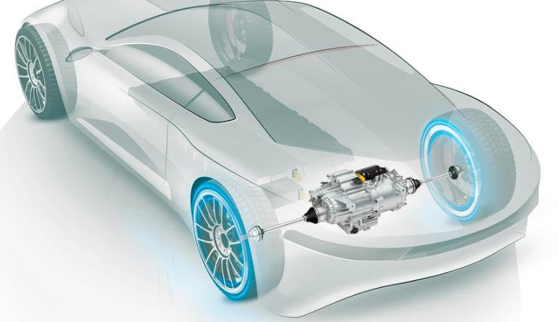
EV Movement
Because of the noted issues with fast conversion to full BEV Consumer OEMs are now ramping down their estimates and adopting a Hybrid
approach similar to Toyota.
General Motors has been the last holdout on ramping down the BEV shift estimates, but just recently is willing
to discuss a Hybrids strategy. Although their advertising and direction of technology development budgets would suggest a stern BEV only position
All of this said, traditional engine oils and drive-line fluids will remain an important part of consumer vehicle builds and maintenance for
the next few decades. The new opportunity will be with Hybrid engine oils, Renewable engine oils, E-Drive, Renewable E-Drive fluids as
well as E-Coolants
Currently the world-wide car parc of EV’s is less than 1% and is less than 1.5% in California
The next few slides will address Consumer automotive trends and the opportunity's Chevron is prepared to tackle
© 2022 Chevron Corporation Confidential

Slide 15
EV Movement
Adoption of battery electric vehicles is widely believed to accelerate by 2025 to mass-scale, full battery electric vehicles (BEVs). This is somewhat dependent on cost parity with ICE vehicles available in the market, or if legislation expands it’s imposed bans on the sale and use of ICE vehicles in specific regions and municipalities. Efficiencies gained from long-life batteries, quick charging and more efficient electricity generation are also major factors in this projected growth
•
According to Kline Research by 2040 Electric vehicles will comprise approximately 22% of the world’s vehicle
Reduction in life-cycle greenhouse gas emissions of electric vehicles compared to gasoline vehicles
population.
The great majority will consist of Start/Stop
Technology, Hybrid, and a handful of Hydrogen units.
But
0%
16% of this group will be full battery electric vehicles.
-20%
Half of these BEVs will operate on Chinese roads
-30%
-40%
•
Electrification of vehicles will eliminate the need for
engine oil, but will open opportunities for oil marketers
to develop specific EV products such as Coolants,
-60%
-48%
-62%
-80%
-74%
specialty greases, and drive-line lubricants
2030
© 2022 Chevron Corporation Confidential

Slide 16
EV Movement
© 2022 Chevron Corporation Confidential

Slide 17
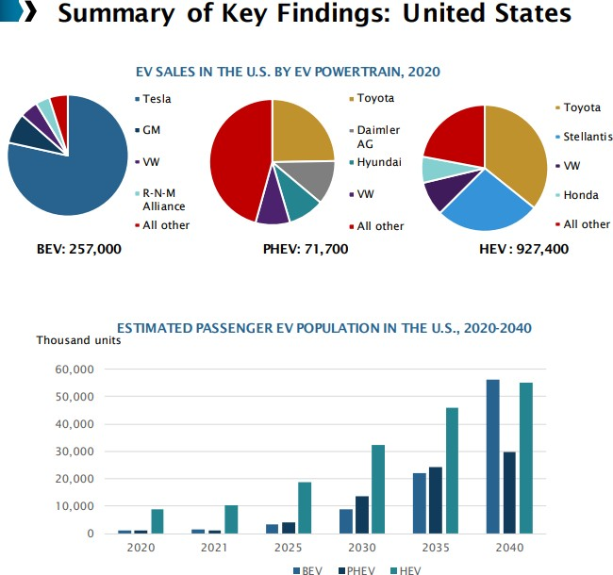
EV Movement
Governmental Support ⚫ Current U.S. administration is committed to support the EV industry. EVs sales are expected to boost within the next four years. A fund of USD 174 billion proposed in March 2021 is under review and subjected for the U.S. Congress approval. ⚫ Build Back Better" infrastructure bill ⚫ The California Air Resources Board (CARB): OEMs should comply to a quota of ZEV and PHEV
© 2022 Chevron Corporation Confidential

Slide 18
EV Movement
Thermal Runaway is the biggest challenge to EV charging, specifically fast-charge systems and fast depletion of the battery at high speeds
Thermal Runaway is the process of uncontrollable, self heating state where CO2 builds up in battery cells causing extremely high-temperature gases to escape in an explosive manner. Although critical mass of EV’s in the market-place bares only a few incidents of consumers burning down their homes these events will multiple with EV growth, and industry demands for faster charging
To address Thermal Management challenges, it’s imperative for the industry to adopt specific designed coolants with unique characteristics
© 2022 Chevron Corporation Confidential

Slide 19
Thanks for your partnership!

