Slide 1


Vericast – media strategy
Joanne Stewart
Meineke Team Lead
Joanne.Stewart@vericast.com

Slide 2

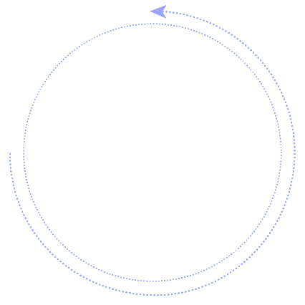
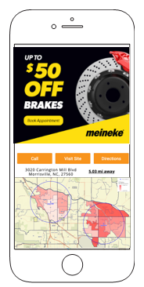

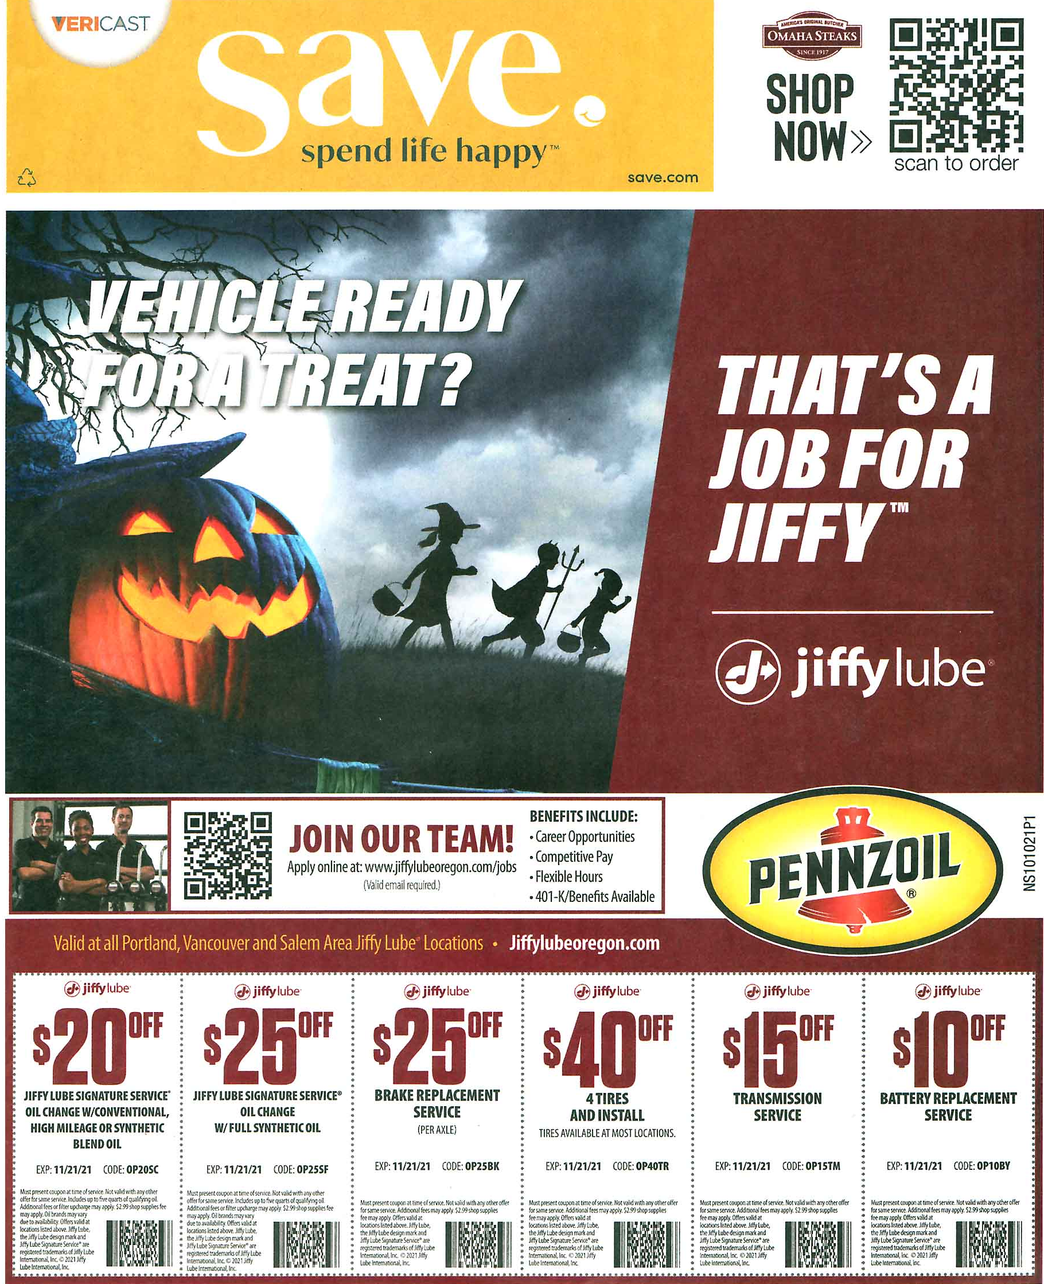

Efficiently Engage the Right Consumers With a Relevant, Multichannel Experience
Dynamic Mobile
Oversized Direct Mail Inserts (10 x 12)

Slide 3



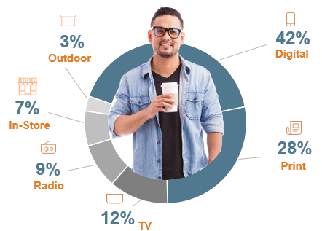
Engagement & Influence is Changing
Traditional Media Challenges
Growing Complexity of Media Influence
Rise of Omnichannel Marketing
Multimedia Purchase Influence on
Adults with Household Incomes <$75K⁵
Declining Newspaper Reach
Print & digital circulation now <20% of USA households¹
74% of US households have not read a newspaper in the past week²
Challenged TV Viewership
86% of households now subscribe to a streaming service³
Cable/Satellite TV market share has now declined to 56%⁴
Marketers Leveraging 3 or More
Channels in any one Campaign
Earned a 494% Order Rate vs. Single-channel Programs⁶
70%
Of purchase influence is driven by print and digital media
Sources ¹: https://www.journalism.org/fact-sheet/newspapers ;
²Scarborough Research, Release 2, 2021; ³Kantar, March 2022,
⁴https://www.pewresearch.org/fact-tank/2021/03/17/cable-and-satellite-tv-use-has-dropped-dramatically-in-the-u-s-since-2015/ ;
⁵Prosper MediaIQ, Jan 2022; ⁶Omnisend Blog, April 2022

Slide 4

With the Right Insights, You Can Inspire Action
POWERFUL INTELLIGENCE
The Valassis Consumer Graph™ fuels growth by creating meaningful connections with consumers.
Ready to Buy
Vehicle Maintenance Interest Wheels & Tires Interest
Off-Road Vehicles Interest
Lifestyle and Interests
What people routinely enjoy throughout their lives
VIN Data
Store Visits
Visit Likelihood – observed in proximity
Demographics
Household Income.
Average Vehicles Available
Purchases
Tires Purchased/ Replaced
Oil Change/ Oil Filters
Firestone– Retail Purchase Data
Coupon Redemption
Likelihood of being a saver
.
Proprietary Intelligence
Notes:
We use patented technology and data science to connect billions of data points of consumers’ everyday lives through our Valassis Consumer Graph. These data points help you understand where consumers shop, what they buy, and what they’re in the market for. All of the data in the Graph is rooted in geography and tied to a common denominator - the household. This provides you a clearer picture of your target consumers and a way to consistently engage them across media.
More detail…
Our data helps you understand:
Who’s ready to buy
What their lifestyle and interests are
What stores they visit
Their predicted age, gender, ethnicity, and income
What products and categories they prefer
If they are value-seekers and savers

Slide 5



Mega Sheet Print Creative Examples

Slide 6

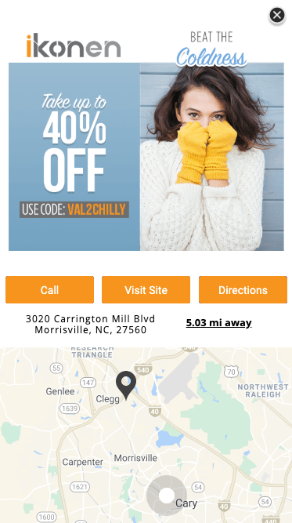




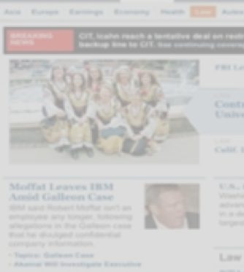
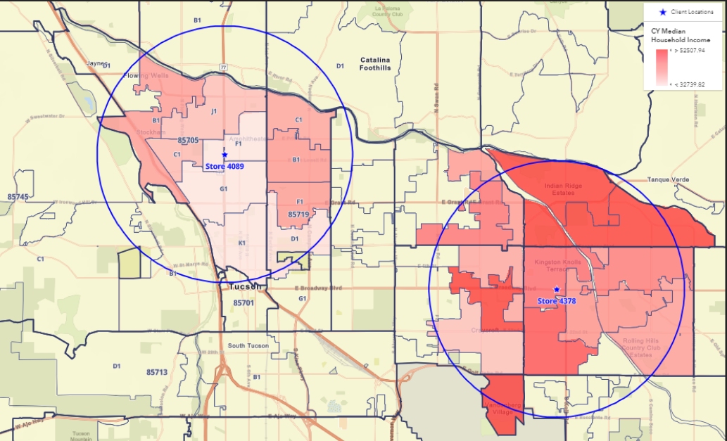
Impactful Mobile Solution that Inspires Action
Drive consumers to your nearest store with personalized, engaging maps and multiple call to actions
01
02
Initial Message Displayed
Expand for Image + Map
+ Three CTAs
+ LOCALIZED MAP OPTIONS
Merchant Address
User’s Current Location
User’s Distance to Store
+ AVAILABLE CALLS TO ACTION
Visit Site
Get Coupon
Save Offer
Click for Directions
Order Online
Download App
Click to Call
DEMO
Notes:
Image + Map Panel and up to 3 CTAs
http://valassis.celtra.com/preview/91a571bf#overrides.deviceInfo.deviceType=Phone&placementWidth=375&placementHeight=auto

Slide 7
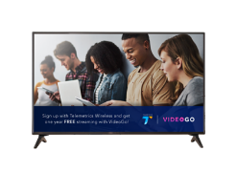


Local OTT Creative Example
CTV, OTT, OLV
Broad reach with sight, sound, and motion. Contextual and DCO features. Retarget viewers with display for ease of response.
LINK to OTT Example: HERE

Slide 8
Connect with the RIGHT Consumer
Utilize the Valassis Consumer Graph to build the Meineke custom audience
  HHI $75k or below
  Households with multiple vehicles
  In-Market for vehicle maintenance in 5-mile radius
  Actual Meineke / Competitive spend

Slide 9






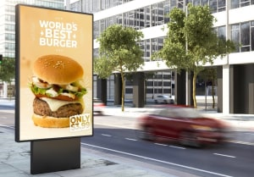

Efficiently Connect with Consumers Where They Are
Display
Distribute highly targeted, flexible, and viewable cross-device media to those who are showing the highest likelihood for response
Dynamic Mobile
Locally aware, expandable mobile ads provide ultimate relevancy, showing offer, map, locations, real-time distance to closest store, dynamic geo-based logo/images, and more
Daily Lifestyle
Searches Google 4x Daily
Spends 2.5 hours watching TV
Browses deals on the open web
Checks mailbox daily
MEINEKE
CTV, OTT, OLV
Broad reach with sight, sound, and motion. Contextual and DCO features. Retarget viewers with display for ease of response.
DOOH: Inspire action with true cross-screen advertising, enhancing you campaign and reaching your consumers wherever they are with digital out of home advertising.
Wrap
Efficiently reach the mailbox for as little as 1.4 cents per household
Direct Mail (postcard)
A number of efficient formats targeting your Key audience
Source 1) Prosper Media Influence Survey, 2022

