Slide 1

Automotive Consumer Driven Commerce
Steve Jacobs
GM – Outside Sales
© 2023, 1stMILE, LLC.

Slide 2
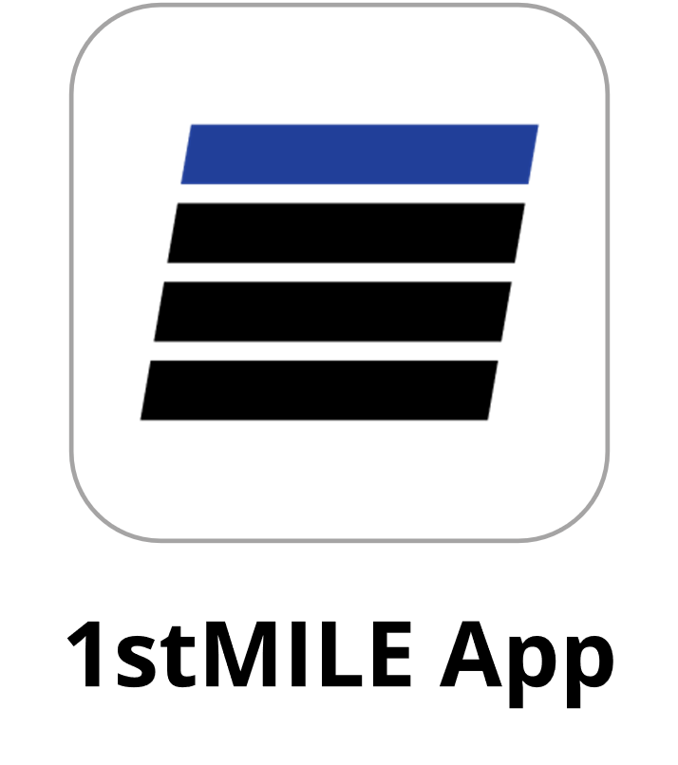
1stMILE Consumer Driven Commerce
Transform the automotive market by providing a consumer driven commerce experience between automotive shops and their customers
Authorize
Apply
Customers can authorize service and repairs from
their personal device
Convenient, secure financing from the privacy of your customers’ mobile devices
Loyalty
Pay
Customers earn Loyalty points that they can track directly
from the 1stMILE Car app
Easy payments from anywhere, enable your customers to enroll in Loyalty
Notes:
Better image needed. Copy could use refinement. -Max

Slide 3
1stMILE Commerce
by the numbers
Over 17,500
26.7 Million
Automotive locations using 1stMILE
Consumers checked out annually
$575 Million
$9.5 Billion
Financed repair orders annually
Total repair orders annually
Notes:
*Re-run these numbers with Q1 2023, annualized

Slide 4














A few current customers

Slide 5






















Some of Our Integrated POS Options
Notes:
Chat with Lindsey on switching to product vs company logos, do we want this slide in this presentation?

Slide 6
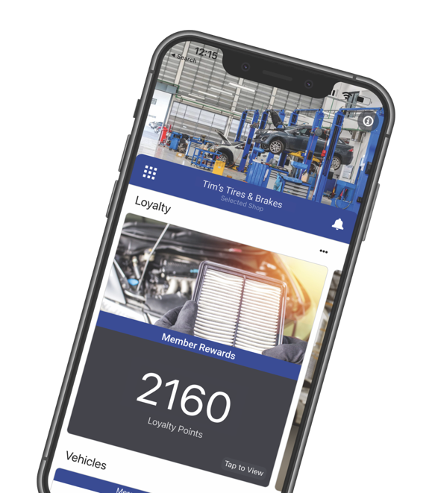
1stMILE - What We Do
Automotive consumer driven commerce
Put your shop in your customer’s hand
Integrated or standalone payment processing
  Major credit and debit cards
  Automotive private label and fleet cards
Drive retention with 1stMILE Loyalty
1stMILE Mobile texting features
  1stMILE Apply
  1stMILE Pay
  1stMILE Authorize
Notes:
- The main feature the customer is interested will be what we focus on in the deck
Speaker notes: mention “credit waterfall” with 1stMILE Apply

Slide 7

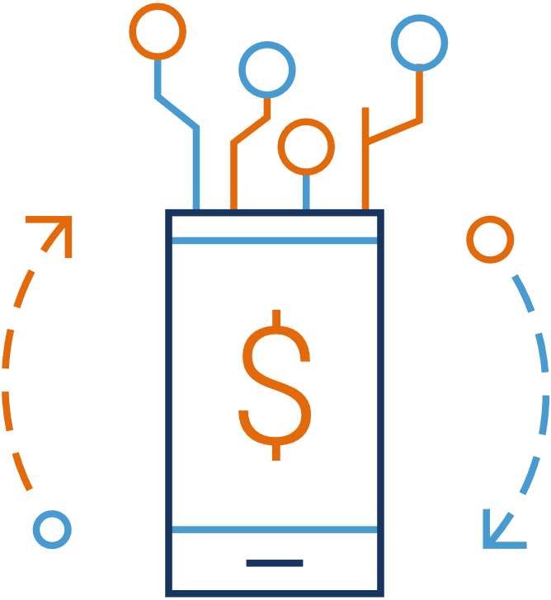
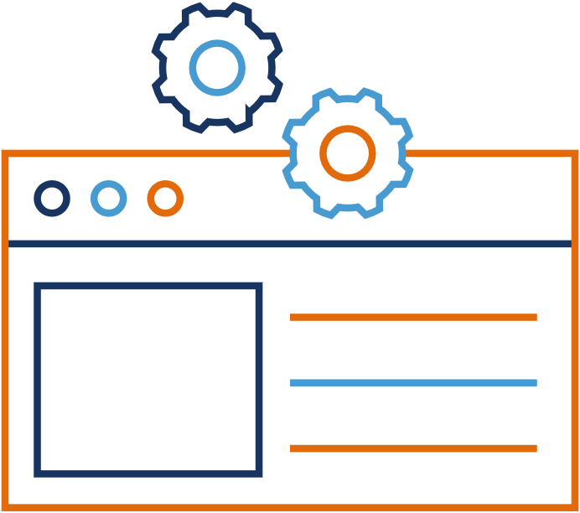


Deliver Customer-Centric Retail Experiences
Accelerate customer checkout and enhance loyalty
Increase revenue with Loyalty
Pay, Authorize, and Apply from mobile devices
Mitigate transaction processing costs
Provide financing options for all credit profiles
Integrated in you POS or available standalone
Notes:
Customers with good, bad, or no credit can apply for on-the-spot financing
Easy-to-use processing software handles major credit cards, fleet, and automotive retail finance cards, all through a single terminal
Enable customers to authorize work, apply for financing, and make payments from mobile devices
Drive customer loyalty with a consumer facing application that delivers maintenance reminders, RO and document storage, and tracks Loyalty rewards
Mitigate transaction processing costs with compliant options in an integrated solution that provides customer checkout in seconds
Reach a broader audience and cater to the preferences of millennials and Gen Z

Slide 8
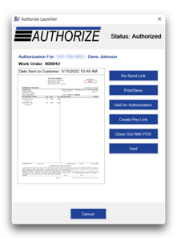
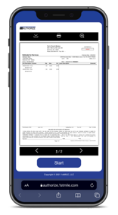
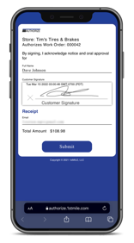
1stMILE Authorize
Customers can authorize service and repairs from their personal devices
Shop Cashier View
Customer View
Your benefits
Customer authorizations are securely stored in 1stMILE
Reduce employee manual tasks
Mitigate unauthorized repair order chargebacks with a verifiable digital footprint that includes signature capture

Slide 9
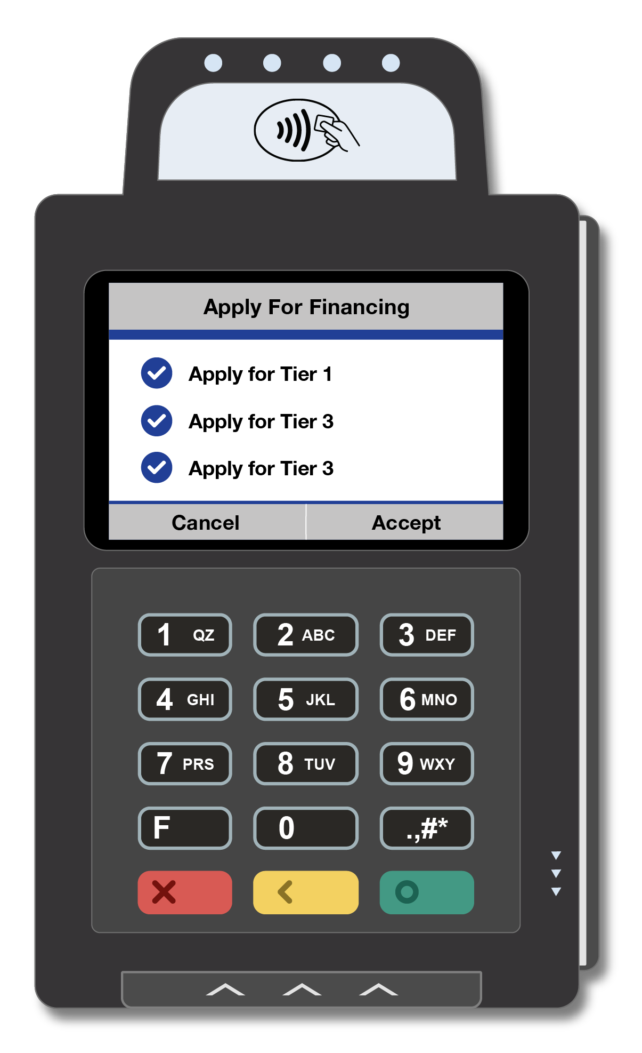
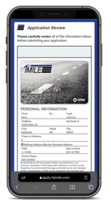
1stMILE Apply
Provide financing options for customers with good, bad, or no credit
In-Store
Or Anywhere
Your benefits
Reduce declined services and help your customers pay for the work they need
Credit waterfall with up to 3 tiers
Customers can text to apply, or apply in-shop right on your terminal
Easy applications increase utilization of financing and decrease the work required by your team
1
2
3
Notes:
POP Materials included

Slide 10
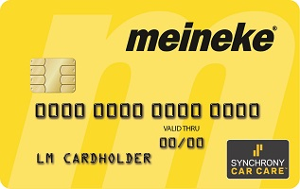
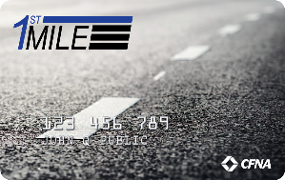
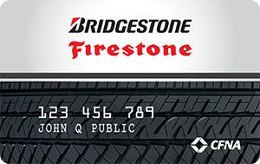
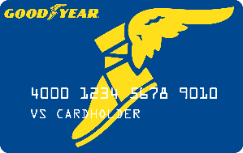
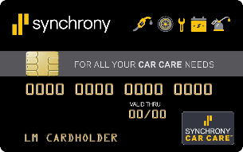






1stMILE Credit Waterfall
Three integrated credit tier options allow nearly all your customers to finance the repairs they need
Private Label Cards
Non-Prime Financing
Sub Prime Financing
Coming Soon
Notes:
Update this slide. Also, sounds like AFF has pulled out of California.
Bob to decide which partners go on this slide, will evolve over time

Slide 11
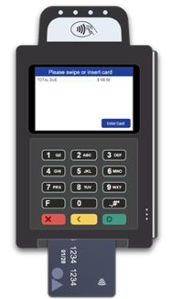
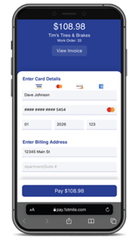
1stMILE Pay
Easy payments from anywhere
In-Store
Or Anywhere
Your benefits
Integrated checkout with your POS
Mitigate transaction processing costs
Fully compliant Cash Discounting or Surcharging options
Customers can enroll in Loyalty at checkout
Boost revenues, one transaction at a time
Notes:
Close Invoice in POS Showing Payment
Initiated in 1stMILE with send pay link dialog box

Slide 12
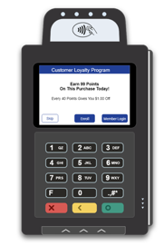
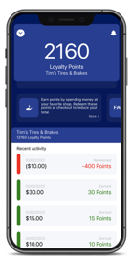
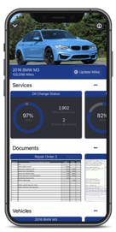
1stMILE Loyalty
Customers can track Loyalty rewards directly from the 1stMILE app
Enroll In-Store
Track Points & Cars
Your benefits
Build loyalty, gain repeat business, earn higher revenues
Your shop information is always available in the customer’s 1stMILE app
Branded with your shop picture, hours, and contact information
Customers enrolled in a loyalty program visit twice as often*
Source: Edmunds study, March 2014
Notes:
Kyle/Max to add the actual Edmunds study name and link

Slide 13
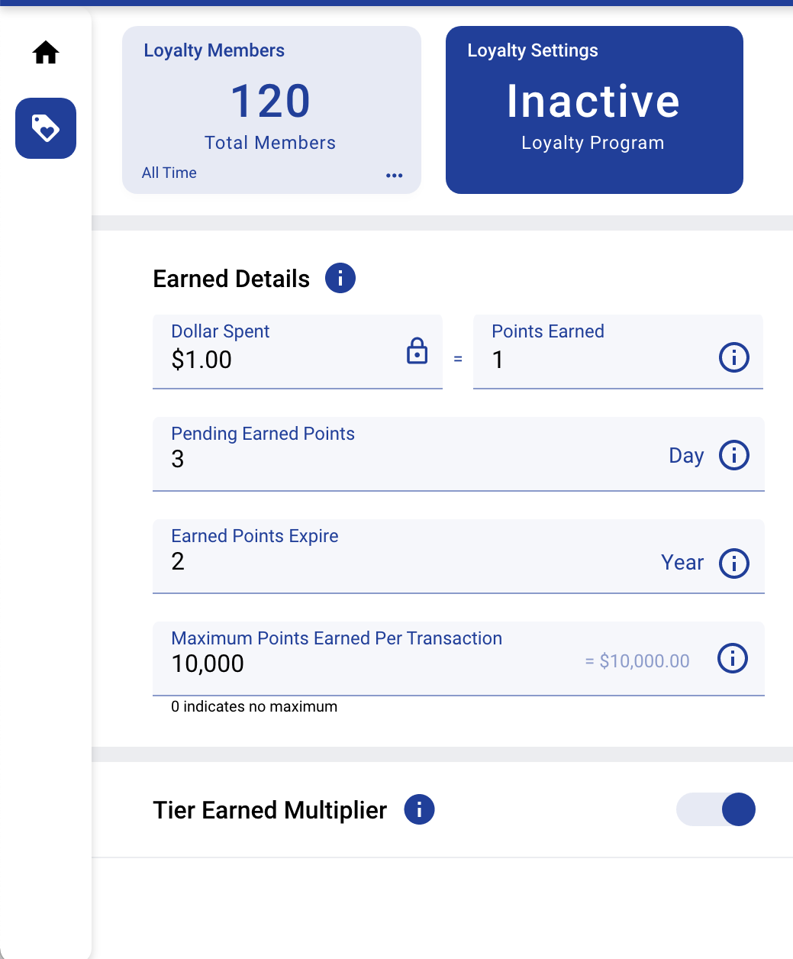
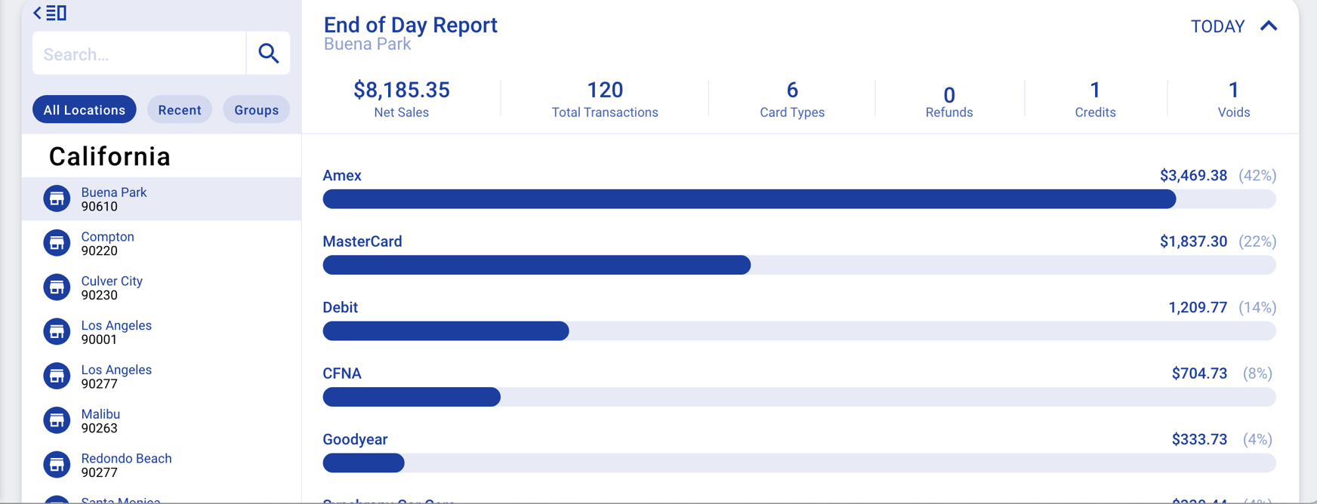
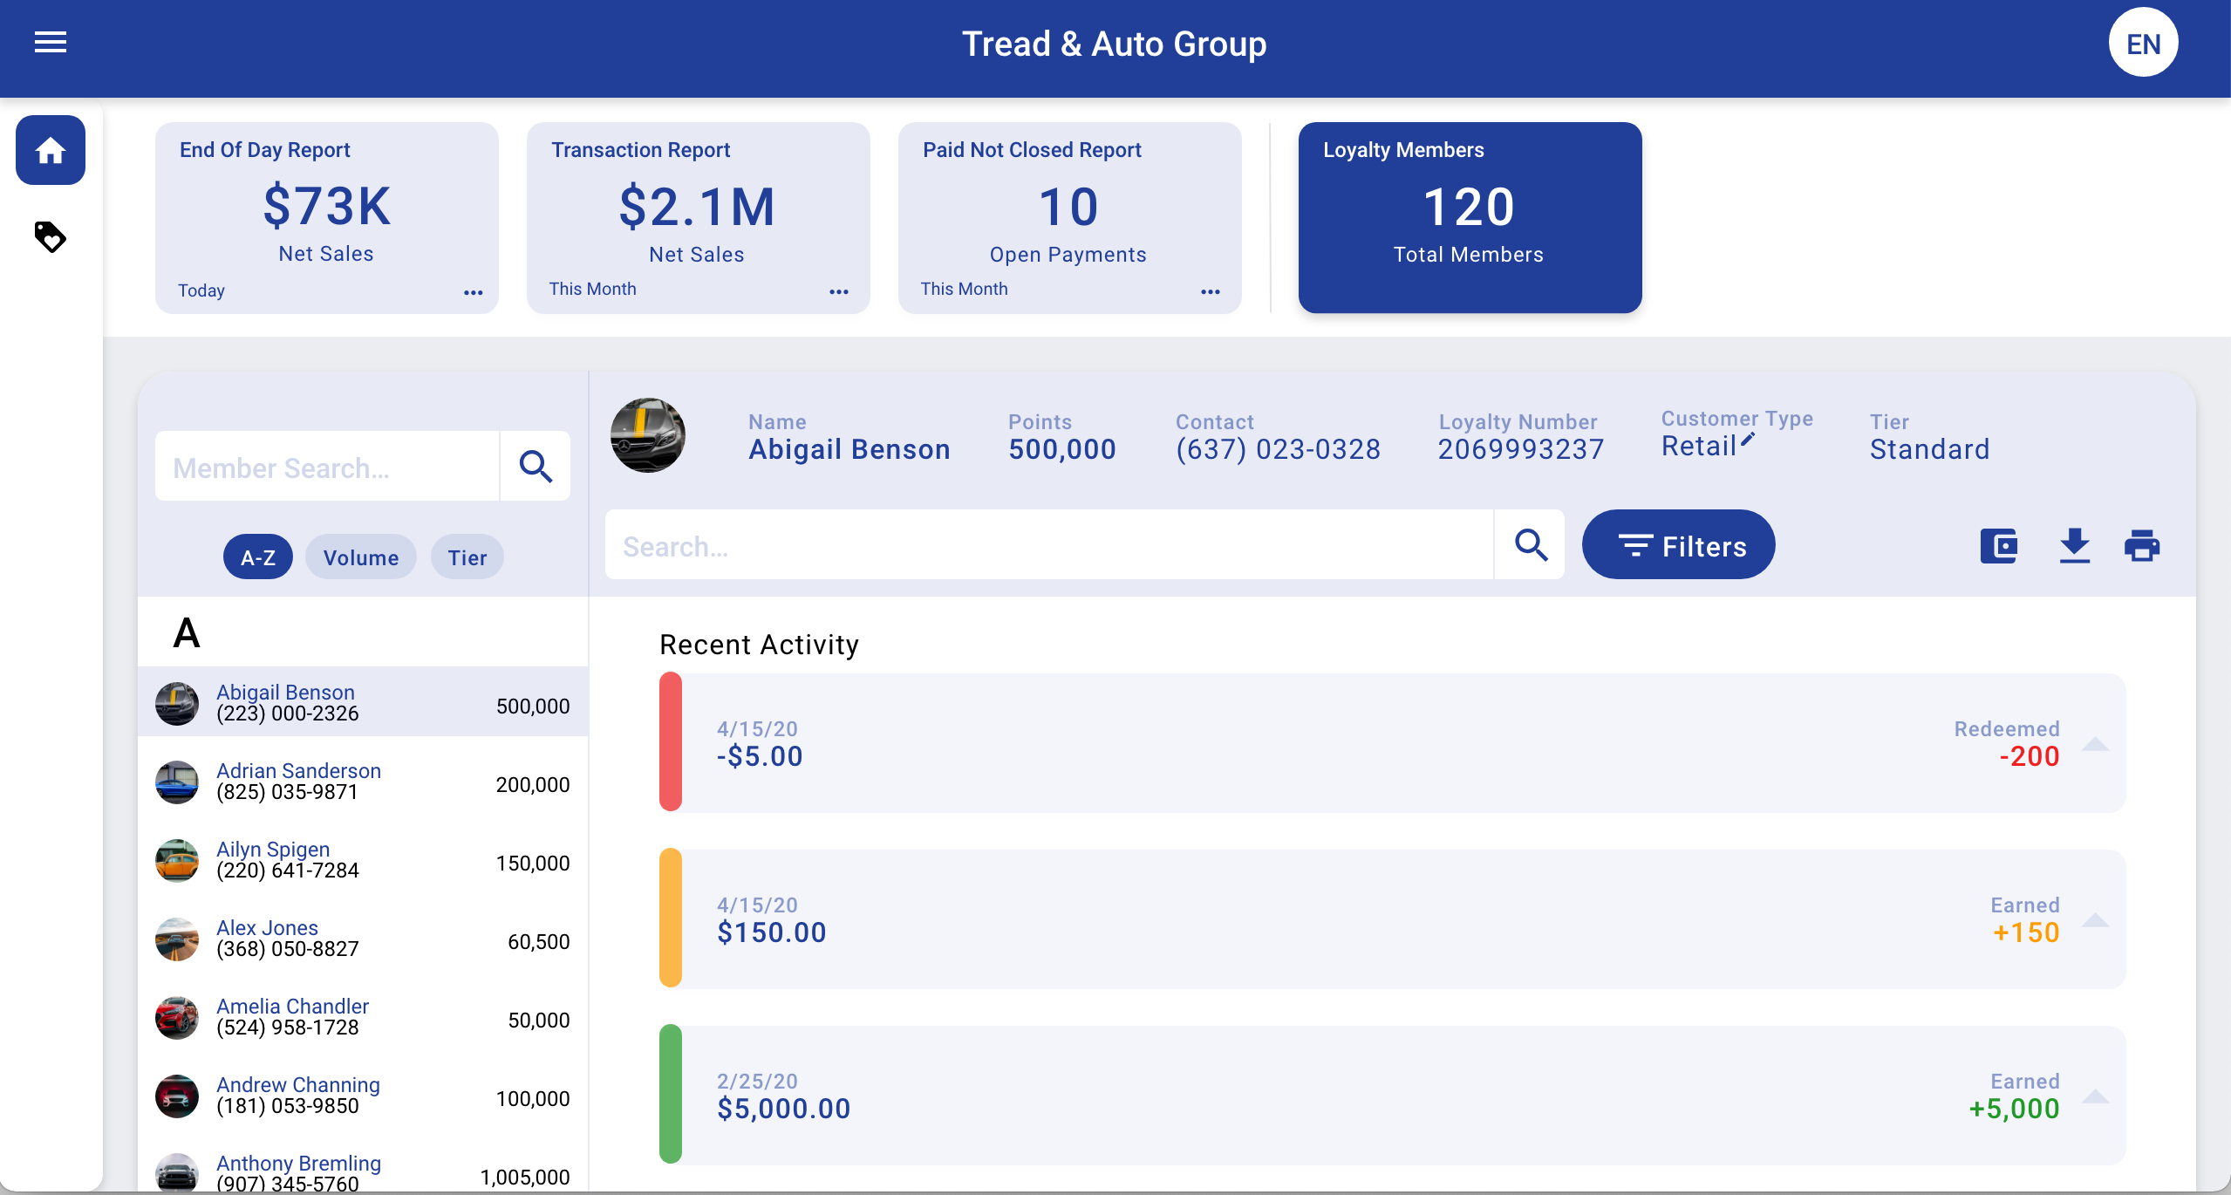
1stMILE Dashboard
Browser-based dashboard to view key shop metrics and view/manage Loyalty
Manage Loyalty
Shop & Loyalty Reporting
Your benefits
View shop and Loyalty metrics anytime at dashboard.1stMILE.com
Activate and Manage your Loyalty program and settings
Add any team members with roles-based permissions

Slide 14
Additional Benefits
Features to boost revenue and minimize costs
Included with 1stMILE
1stMILE Shop App
Fleet Card Processing – WEX, Voyager, FleetOne, Fuelman
Heavy Trucking – Comdata, T-Chek, EFS
Web Payments – Integrated and standalone options that integrate back into POS invoices
State-of-the-art hardware
PCI Compliance program included
Notes:
Edit to fix spacing

Slide 15
Lead with innovation,
win with loyalty
Contact us
1stMILE Sales
1-866-354-3490
1stMILE.com/MDA

Slide 16
Thank you

