Slide 2
NEW Program Overview and Business Review

Slide 3
Agenda
Our Story
Our Differentiators
Our Brand
Our Commitment

Slide 4
OUR STORY

Slide 5
TAKING CARE OF PEOPLE WHO TAKE CARE OF CARS
AutoZone started with a vision and a commitment to taking care of people who take care of cars.
On July 4, 1979, in the small town of Forrest City, Arkansas, we opened the first “Auto Shack”, with first day sales of only $300.
Since that first day, we’ve kept that vision and
commitment alive, and it’s been the driving force
behind AutoZone’s success –
We’re ready to help you take your business to the
next level with dedicated people, commercially focused programs and the parts you need when you need them.
Notes:
Opened in 1979 as Auto Shack by J.R. "Pitt" Hyde III, AutoZone was created with the belief that we can offer ordinary customers clean, well-organized auto parts stores and excellent customer service. Since then, AutoZone has revolutionized the industry while maintaining a customer-first, innovative mindset. AutoZone has grown to be the leading retailer and a leading distributor of automotive replacement parts and accessories. Auto and truck parts, chemicals and accessories are available through AutoZone stores in 50 U.S. states plus the District of Columbia, Puerto Rico, Mexico, and Brazil.

Slide 6
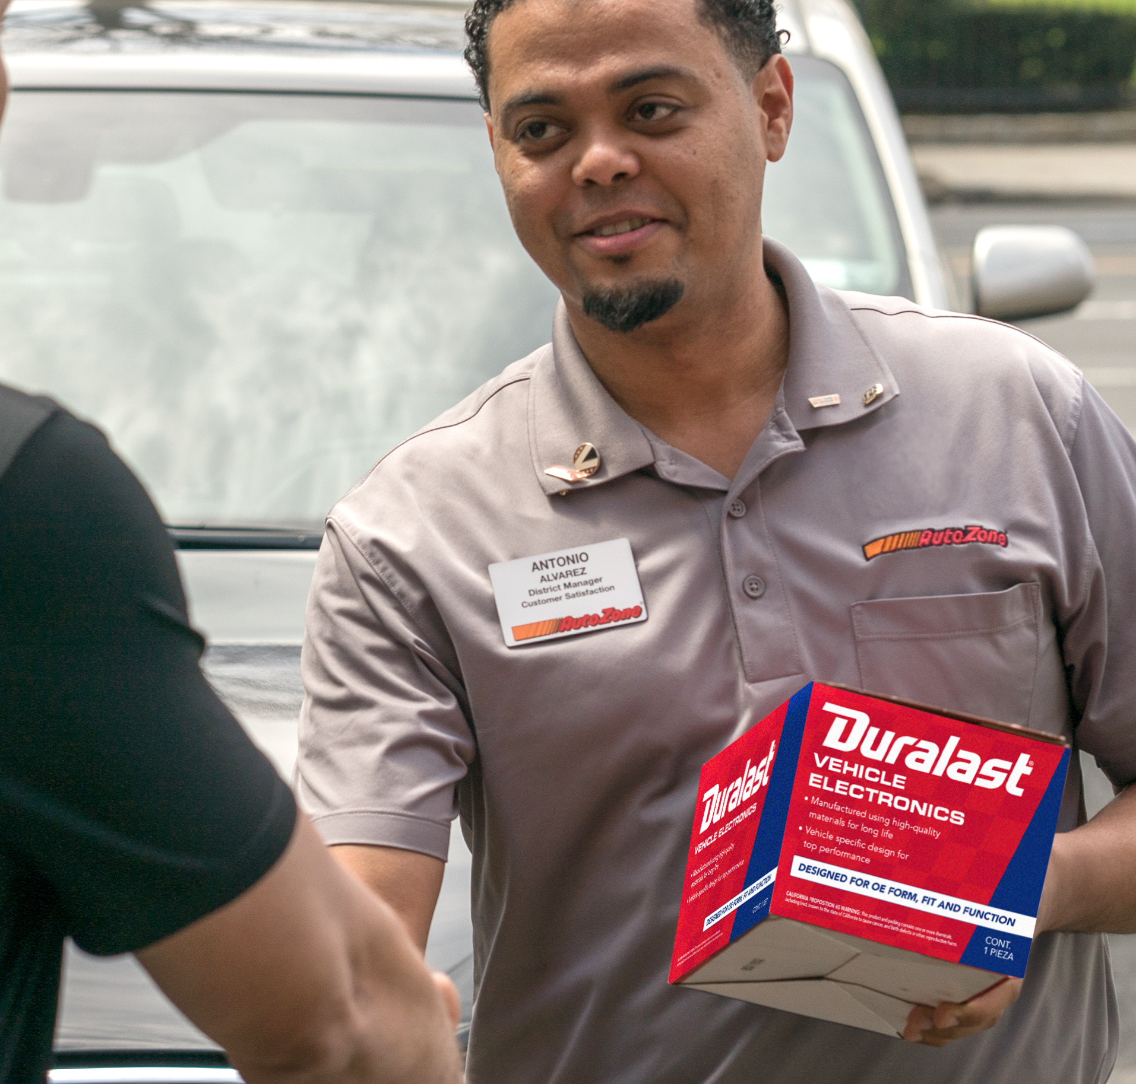
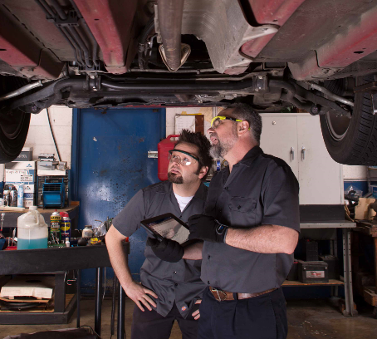
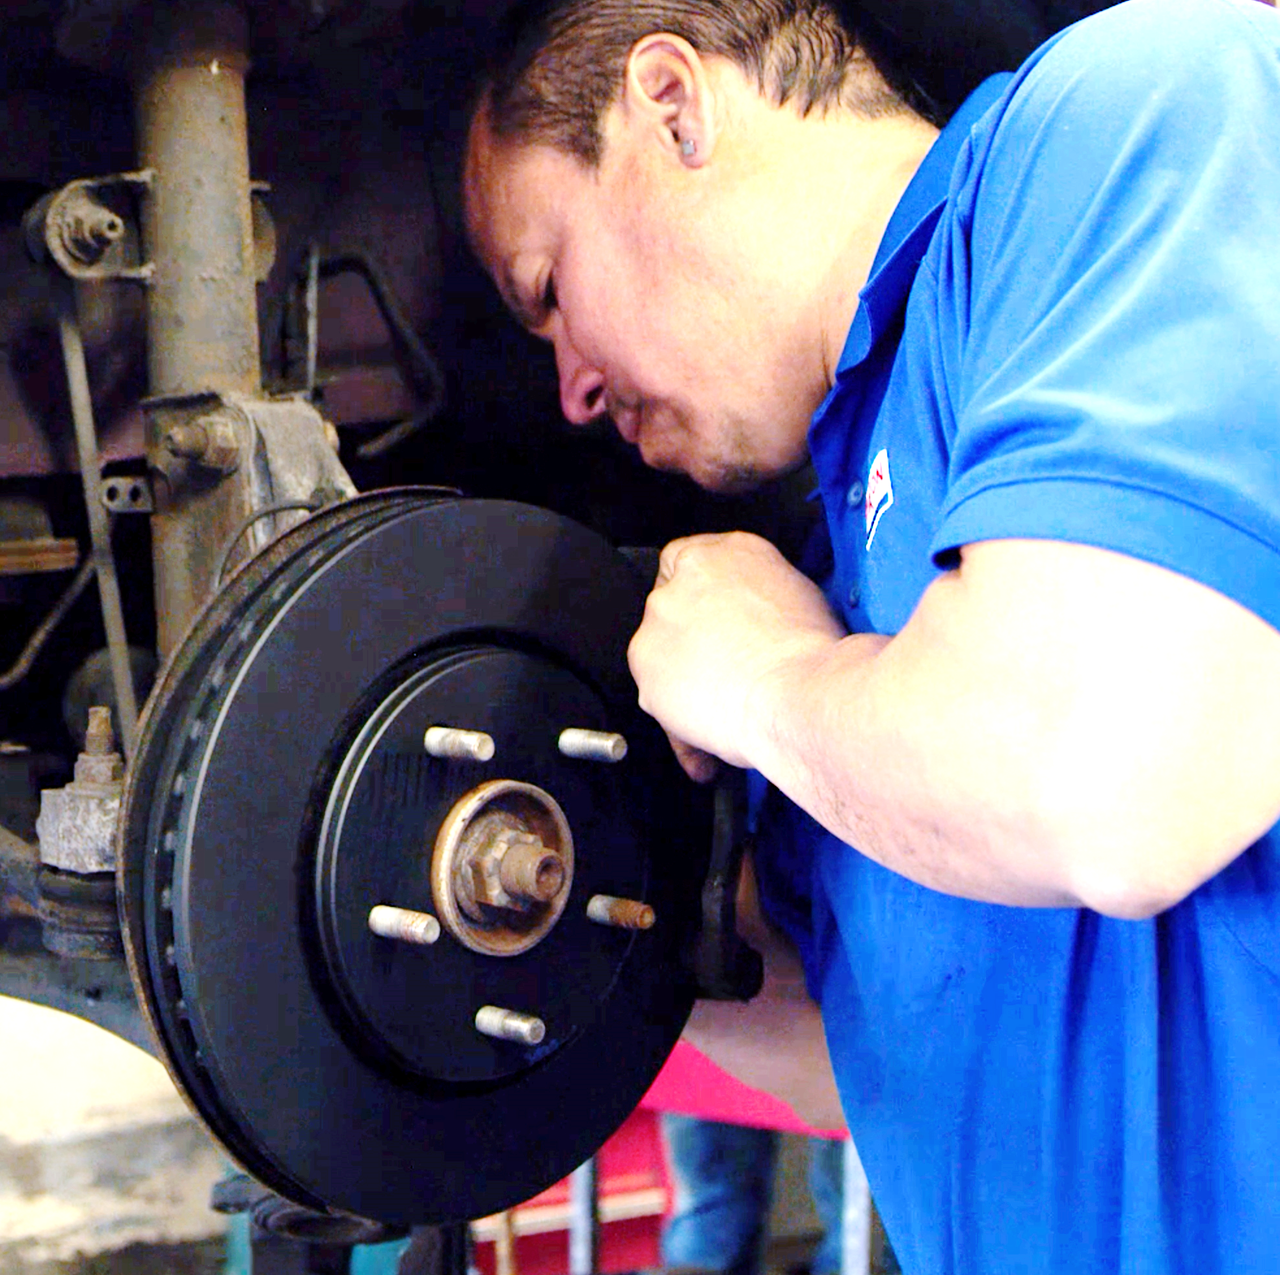
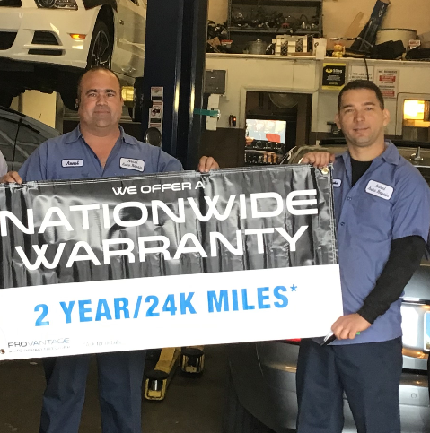
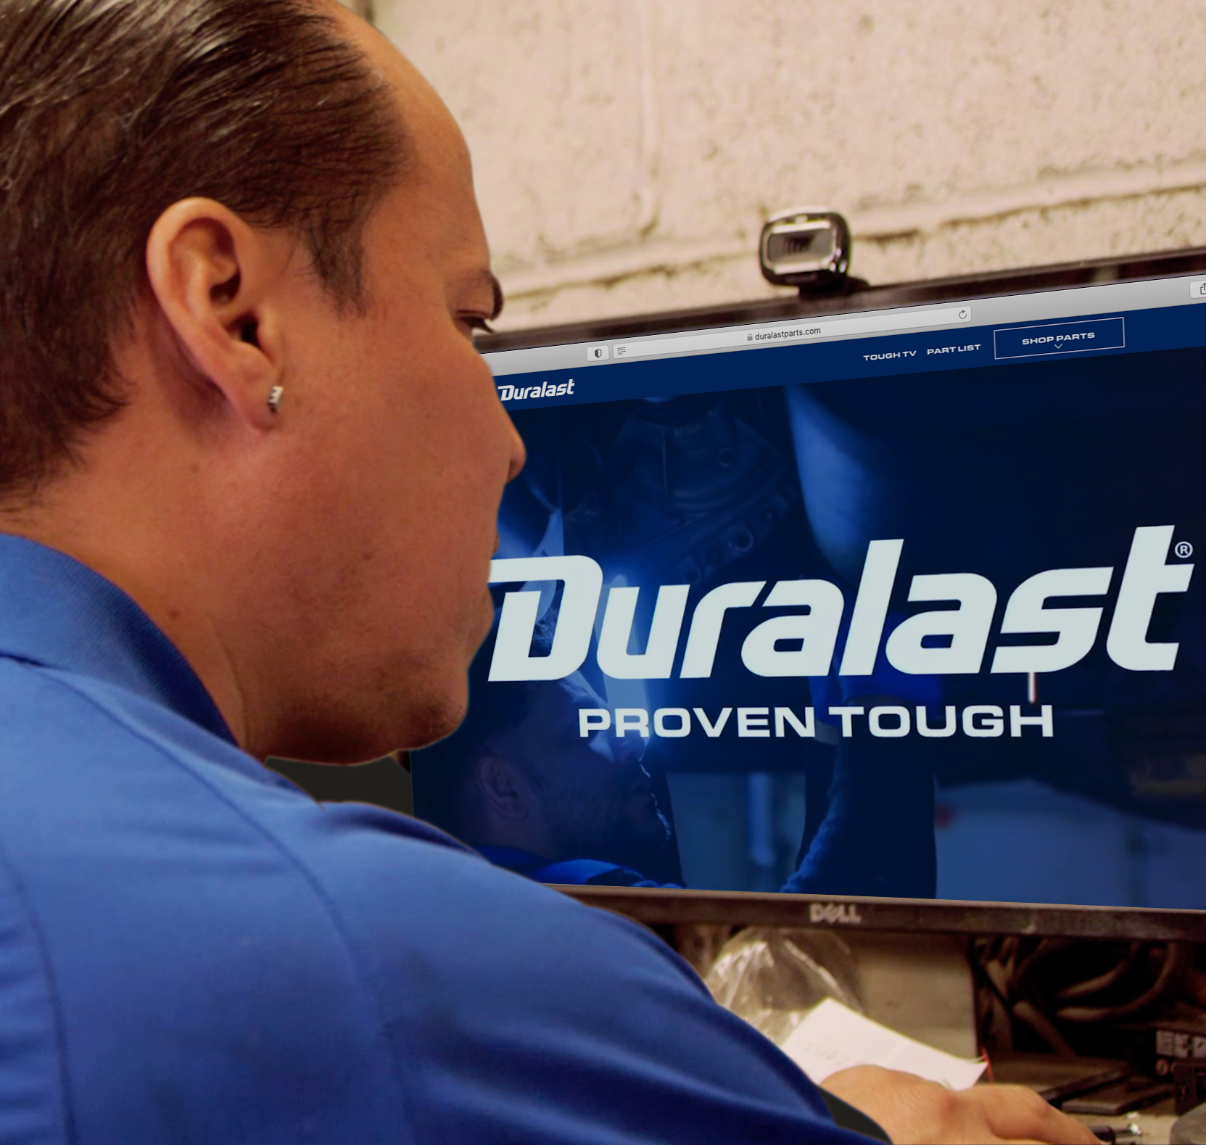
AUTOZONE HISTORICAL TIMELINE
1996 Launched
AutoZone Commercial
1996 Acquired
ALLDATA Software Company
2011 Introduced
Duralast Gold Brake Pads and Rotors
2015 Began
ProVantage Loyalty Test
2019 Launched
DuralastParts.com
AutoZone Commercial Launched
----------------------
AutoZone Acquired ALLDATA
Dedicated National Account Team Introduced
Web-based Electronic Ordering Introduced
Surpassed $2B in Commercial Sales
Launched AutoZonePro.com Upgrades
5000th AutoZone Store Opened
Surpassed $3B in Commercial Sales
----------------------
CCC One Integration
Introduced Commercial Category Management Team
4000th Commercial Program Opened
Began Introducing Professional Edge Improvements
AutoZone Opened First Location
AutoZone de Mexico Opened First Store
Surpassed $1B in Commercial Sales
‘79 ’96 ’98 ’02 ’05 ’07 ’11 ’12 ’14 ’17 ’20 ’21 ‘22

Slide 7
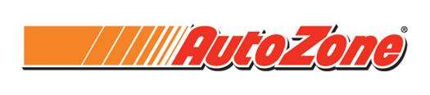












THE COMPLETE SOLUTION
Dedicated Staff, Quality Parts, Professional Programs and Services
OEM Data, Repair Information, and Shop Management
250+
Genuine, OES, & Aftermarket Import Brands

Slide 8
AutoZone Company Overview
Fortune 250 company with 100,000 employees
Over 7,000 stores in 50 States, Mexico and Brazil
  ALLDATA, LLC
  AutoZone.com and AutoZonePro.com
100% company-owned stores
Dedicated National Account Division
Nationwide Warranty
More than 40 years in business
  The best performing company in the industry

Slide 9
AutoZone Operations
Highest quality parts in the Business
  Every part inside our stores is a Tier1 or OE supplier
Expanded Hub & Spoke Model
  We get you the part you need, where you need it
More wholesale parts specialists
  And more ASE certified parts pros
Online Shop Referral Program
  Our customer is your customer
State of the art online ordering system compatible with Meineke POS

Slide 10
OUR Differentiators

Slide 11
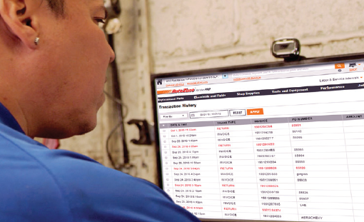
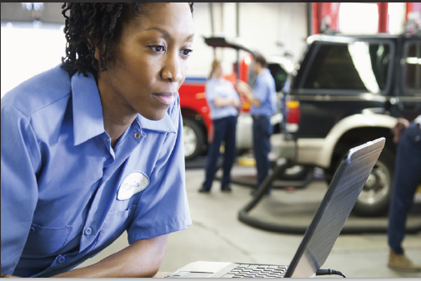
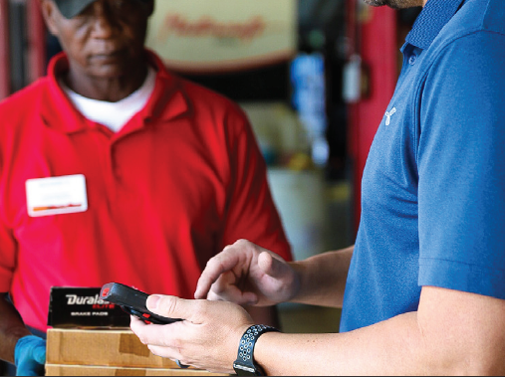
GET THE PROFESSIONAL EDGE
Parts buying innovation geared toward your success
Easier Parts Ordering
Cutting edge search functionalities
Search extended parts catalog
Upgraded mobile app allows you to order parts from anywhere with real-time availability
Streamlined Account Management
“Dashboard” view of account vitals (credit, transactions, etc.)
Access, download and search all transactions
Paperless deliveries and instant returns
Securely pay bills online
Faster Delivery
Easily track orders online
Expanded late-model coverage available locally
GPS map technology for fastest routes to your shops
Exclusive Pricing
Multi-sourced price matching intelligence
Custom competitive pricing
Priced to drive your success

Slide 12
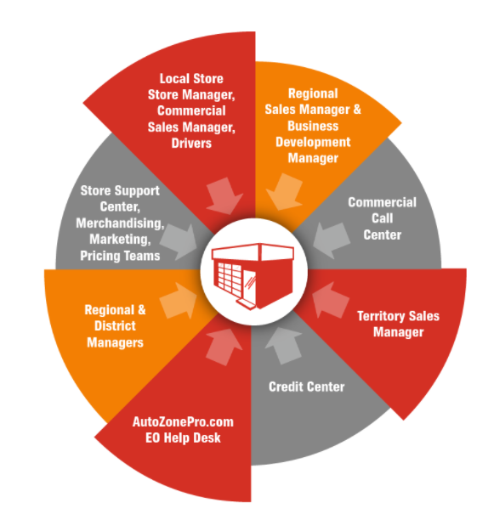
A DEDICATED COMMERCIAL SERVICE TEAM
7,000+ AutoZone Stores
5,200+ Commercial Programs
5,400+ Dedicated Commercial Team Members
  4,900+ Commercial Sales Managers
  460+ Territory Sales Managers
  220+ Corporate Support AutoZoners
  60 Regional Commercial Sales Managers
  7 Divisional Commercial Sales Managers
  30+ National Account Mangers

Slide 13
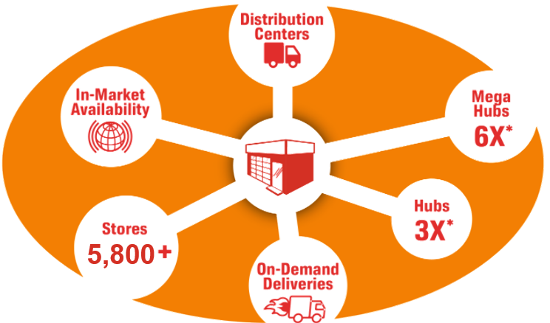
MORE PARTS, AVAILABLE FASTER
OUR Company-Owned Distribution Network Delivers Parts More Efficiently
6,800+
Notes:
We know less waiting means more bays turning, so we’ve made several improvements to increase our in-market parts availability and get them to you faster.
“We’ve increased our late-model coverage for the most popular applications across all product lines – and we’re often first-to-market with these late-model parts. We’ve also expanded our import coverage to match car sales trends. All within this local market, so when you call to check on a part, we’re most likely going to say, “yes, we’ve got it.”
“Greater local availability means less waiting and faster delivery. And now, we’ve improved the tools for our delivery drivers. This helps us create more efficient, shorter routes to your shop and make sure our drivers are on time.

Slide 14
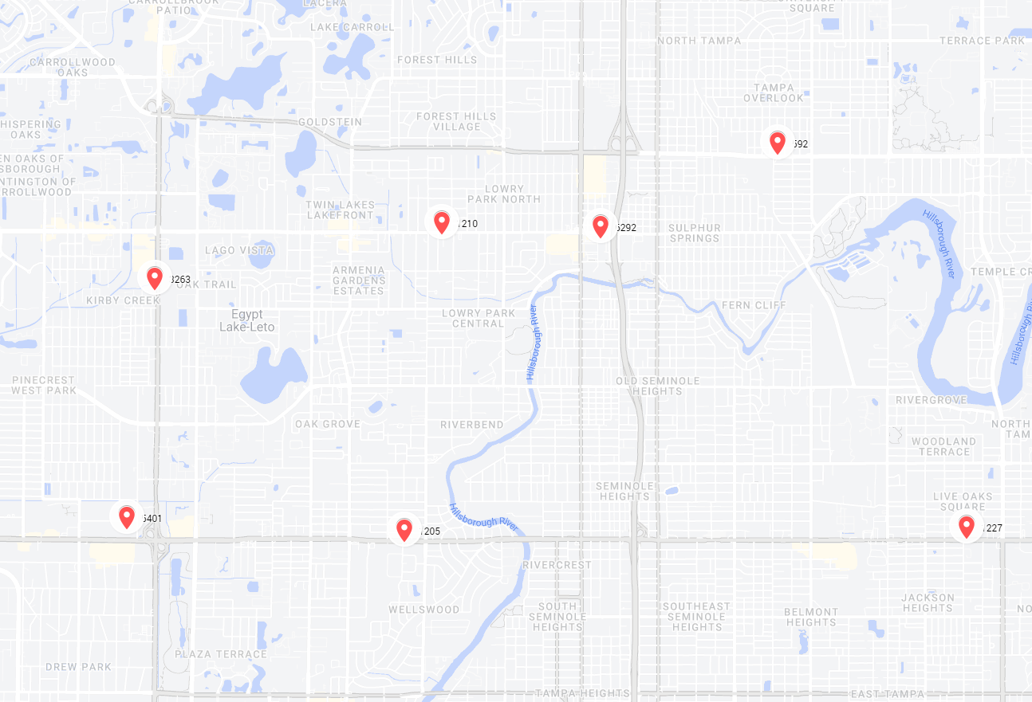
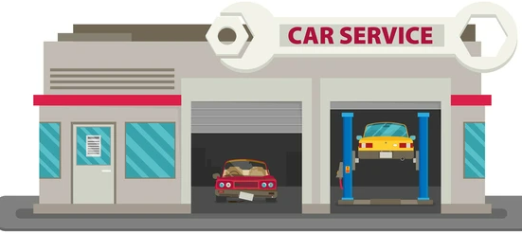



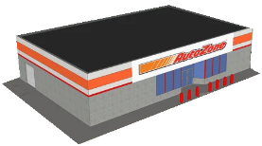
Using the Fulfillment Model
12 min trip to customer
New process for non-stock store items finds the closest fulfillment store that has all the parts, sends the order and has that store pick and make the delivery
Eliminates the back-and-forth drive from the Hub to sister store
Reduces total cost of delivery
More consistent delivery times

Slide 15
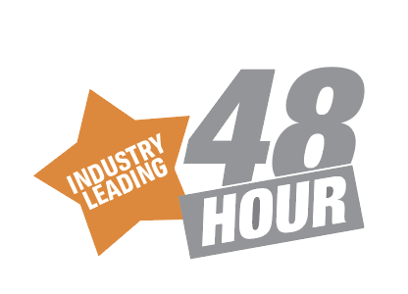

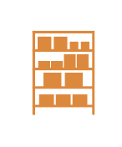


PROFESSIONAL SERVICES TAILORED TO YOUR BUSINESS
48 HOUR LABOR CLAIM POLICY**
72 HOUR NO CORE POLICY*
BATTERY TESTER PROGRAM
CONSIGNMENT & STOCKING PROGRAMS
SPECIALTY TOOL PROGRAM
Buying decisions have never been easier. Install parts with confidence and keep your
bays turning at full speed with the industry’s only national 48 Hour* Labor Claim Policy.
** 48-hour response guarantee does not apply to claims over $1,000 or claims requiring product testing. Contact your AutoZone Commercial Representative for details.
No hassle with cores – we’ll come pick them up within 72 hours and you pay no core charge, so you can keep your money in the cash drawer.
*72-hour core deferral does not apply to engines, heads, crankshafts, transmissions or outside buys. Core charge deferral is available only to qualified delivery customers.
Our Battery Testers can help your shop be the hero and prevent a breakdown before it occurs. Plus, your shop can earn up to $16,000 per bay per year in increased revenue by testing every vehicles’ starting and charging system in just two minutes.
Bulk up and save or try a consignment program. You’ll have the parts and supplies you need on hand for fast installations.
Take advantage of those specialty repairs with the tools you need for the job, then return them for a full refund, or keep them as part of your vehicle repair arsenal – it’s your choice.

Slide 16
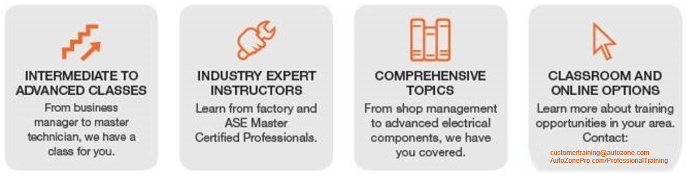
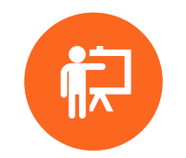
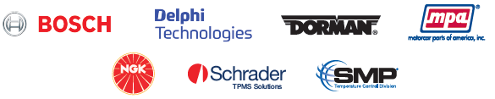
PROFESSIONAL BUSINESS & TECHNICIAN TRAINING
Train Today for Tomorrow’s Success
Our Training Partners:
Notes:
AutoZone offers Commercial customers online/virtual, on-demand, and live/in-person training. Training content is developed and presented by industry experts, factory and ASE Master Certified Professionals. Topics cover servicing and diagnostics of all major systems, emerging technologies, and shop manager's training to increase shop performance and sell preventative maintenance
Online/virtual and live/in-person training topics are scheduled based on industry updates, seasonal opportunities, and customer needs. The up-to-date virtual training schedule is available on AutoZonePro.com/ProfessionalTraining. For a limited time, shops can attend virtual training at no cost; however, registration is required
On-Demand/Online annual subscription allows unlimited access for one year. More than 125 topics, approx 50 minutes per topic. Training is built around actual case studies and practical, specific, expert advice to maximize the use of your time. Each modular is approximately 50 minutes, and a certificate of completion is available for each course. $229/annual subscription
Currently, we are testing a comprehensive, turn-key training solution to offer consistent technical and shop management training. The platform utilizes micro-learning to deliver 3-5 minutes of daily training activity via mobile apps, so time spent training is efficient and effective. Daily engagement lets shops connect to their technicians regularly and rapidly share information. Data provides insight to a shop's return on investment in training. Leaders can make better staffing and business decisions using data showing knowledge growth, progression, participation, and detailed results at multiple org levels. We plan to launch this training platform chain-wide starting January 2023

Slide 17
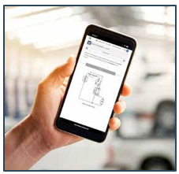
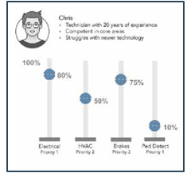
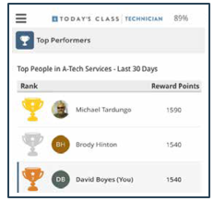
PROFESSIONAL BUSINESS & TECHNICIAN TRAINING
Today’s Class Technician
Today’s Class utilizes micro-learning to deliver 3-5 minutes of daily training activity via a mobile app and web
Daily engagement enables Today’s Class to use artificial intelligence and establish training priorities based on an individual’s need to improve knowledge and confidence - resulting in performance improvement
Leaders can make better staffing and business decisions using detailed data showing participation, progression, knowledge growth, and detailed results made viewable at multiple levels of the organization – MSO, shop, tech
The platform provides four levels of training: Basic (learn & recall), Advanced (recall), Application (aligns with ASE exam prep), Diagnostics (high-level thinking)
Current users of the platform have increased their knowledge by more than 28% to date

Slide 18
Business Resources

Slide 19
business resources
Resources to boost traffic to your shop and increase your profits
Boost Traffic
  Shop Referral program to connect DIY customers to your shop
  Customer signs and marketing to promote your shop
  Marketing plan to guide shops for business growth
  Online marketing solutions to get your shop found online
Selling Tools
  Digital diagrams, sales kits, inspection sheets and checklist to explain needed repairs to customer and increase average repair orders
  Auto repair financing to helps your customers get the repairs they need
  In-shop and online marketing to engage customers
Sales Tools
  Consignment and stocking programs
  Display racks and stocking cabinets
  Quarterly catalogs
Business Tools
  Professional Edge
  Business financing
  Business and employee insurance
  Uniforms and shop supplies

Slide 20
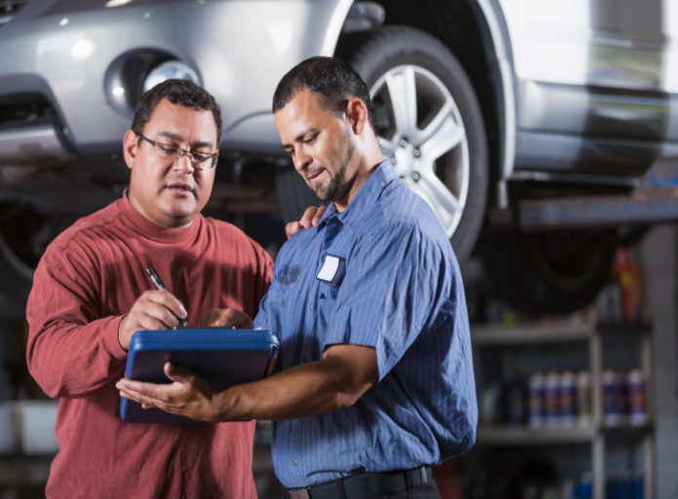
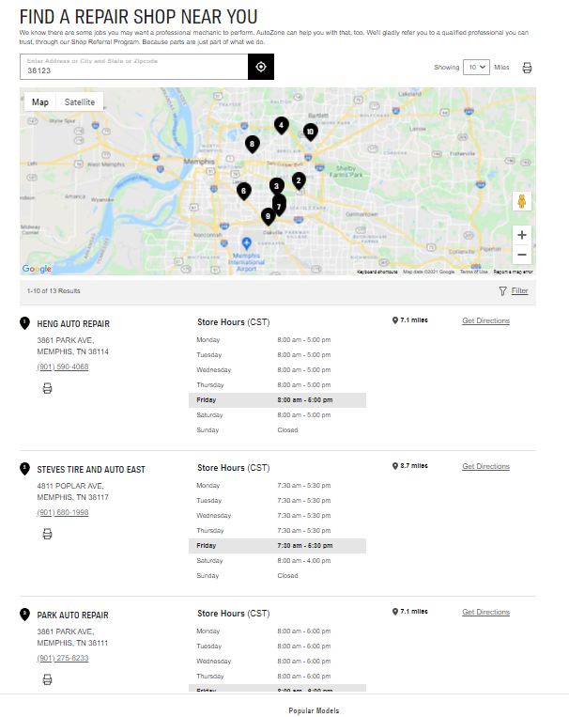
business resources
Shop Referral Program
Connect DIY customers to your shop
Promote your shops
Create custom coupons
Quick and easy signup process
Create custom coupons to be displayed in your referral profile
Updated search functionality in AutoZone.com to make it easier for customers to find your shop
OVER
5,000,000
ONLINE CUSTOMERS EVERY WEEK
OVER
5,000,000
IN-STORE CUSTOMERS EVERY WEEK

Slide 21
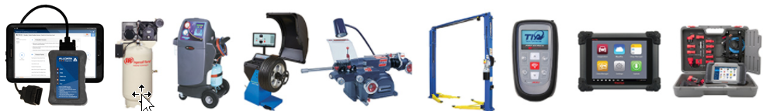
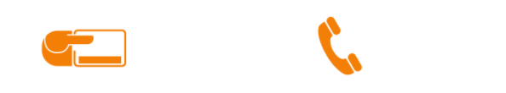
TOOL AND EQUIPMENT PROGRAMS
In-house extended credit terms and third-party financing available to help grow your business.
Experienced professionals on hand to guide you through your purchasing experience or customer service needs
1-877-AZTOOL1

Slide 22
DURALAST
Notes:
Professional:
More technicians choose Duralast Parts*
More technicians choose Duralast Brakes*
* Source: Proprietary Consumer Study of Automotive Aftermarket Parts Conducted by The NPD Group, 2019.
Consumer:
More consumers choose Duralast Batteries*
More consumers choose Duralast Brakes*
* Source: Proprietary Consumer Study of Automotive Aftermarket Parts Conducted by The NPD Group, 2019.

Slide 23

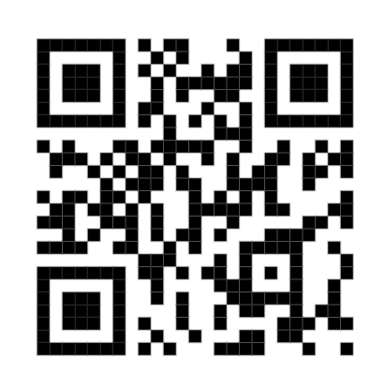
Duralast for the professional

Slide 24
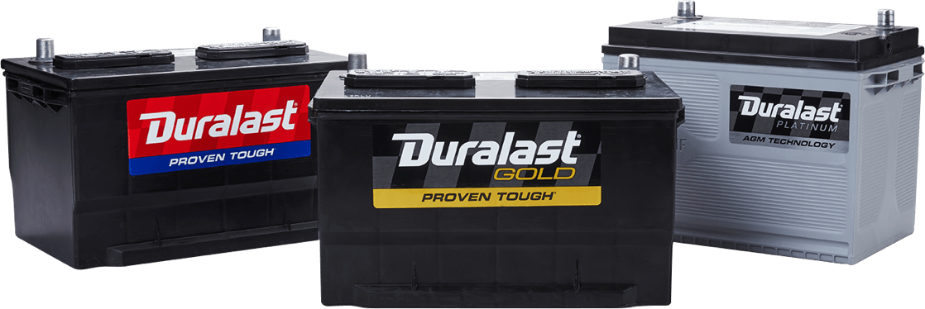
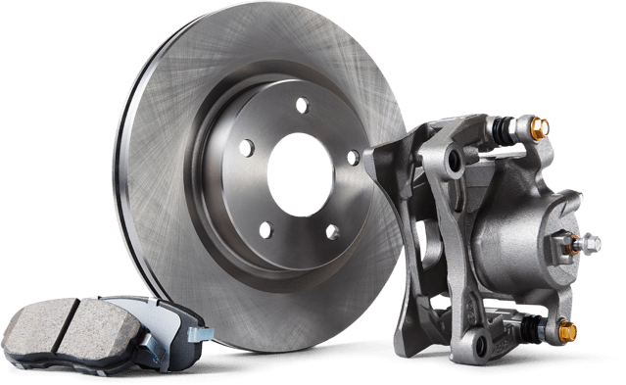
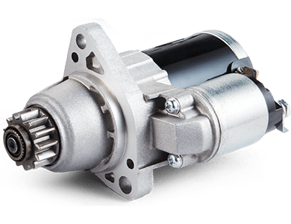
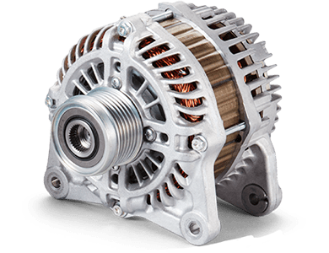
Duralast for the professional
We’ve built our brand to protect yours
The standards for Duralast parts are equal to or higher than the OE and many competitors
Extensive torture, life-cycle and component testing ensure OE or better performance
  Produced by category-leading, Tier-1, or OE parts manufacturers
Duralast is Proven Tough on millions of vehicles across America every day
Notes:
Our Pro Power Batteries are sold exclusively to Commercial customers only!
The batteries, along with our Starters and Alternators come with a FREE 3 Year Roadside Assistance Warranty covering Jump Start, Towing Service, Tire Change, Fuel/Fluid Delivery, Auto Lockout and Trip Interruption

Slide 25
Meineke Program
Meineke program is “Enhanced” level national account pricing. AutoZone's best pricing available.
5% rebate monthly paid directly to your shop
Driven Brands has negotiated the Best pricing for Meineke Dealers and continues to provide the dealers with the benefits of the Driven Brands’ group buying power.
As new Dealers are opened, AutoZone is opening purchasing accounts so that the new franchisees can get right to business on day 1.

Slide 26
THANK YOU!

