Slide 1



Let’s chat
William Folsom
VP Operations and Client Success

Slide 2
Agenda:
Introduction to Chatter
Since the last regional meeting
YTD results
What’s in the oven
In Pilot – Chatter Plus
Open Discussion

Slide 3



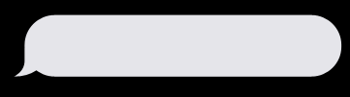

So, What’s New?
Released since May 2023:
Early June- Solicitations to all possible numbers
Late June-Emails Solicitations- All Centers
Reminder Solicitations 144 Centers
Live Conversations 26 Centers
Summer Sweepstakes
Thanks for visiting The North Face. Can we ask you a few questions about your experience today?
Sure, what do you want to know?

Slide 4
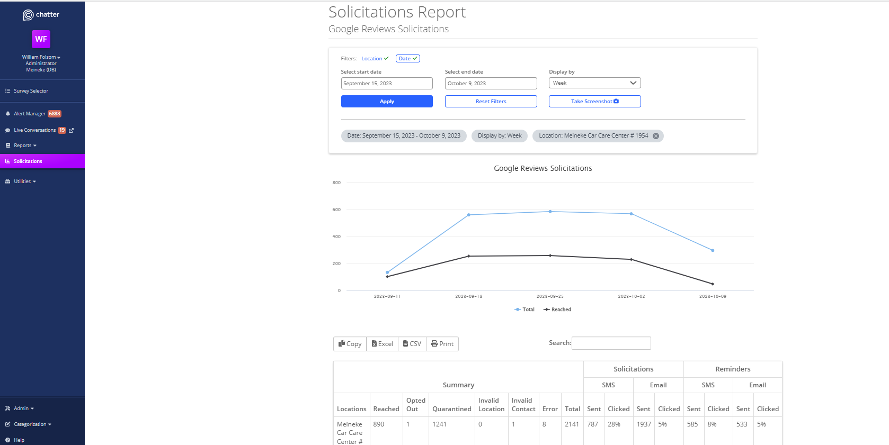
New Report
Thanks for visiting The North Face. Can we ask you a few questions about your experience today?
Sure, what do you want to know?

Slide 5
Quick Stats 2023
1,253,455 Solicitations
Annual CTR 22.7%
49,340 New Reviews
YOY Increase 2,117

Slide 6

2023 Sweepstakes
92,470 SMS Solicitations
20,208 Entries
Impact on Google Reviews
Google CTR increased 2.4%
2,348 Additional Reviews
Thanks for visiting The North Face. Can we ask you a few questions about your experience today?
Sure, what do you want to know?

Slide 7
What’s in the oven
Solicitations by Service
Solicitation by $$ Spent
Enhancements to Live Conversations
Reminders Solicitations for all centers

Slide 8
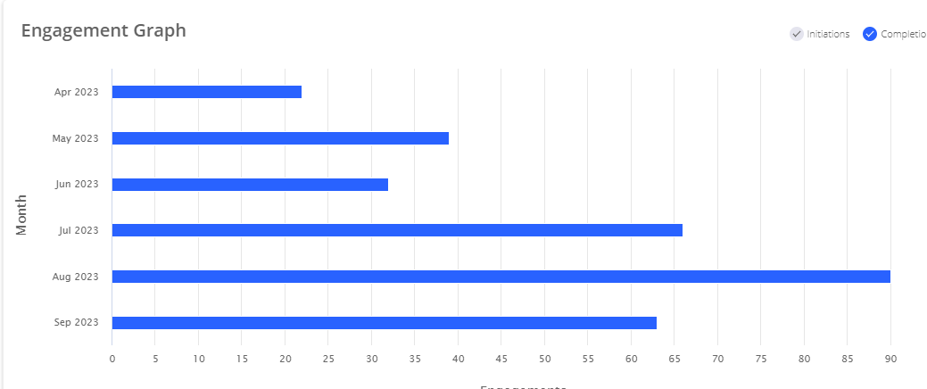
Boost google reviews
Dave Repass 1954
Thanks for visiting The North Face. Can we ask you a few questions about your experience today?
Sure, what do you want to know?

Slide 9
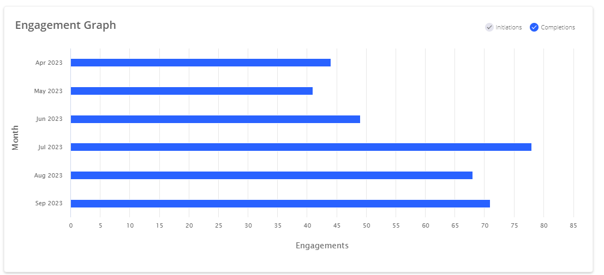
Boost google reviews
Greg and Marc
Thanks for visiting The North Face. Can we ask you a few questions about your experience today?
Sure, what do you want to know?

Slide 10
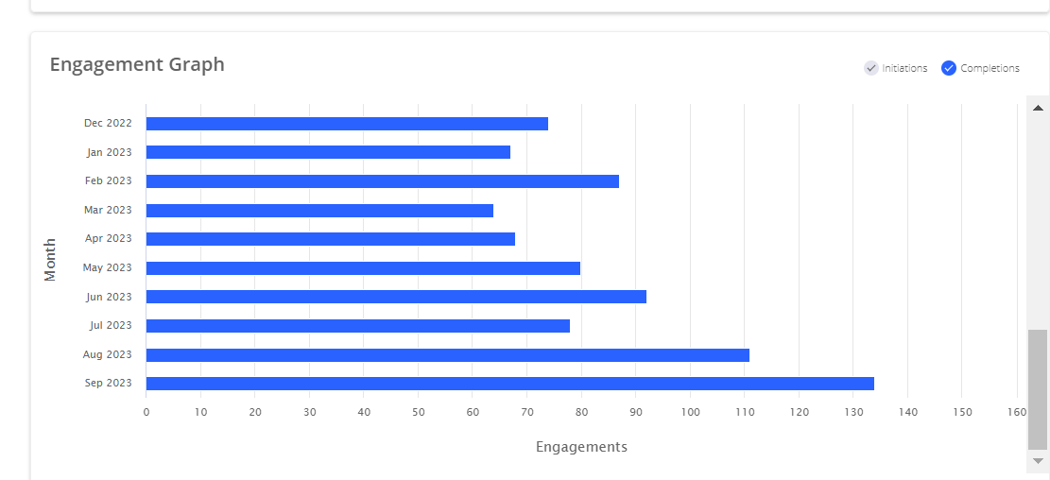
Boost google reviews
Scott Martin
Thanks for visiting The North Face. Can we ask you a few questions about your experience today?
Sure, what do you want to know?

Slide 11
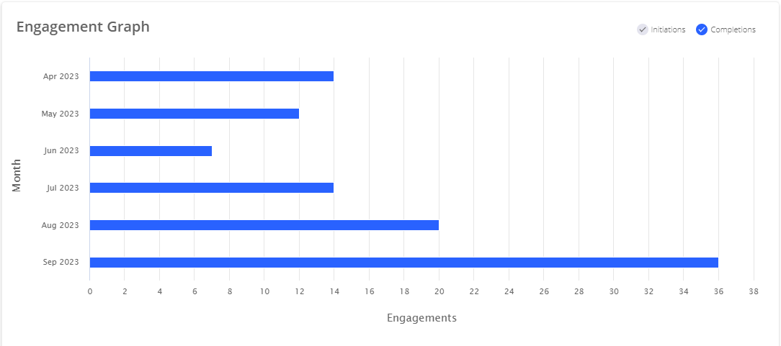
Boost google reviews
Joe Lamanna
Thanks for visiting The North Face. Can we ask you a few questions about your experience today?
Sure, what do you want to know?

Slide 12
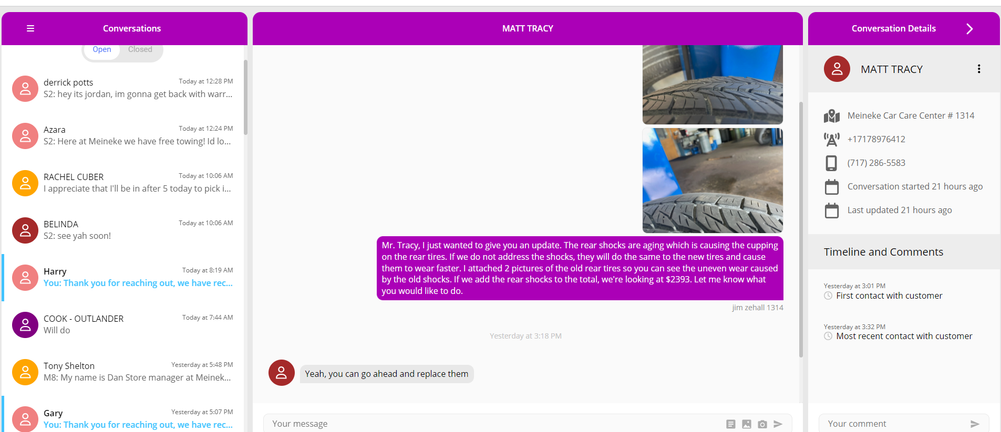
Reaching your customers where they’re at.

Slide 13
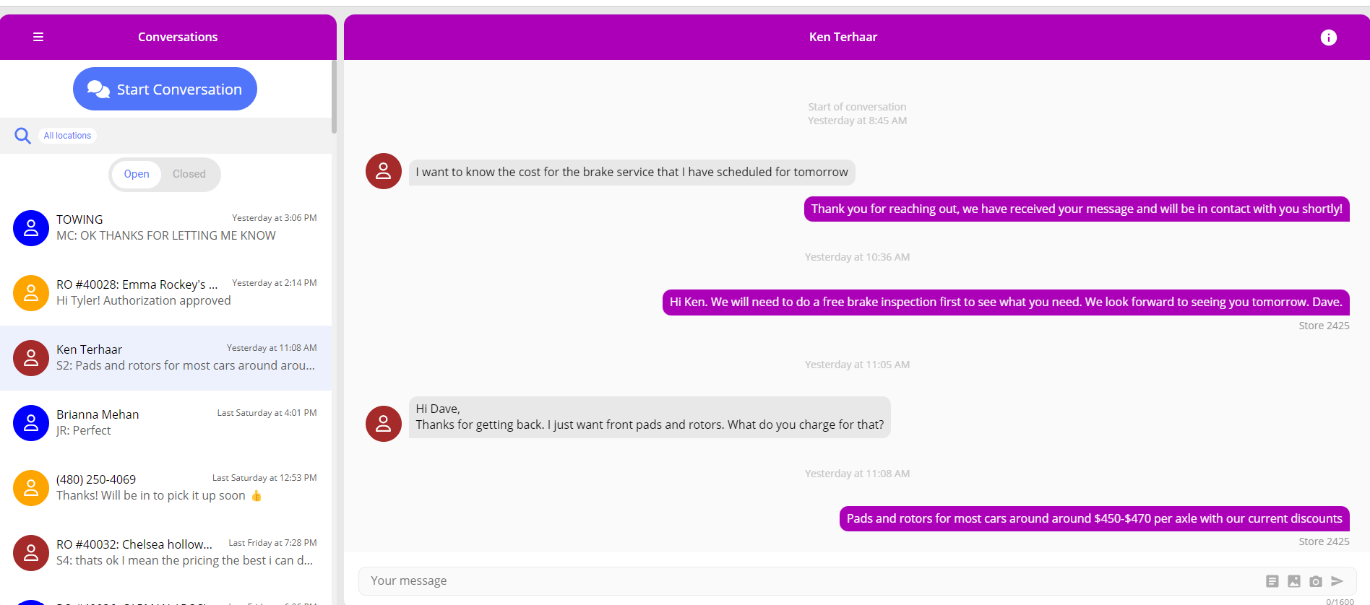
Real time conversation with customers
Thanks for visiting The North Face. Can we ask you a few questions about your experience today?
Sure, what do you want to know?

Slide 14
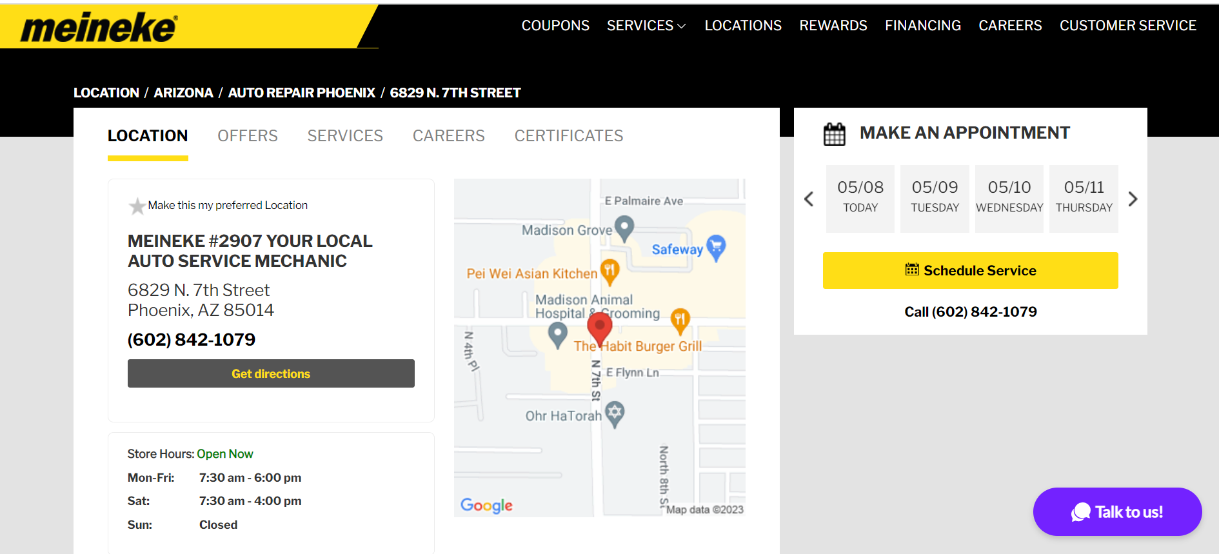
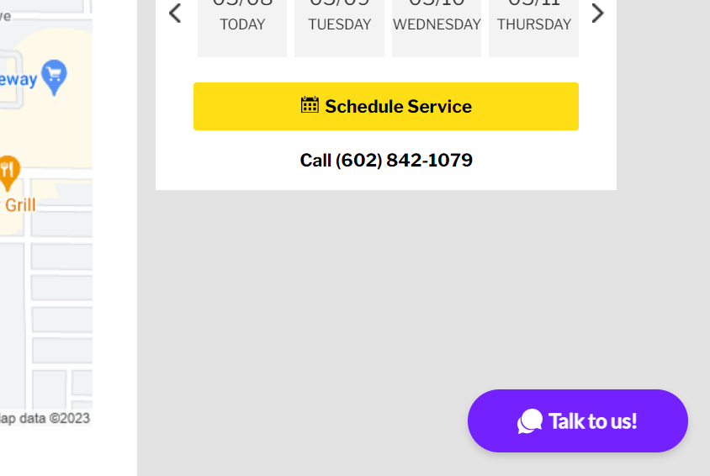

Live Conversations + Meineke.com
For customers having trouble making an appointment online.
Click the “Talk to us!” Button

Slide 15

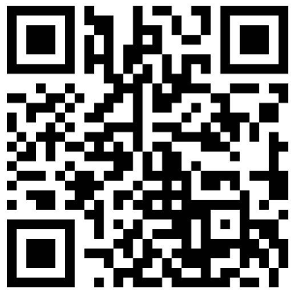
Want free webinar training ?
Want additional services?
Don’t have access to Chatter?

Slide 16

Thanks for
taking the
time to
chat.

