Slide 1

Driving Retention and Profitability
V03162021
RelaDyne reserves the right to change, amend, modify, suspend, continue or terminate all or any part of the programs outlined in this proposal at any time.
Notes:
Intros

Slide 2
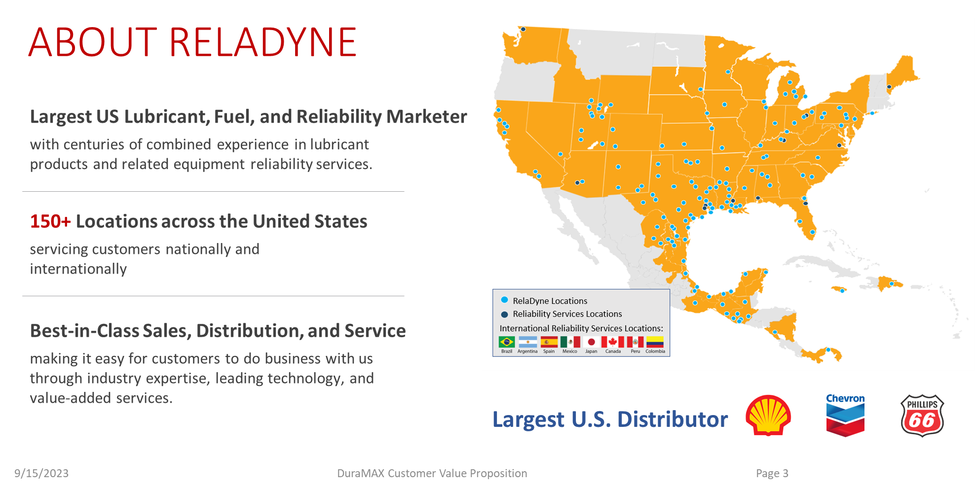
Notes:
LOCKED

Slide 3
Testimonials
“I’m very happy with the quality of the DuraMAX brand and the service provided by Circle Lubricants.”
“…have seen a significant increase to the bottom line as a result of working with Reladyne. Now I purchase from the same company who delivers the product as opposed to buying from one and having another deliver. DuraMAXx is a great asset in my product mix and would recommend to all centers.”
Lino Rodriquez
Owner Meineke #1320
Newark, NJ
Roger Cross
TX
“…We have found their products to be of excellent quality and the pricing is better than our previous supplier. Based on our experience with RelaDyne, I would highly recommend using this program.”
Ross Hiltz
CT Zuckerman / Hiltz Group
CT / NY / NJ

Slide 4
Why RelaDyne & DuraMAX?
Drive RETENTION and PROFITABILITY
  National brand and distribution with size, scale and resources to support the entire Meineke network
  Dedicated account manager with team of 170+ sales reps
  Own the “last mile” (most markets)
  Standardized pricing (East / West)
  Consumer rewards programs that drives customer retention and profitability
  RelaDyne Rewards Program (New)
  DuraMAX Lube Advisor (New)
  Annual volume incentives + Co-Op & Loyalty rebates, point of sale support and equipment program

Slide 5
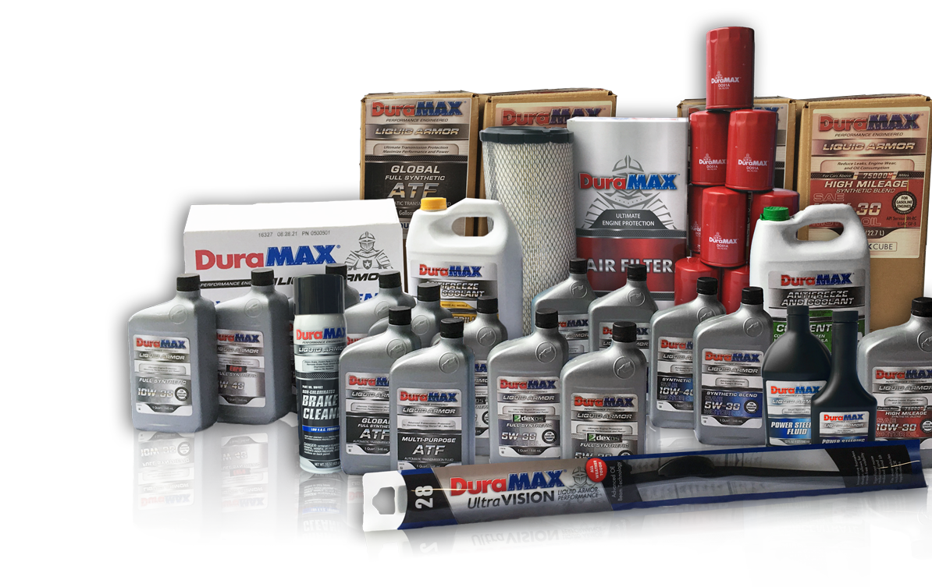
WHY CHOOSE DURAMAX
Drive RETENTION and PROFITABILITY
Complete Line of Automotive Products
High quality full synthetic and synthetic blend motor oils
Fully-licensed GF-6, API SP, SN Plus, and GM dexos1™ Gen 3 products
Antifreeze and coolants
Wiper blades (Market based availability)
Air, cabin air, oil, and fuel filters (Q1 2024 available in every market)
Automotive ancillary products
Marketing Support to Retain and Grow Your Business
DuraMAX DOLLAR$ Program with Text & Online Redemption
DuraMAX Liquid Armor Engine Warranty
RelaDyne Rewards Program (New)
Online Presence with the Installer Locator Map
Enhance retention and profitability for you!

Slide 6
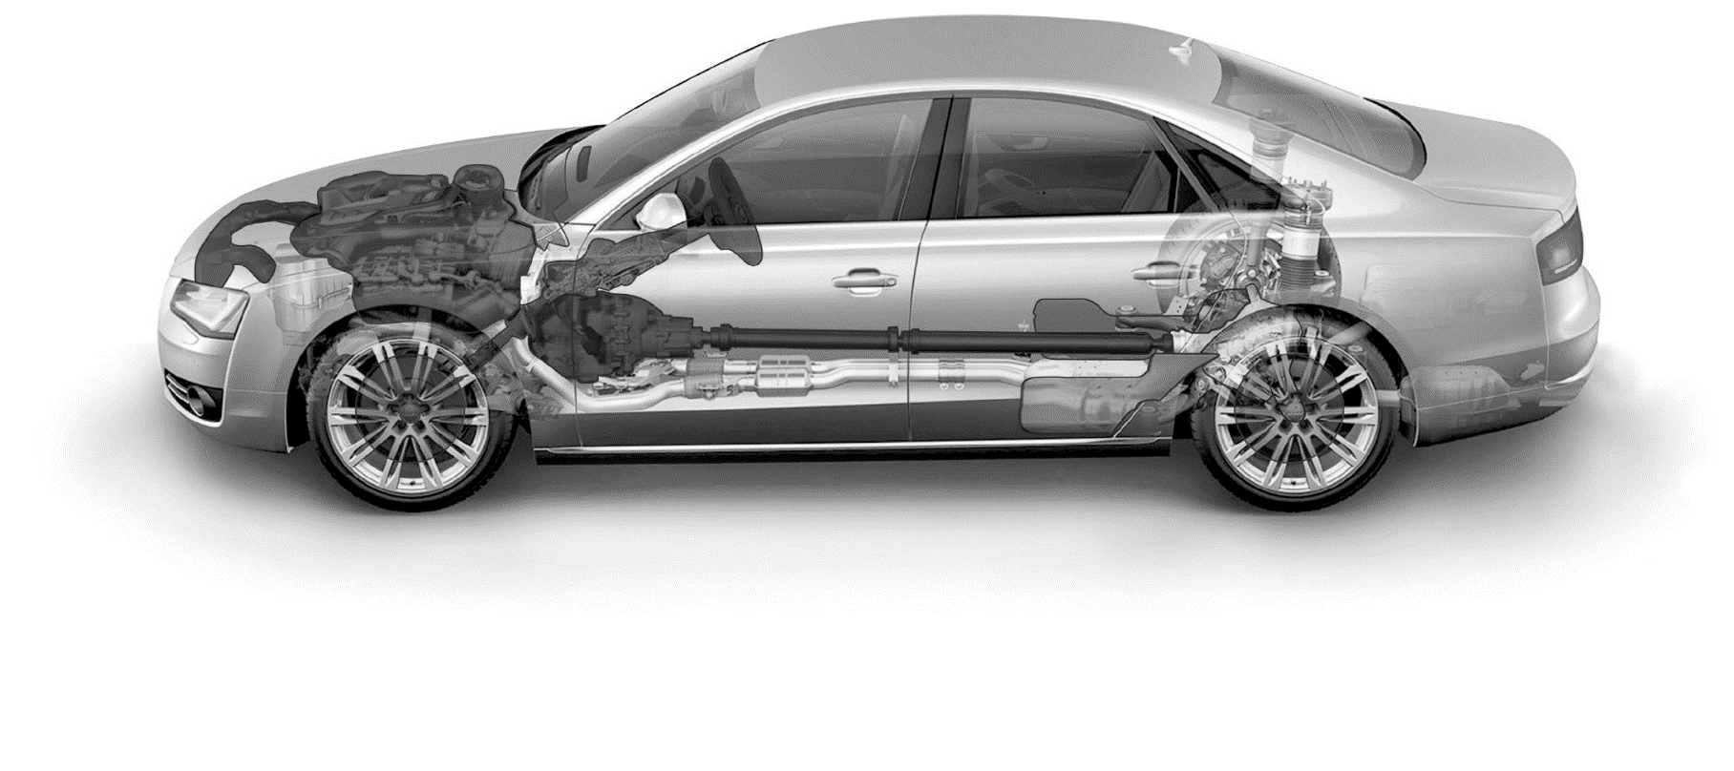
MOTOR OIL
WASHER FLUID
WINDSHIELD
OTHER
Synthetic Blend
High Mileage
Full Synthetic
Full Synthetic dexos1™ Gen 3
-20° Washer Fluid
0° Washer Fluid
32° Washer Fluid
ClearVISION Wiper Blades
UltraVISION+ Wiper Blades
Glass Cleaner
Penetrating Lubricant
Carb Cleaner
FILTERS
Power Steering Fluid
Oil Filter
Air Filter
Cabin Air Filter
Fuel Filter
Fuel Injector Cleaner
ATF FLUIDS
BRAKES
ANTIFREEZE
GEAR OILS
Global ATF
Dexron® VI ATF
D/M ATF
CVT Fluid
Type F ATF
Antifreeze (Green)
AMAM Extended Life Antifreeze
75w90 Syn Gear Oil
80w90 Gear Oil
75w140 Gear Oil
DOT 3 Brake Fluid
DOT 4 Brake Fluid
High VOC Brake Cleaner
Low VOC Brake Cleaner
Some products may not be available in all areas.

Slide 7
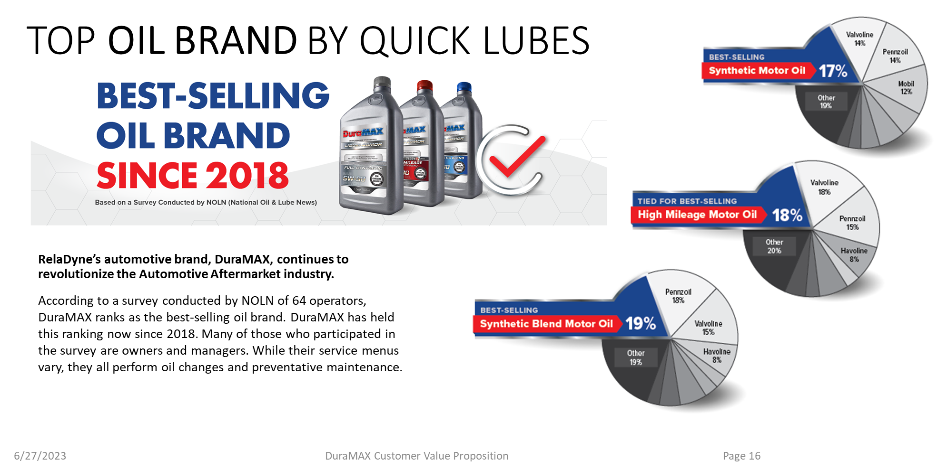
Notes:
LOCKED

Slide 8
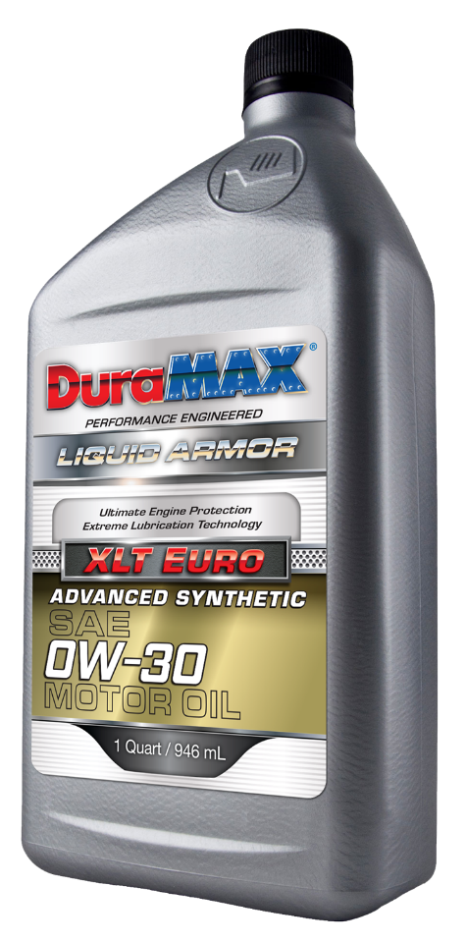
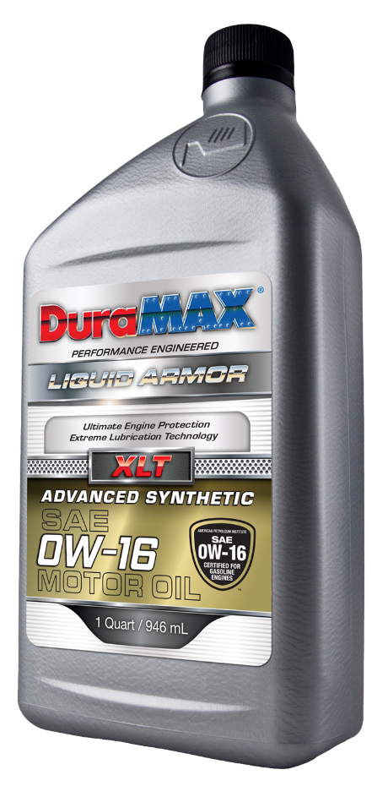
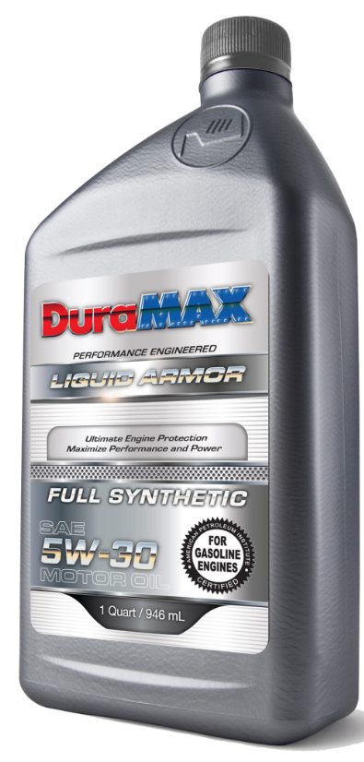
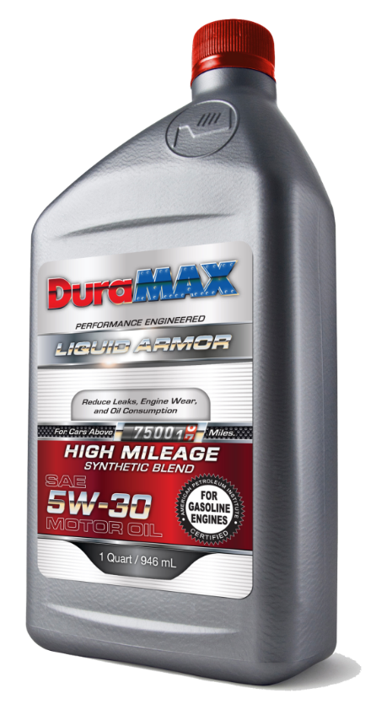
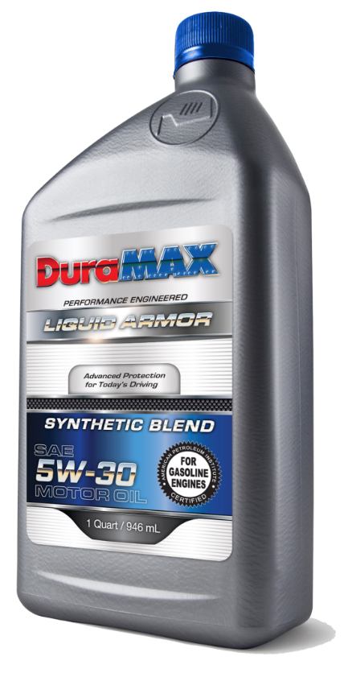
Engine Oil Product Slate
XLT Advanced Euro Synthetic
XLT Advanced Synthetic
Dexos 1 Gen 3 Synthetic
Full Synthetic
High Mileage Synthetic Blend
Synthetic Blend

Slide 9
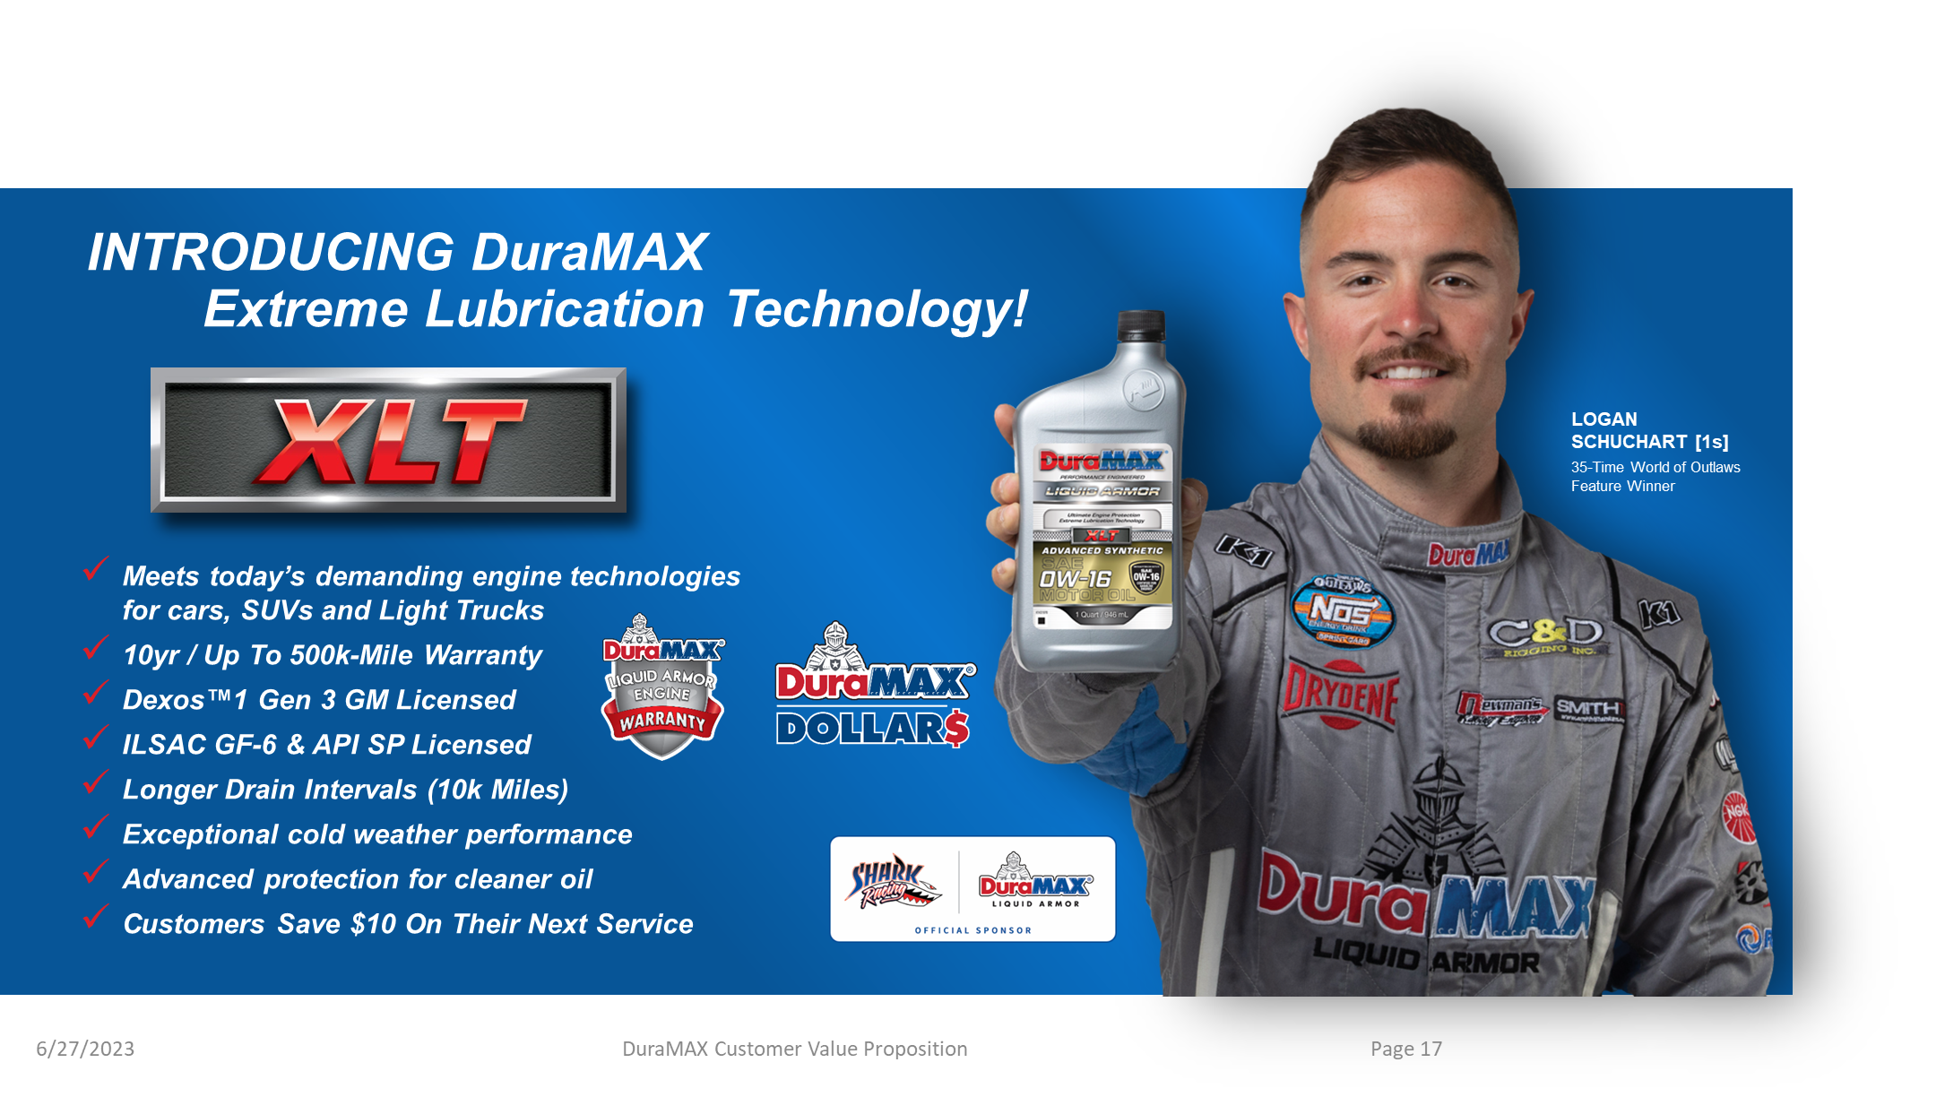
Notes:
LOCKED

Slide 10
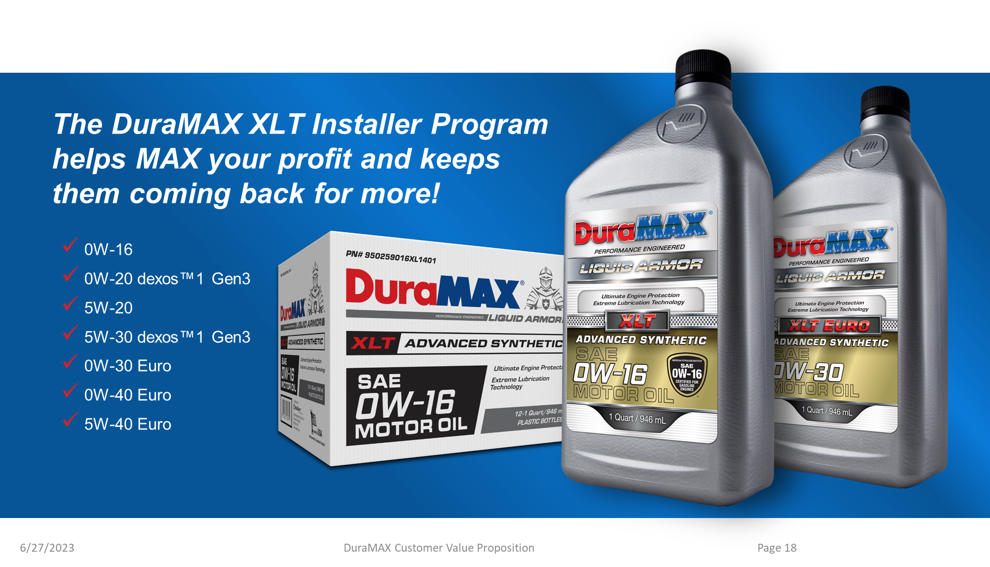
Notes:
LOCKED

Slide 11
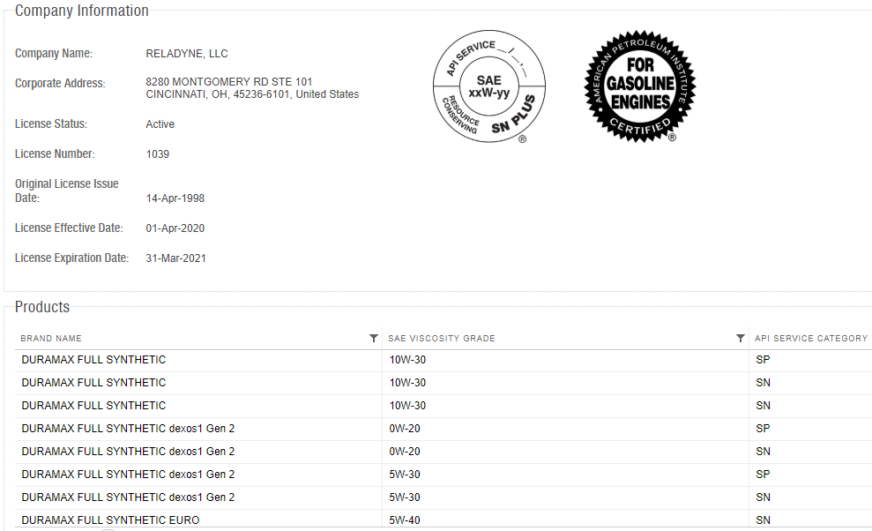
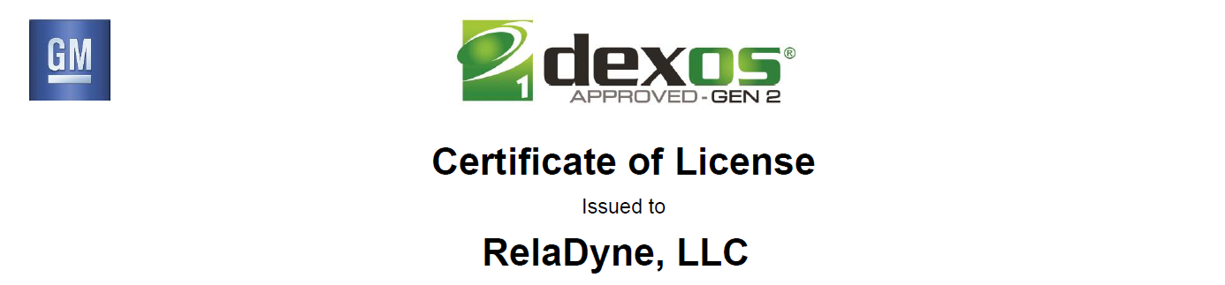
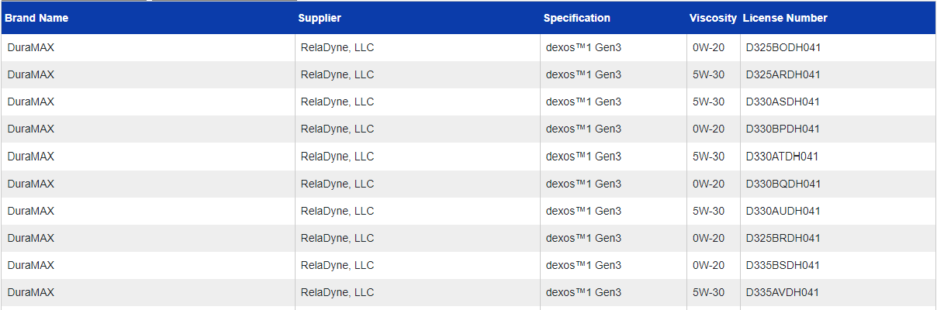
DURAMAX QUALITY OF PRODUCTS
API Licensed
GM dexos1™ Gen 3 Licensed
https://engineoil.api.org/Directory/EolcsSearch
https://www.gmdexos.com/brands/dexos1/index.html

Slide 12
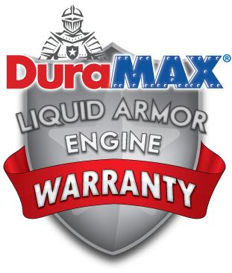
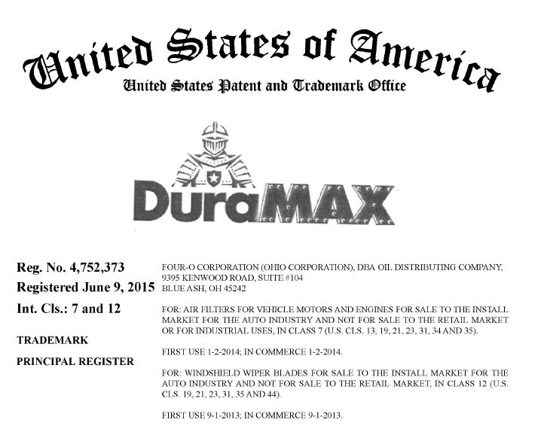

DURAMAX QUALITY OF PRODUCTS
Owned by RelaDyne
Backed by 10-Year, Up to 300k-Mile* Warranty
*The DuraMAX® Liquid Armor Engine Warranty covers 300,000 miles for DuraMAX oils. See www.duramaxwarranty.com for details/terms and conditions.
Part of PQIA in Support of Lubricant Quality and Integrity Assurance

Slide 13
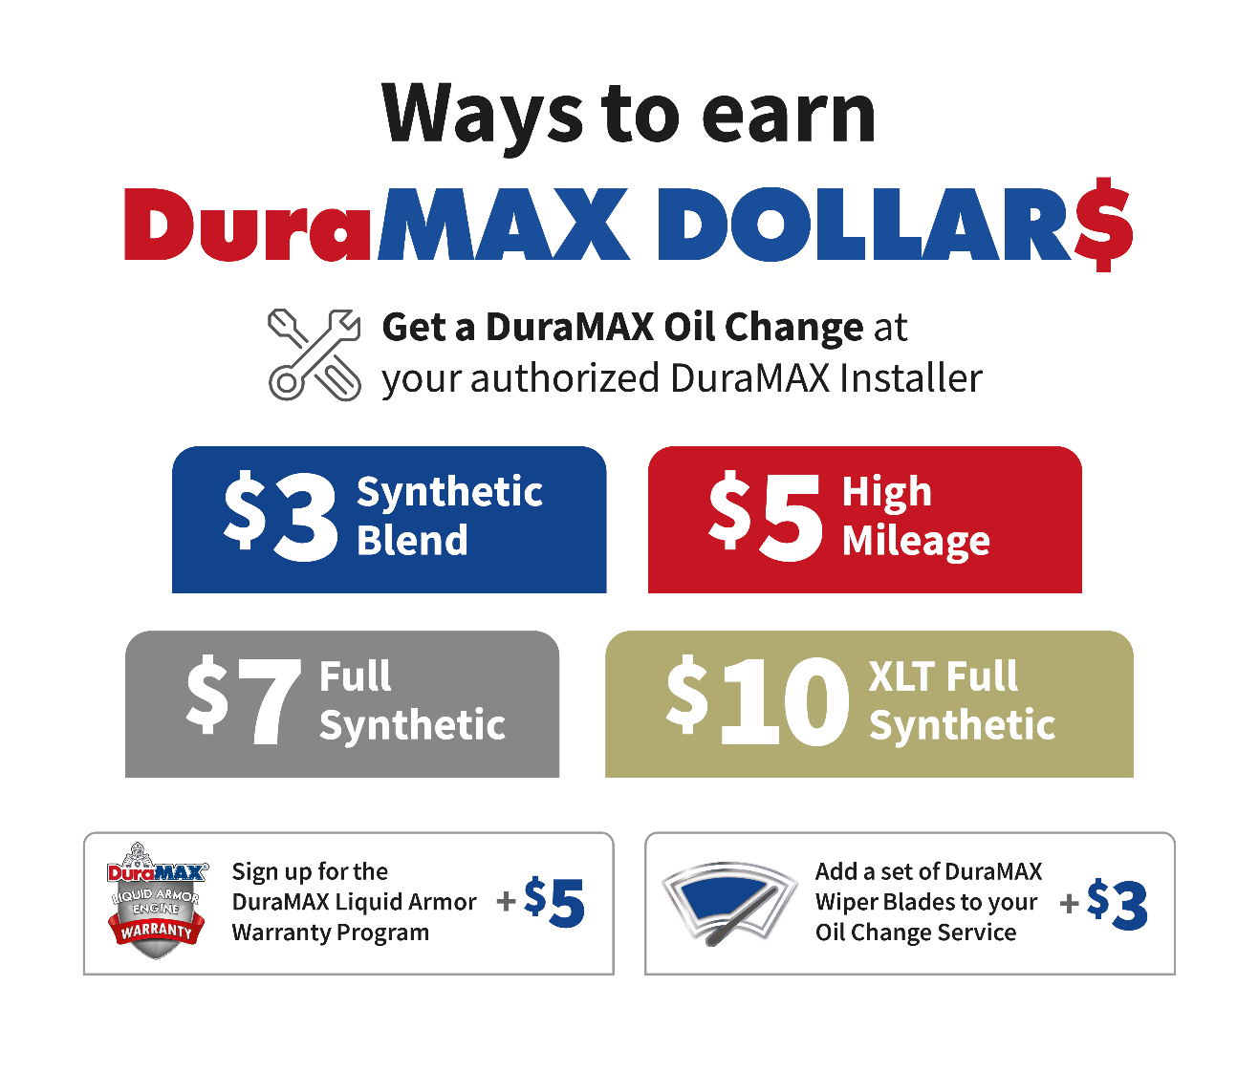
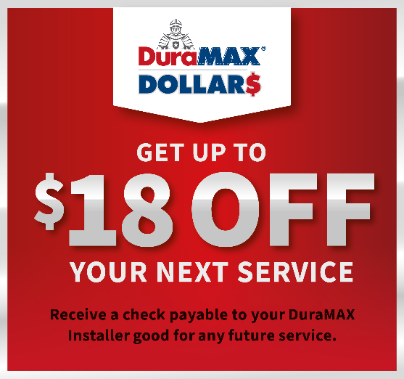
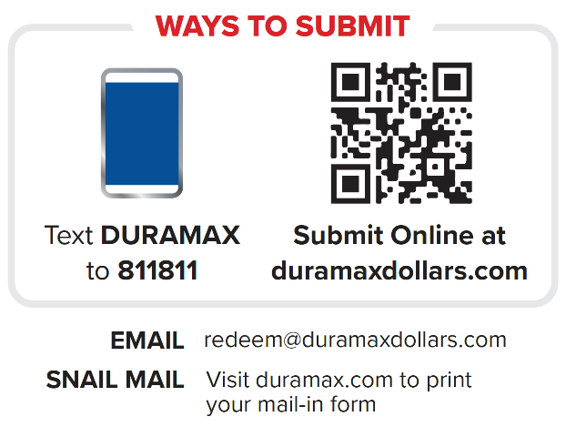
DuraMAX DOLLAR$ PROGRAM
www.DuraMAXDollars.com
Offering your customers up to $18 off
their next Vehicle Service, with a DuraMAX DOLLAR$ check, made payable to you, the Authorized DuraMAX Installer.
Increase your Retention, Frequency, and Profitability
Utilize ongoing DuraMAX DOLLAR$ Program as a retail profit enhancer
Watch Program Video
Notes:
LOCKED

Slide 14
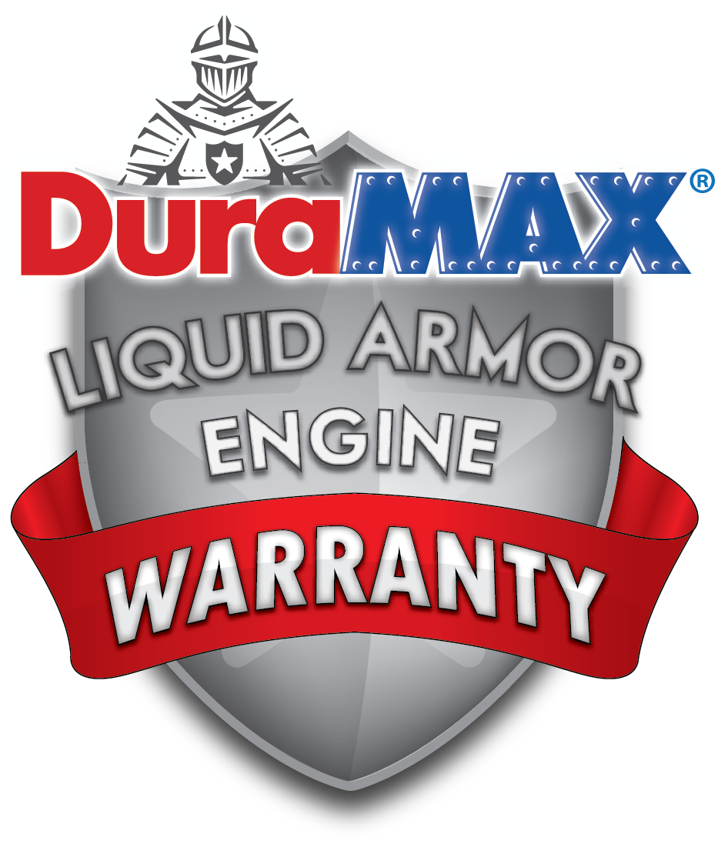
ENGINE WARRANTY PROGRAM
Your customers can receive a $5 DuraMAX DOLLAR$ Check just for enrolling
www.DuraMAXWarranty.com
When your customers use premium DuraMAX Motor Oil and have their oil changed as recommended by the Original Equipment Manufacturer, they will receive a FREE 10-Year/Up to 300,000-Mile* Limited Engine Protection Plan that is completely transferrable.
(*See www.duramaxwarranty.com for details/terms and conditions.)
As a DuraMAX Authorized Warranty Installer, you’ll receive the following benefits:
Increased customer retention and loyalty
Increased profitability
Online features and capabilities:
  Consumers will receive a Service Reminder every 120 days (3 times a year) starting on the day the vehicle was enrolled in the Warranty.
  You, as the Installer, receive 2 Email Marketing Campaigns per Year to send to Warranty enrollees where you can offer service coupons, special deals, or announcements specific to your business.
    Additional email marketing campaigns can be purchased for $50 plus $0.05 per email.
  (See next page for Service Reminder and Email Campaign examples)
Notes:
LOCKED

Slide 15
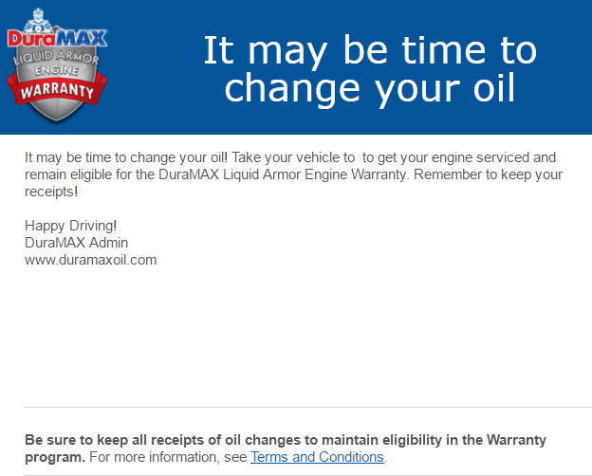
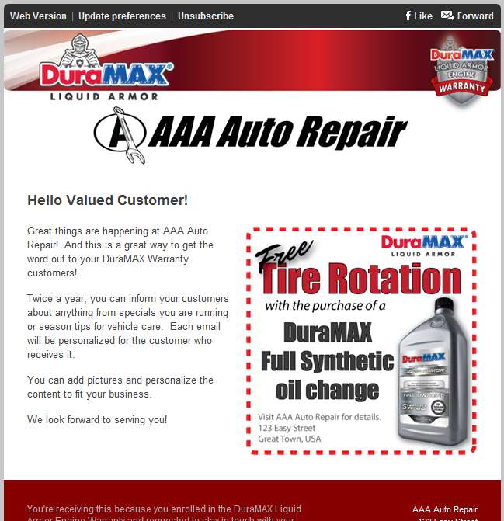


ENGINE WARRANTY PROGRAM
Online Capabilities included in your DuraMAX Authorized Warranty Installer Program
Example 120-Day Service Reminder
Example Email Marketing Campaign
Customized with
your logo and name
Customer Name
goes here
Your Company Name Here!
123 Main St USA
888-123-4567
Include any
promotion you have
Notes:
LOCKED

Slide 16
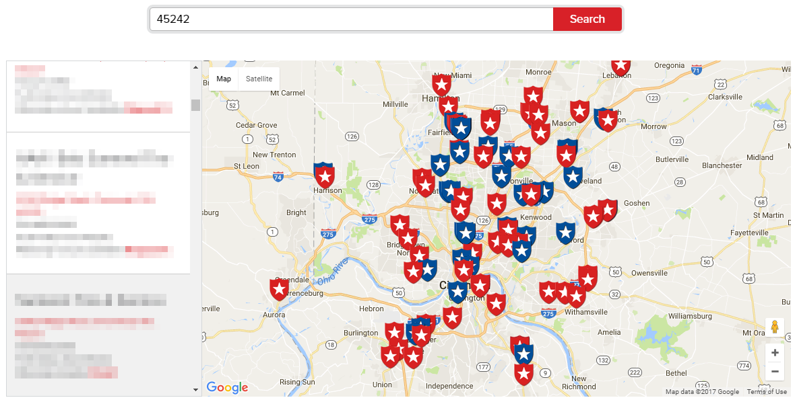
INSTALLER LOCATOR at www.DuraMAX.com
Now, your consumers can learn about DuraMAX products, enroll in the DuraMAX Warranty Program, submit for DuraMAX DOLLAR$, and contact you for service appointments – all from one mobile-friendly location.

Slide 17
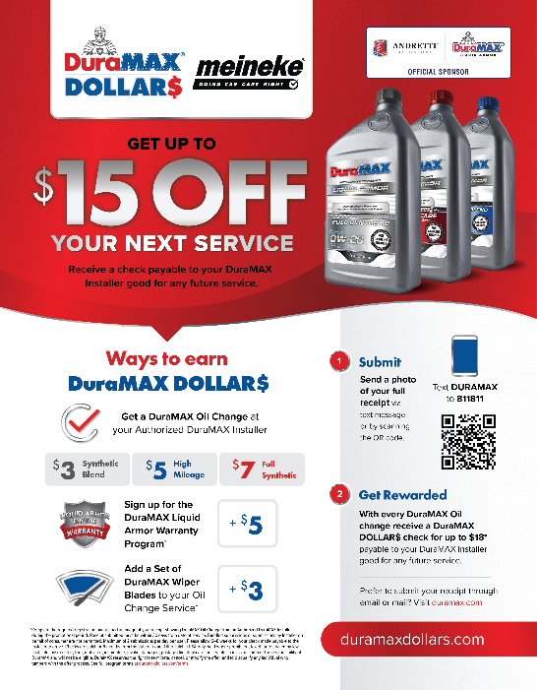
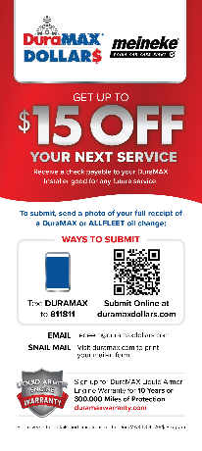

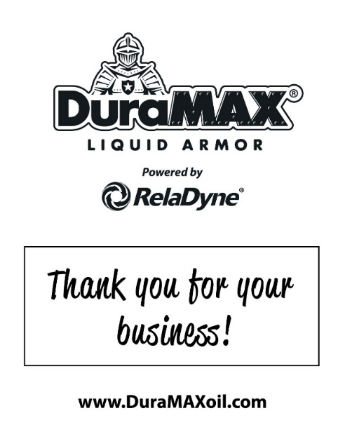
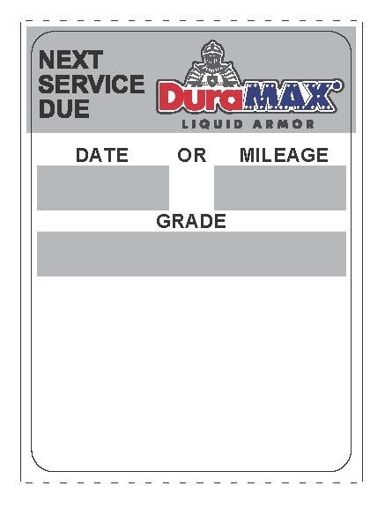
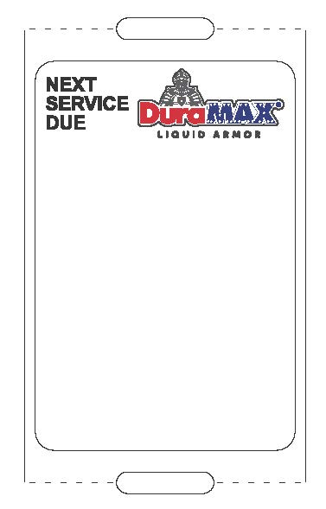
DURAMAX POS ITEMS INCLUDED
Program Flyer
Promo Tear Pads
Floor Mats
Static Cling Stickers
Godex
Zebra

Slide 18
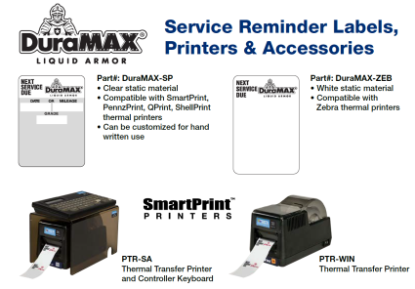
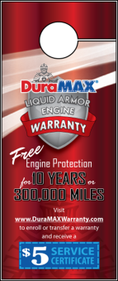

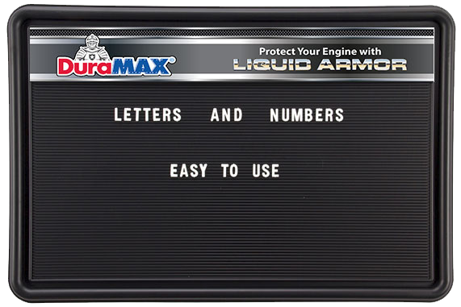
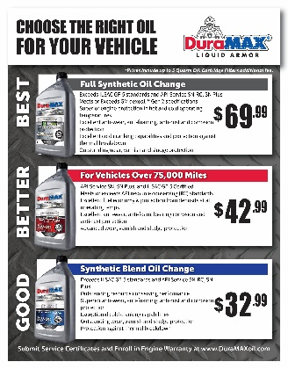
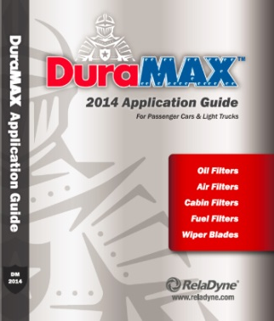

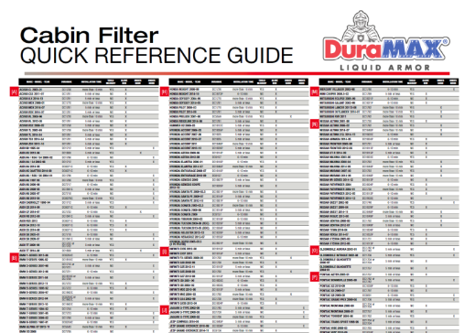
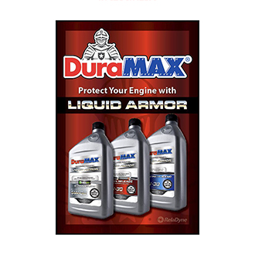
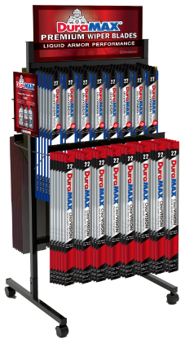
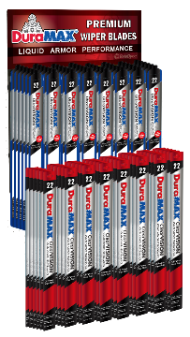

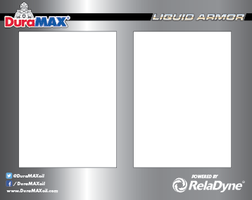

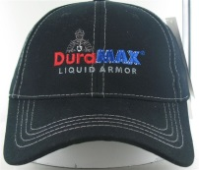
ADDITIONAL POS AVAILABLE
Static Clings Printers
Mirror Dangler
Header Card (Customizable Size)
Customizable Menu Board
Customized Menu Card
Filter & Wiper Blade Application Guide
Customizable Bay Banners
Shop Installation Guide Poster
Poster & Static Clings
2-Sided Floor
Rack
16-Prong Wall Rack
Waiting Room Poster
Counter Mat & Inserts
Apparel

Slide 19
PROGRAM ELEMENTS
2 Price schedules – EAST & WEST ($0.45/gal price differential)
Market Pricing
Pricing is uniform across all locations (subject to note above)
Equipment loan options (4-Year amortization)
  $1 per annual gallon (+$.30 / gal.)
  $2 per annual gallon (+$.60 / gal.)
Marketing Programs
  Dealer participants will have access to all DuraMAX programs & POS materials
    Static cling decal, floor mats & customized Service Certificates @ N/C
Volume & loyalty rebates to be paid to MDPCI

Slide 20
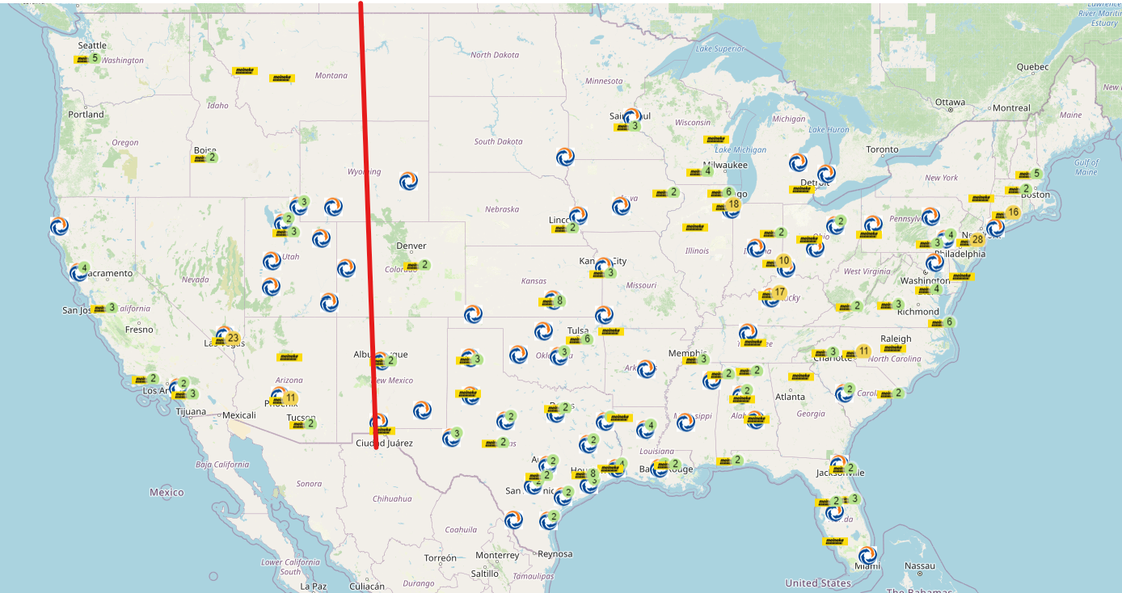
Program Participation
West Pricing
East Pricing
134 Locations

Slide 21
KEY ITEM PRICE SCHEDULE (Eff. 09/11/2023)
PRICE SCHEDULE
Packaged Pricing
Drums: add $1.00 gal to bulk
Product | Packaging | Price- East / West
DuraMAX Synthetic Blend 5w20 / 5w30 Motor Oil | Bulk | $7.45 / $7.90
DuraMAX High Mileage 5w20 / 5w30 Motor Oil | Bulk | $8.65/ $9.10
DuraMAX dexos1™ Gen 3 Full Synthetic 0w20 / 5w30 Motor Oil | Bulk | $10.65/ $11.10
DuraMAX Global ATF | Bulk | $11.95/ $12.40
Notes:
Market Pricing
West coast pricing add +$.45/gal
Terms: 30 days
CONFIDENTIALITY: This quote is offered only for the entity or organization listed above. It contains confidential and/or privileged material. Dissemination or retransmission of this quote is strictly prohibited. Violation or breach of any provision of this agreement will void the offer.

Slide 22
MDPCI REBATES
In addition to the other program components, there are rebates and accruals earned with our program:
    3% MDPCI Co-op (paid quarterly)
    2% MDPCI Loyalty Trip rebate (paid quarterly)
    MDPCI Volume Incentive rebate (paid annually)

Slide 23
MDPCI VOLUME REBATE
ANNUAL VOLUME | 250,000 - 499,999 | 500,000 - 999,999 | 1,000,000 - 1,499,999 | 1,500,000 +
PRODUCT
DuraMAX Synthetic Blend | $0.05 | $0.10 | $0.15 | $0.20
DuraMAX Syn Blend High Mileage | $0.10 | $0.20 | $0.30 | $0.40
DuraMAX Full Synthetic | $0.20 | $0.40 | $0.60 | $0.80
Notes:
Rebate paid to MDPCI and distributed to members- current run rate approaching 200K

Slide 24
ORDERING PROCESS
MDPCI franchisees can order via several methods:
  Email: MeinekeOrders@reladyne.com
  Web: https://info.reladyne.com/Meineke via Order Form link
  Customer Portal: My.RelaDyne.com
  Phone: by contacting local RelaDyne branch or Territory Sales Rep

Slide 25
DELIVERY COMMITMENTS
All orders delivered within 3 business days of P.O. receipt
Minimum delivery = 165 gallons aggregate all products
Minimum bulk delivery = 100 gallons PER BULK SKU
Less than minimum volume fee of $75 per delivery
Product portfolio includes all DuraMAX products, including filters, wiper blades & chemicals (where available)
Products not on authorized list can be sold through RelaDyne branch

Slide 26

Lube Advisor
Dedicated application and oil selector site
Will provide all product options
Will have applications for DuraMAX & Drydene

Slide 27
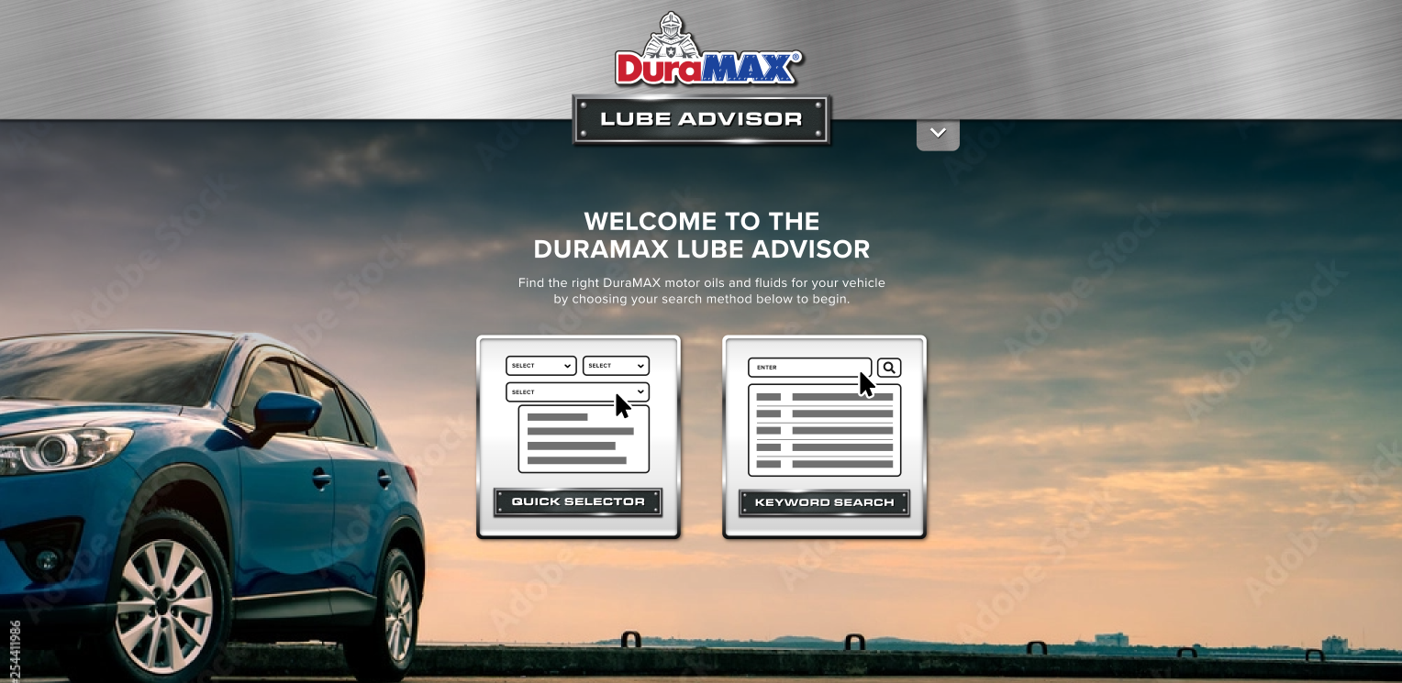
Lube Advisor

Slide 28
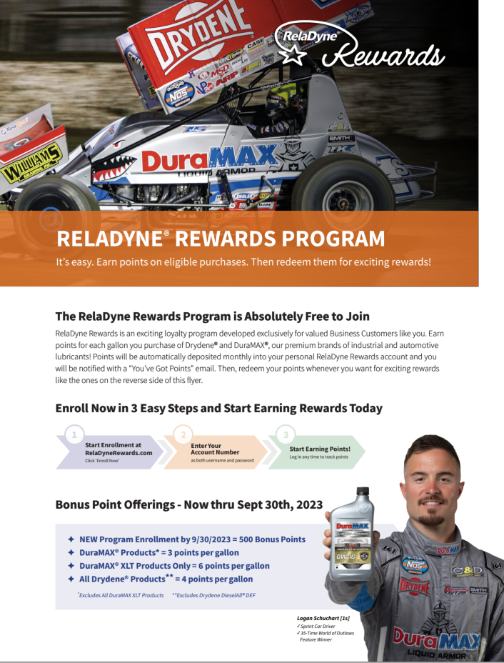
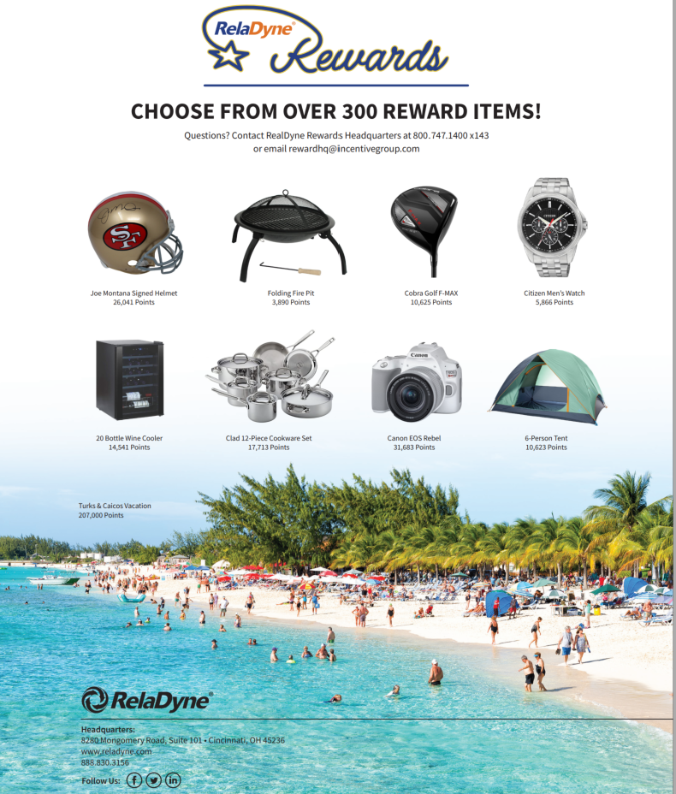
RelaDyne Rewards

Slide 29
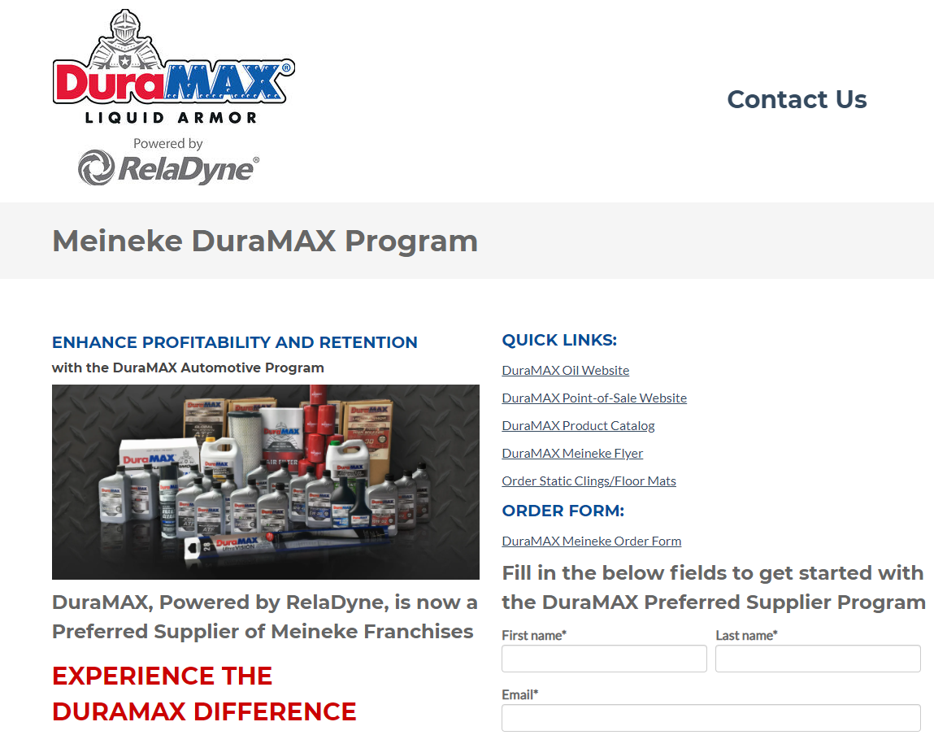
MORE INFORMATION?
info.reladyne.com/meineke

Slide 30
MDA ACCOUNT CONTACT
David Barnett, Corporate Account Manager
  David.Barnett@reladyne.com
  (502) 751-8020

Slide 31
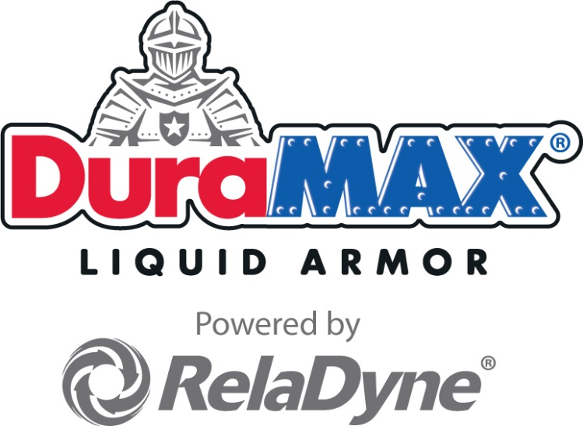
Thank you !

