Slide 1
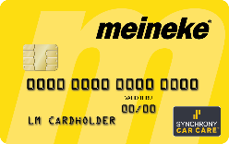
MEINEKE CARD
MEINEKE
October 11, 2023
Jerry Powers
Troy Myers

Slide 2
Penetration Rate
Definition
Store Pen Rate = What % of your Store Sales are from financing?
5% = Synchrony’s Industry Average Penetration rate in Auto Service and Repair
10% = Pen Rate in the Auto Service & Repair is GOOD.
Meineke’s Financing Pen Rate in 2022 = 6.3%

Slide 3
Meineke Card = Turning Applications into Sales
2023 Goal = 6 Applications per store per week.
What can that mean for Meineke Sales Growth?
$153,216
Sales per year
144 new accounts
x $1,064 First Average Ticket =
6 applications per store per week yields
24
applications
per month
24 applications
per month x 12 Months
288
applications per year
288 applications per year
X 50% approval rate =
144
NEW Accounts per year
+ $96,048
(144 new accounts x $667 Repeat)
$249,264
Sales per year
Over 3 years = $747,792

Slide 4
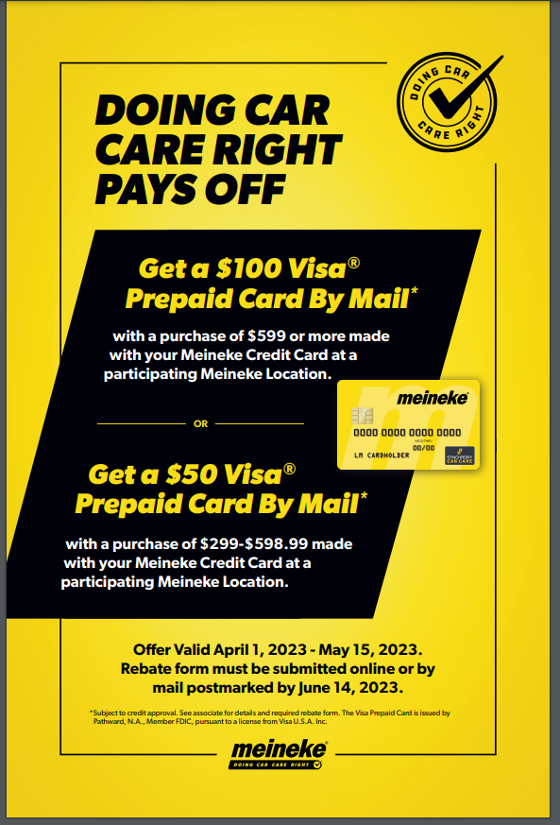
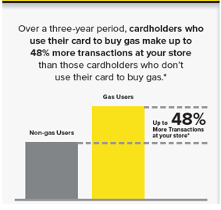
Meineke Card Information
Deferred Interest Financing
6 months on any purchase $199+
12 months on any purchase $750+ (Optional)
Increase Sales, Increase Repeat
$1,064 Average FIRST Ticket
$667 Average Repeat
60% of Meineke Cardholders repeat
Customer Loyalty/Brand Awareness
Create a customer for life
Ignite Associate Application Incentive
$25 for 5 applications
www.igniterecognition.com/synchrony
#1 Way to Succeed =
MEMO = Mention Early, Mention Often

Slide 5
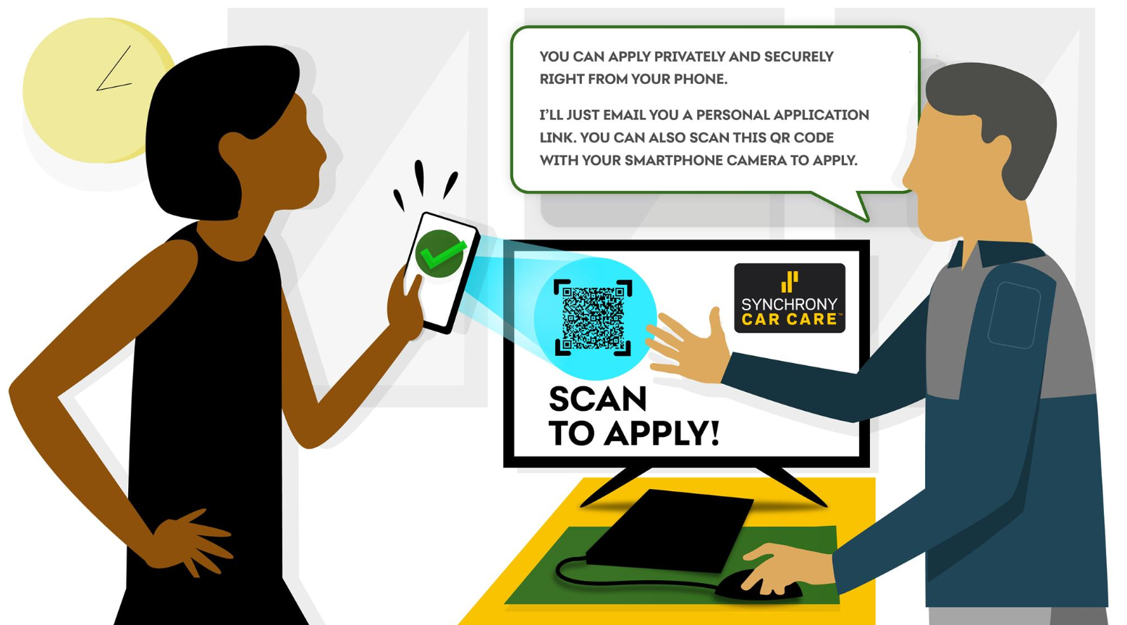
Business Center EMAIL To Device
Benefits of Direct to Device
Private
Fast
Safe & Secure
Paperless (No Printing)
How to use Direct to Device in Business Center
Go to www.bc.syf.com
Click “New Credit Application Page” in Business Center.
Click “Send to the Customer's Device.”
Notes:
Birst
D2D Filters for in-store
Agent Name = client
Date Range = 5/12/21 – current date
Channel = BC POS/BC
D2D Filters for D2D
Agent Name = client
Date Range = 5/12/21 – current date
Sub Channel = D2D

Slide 6
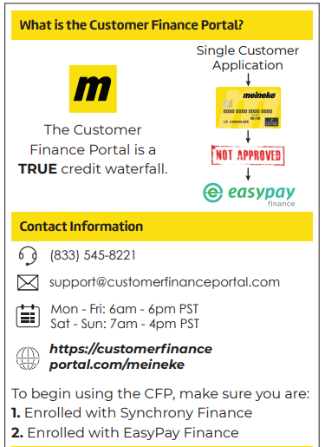
The Meineke Card Consumer Finance Portal (“The Waterfall”)
Easy Pay Waterfall
360 Payments Waterfall
The Meineke Card
New and Improved “Waterfall”
Customer Application Flow
Primary
Option
Secondary
Options
In Partnership with 360 Payments

Slide 7
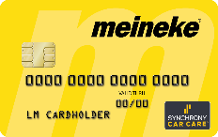
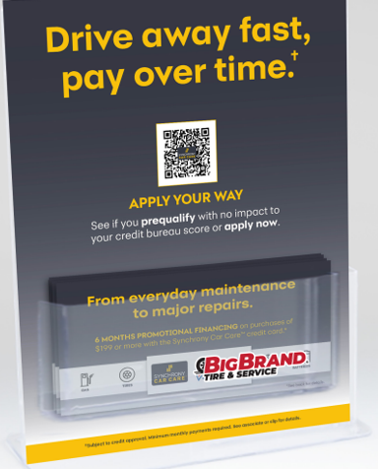
Apply Your Way
Objective: To generate an additional application/prequal option for guests.
Key Points:
In-store sign that includes a unique QR code that when scanned takes the customer to the digital apply and prequal options. Upon approval the temporary shopping pass is delivered to the customer.
Application will be tied back to the store MID.
Strategy:
Synchrony Car Care Branded + Meineke Branded
Ship to all stores 1 Kit per store includes
1 display sign w/ unique QR Code (by store MID)
100 inserts to each location
Instructions, tips and directions to reorder inserts
Inserts will include unique QR code, store name, store #, address

Slide 8
WRAP UP -
Sales – Make the Meineke Card a Priority
Set a Daily Application Goal (1 application per day)
MEMO – Mention Early Mention Often
Use the waterfall strategy with SYF and a secondary
Training with Synchrony
Results
Maximize Sales ($1,064 average first ticket)
Driving Repeat (60% Meineke Cardholders return)
Increase Employee Engagement
Notes:
Birst
D2D Filters for in-store
Agent Name = client
Date Range = 5/12/21 – current date
Channel = BC POS/BC
D2D Filters for D2D
Agent Name = client
Date Range = 5/12/21 – current date
Sub Channel = D2D

