Slide 1
2023 Fall MDA
Regional Meeting
Region 3
Joel Cruz and Anthony Torino
Business Development Officer
October 2023

Slide 2
Specialized Financing Solutions – Franchise Lending
Who we are
Nationwide Franchise Lending Division within Bank of America Small Business Banking
Specialized salesforce with a strong understanding of the brand and franchise model
Dedicated underwriting team with a streamlined process for quicker turn times and better client experience
Over $1B in funded franchise loans since 2013

Slide 3
Specialized Financing Solutions – Franchise Lending
What we provide
Customized lending solutions for all brand needs:
Acquisition
Real Estate
Partner Buyout
Lines of Credit
SBA (7a, 504, Express) and Conventional Lending Products
Fixed Rates
Offer best in market conventional rates

Slide 4
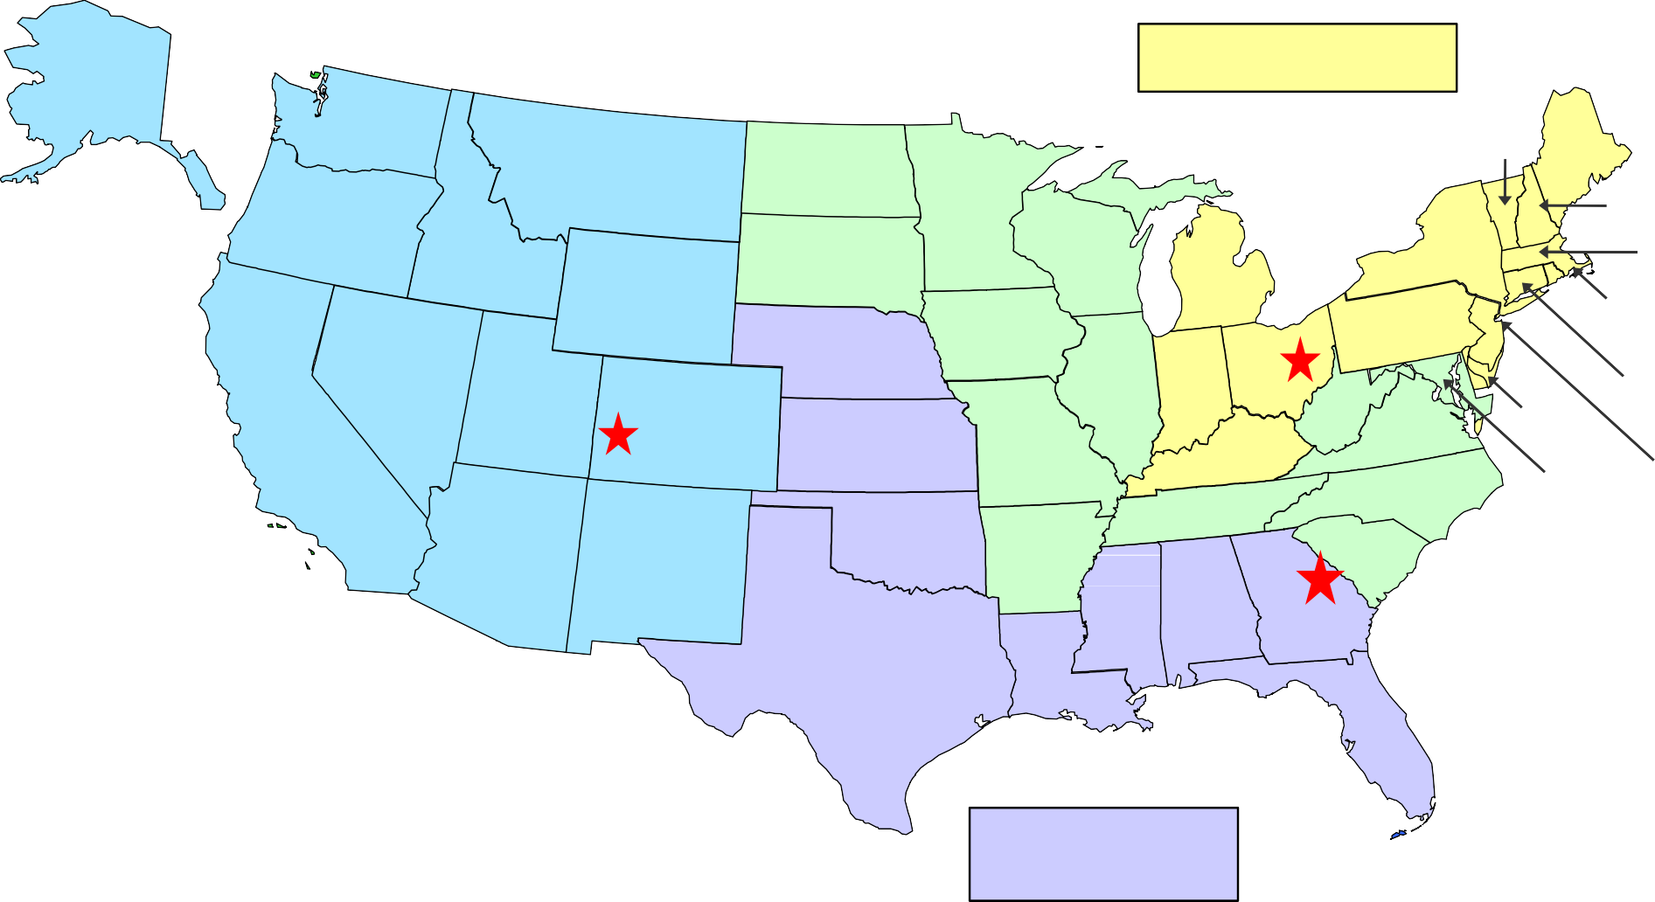
Business Development Officer – Territory Map
Joel Cruz
Eastern & Central Divisions
AK
WA
VT
ME
MT
ND
OR
MN
NH
ID
SD
WI
NY
MA
WY
MI
RI
NE
IA
PA
NV
IL
IN
OH
CT
HI
CA
UT
WV
DE
CO
KS
MO
VA
KY
NJ
TN
NC
MD
AZ
OK
AR
SC
NM
MS
AL
GA
TX
LA
Anthony Torino Atlantic & Midwest Divisions
FL
Javier Zuniga Western & Mountain Divisions
Monica Hunt Southern & Southwest Divisions

Slide 5
BDO Contact Information
Regional BDO | States | Contact Information
Joel Cruz – Eastern / Central Region | ME, VT, NH, MA, RI, CT, DE, NJ, OH, KY, IN, MI | 813-362-4732 Joel_.Cruz@bofa.com
Monica Hunt – Southern / Southwest Region | FL, GA, AL, MS, LA, NE, KS, OK, TX | 415-319-0473 Monica.Hunt@bofa.com
Anthony Torino – Atlantic / Midwest Region | AR, MD, WV, VA, NC, SC, TN, MO, IL, IA, WI, MN, ND, SD | 404-395-2704 Anthony.Torino@bofa.com
Javier Zuniga – Western / Mountain Region | NM, CO, WY, MT, ID, UT, AZ, NV, WA, OR, CA, AK, HI | 840-201-0618 Javier.Zuniga@bofa.com

Slide 6
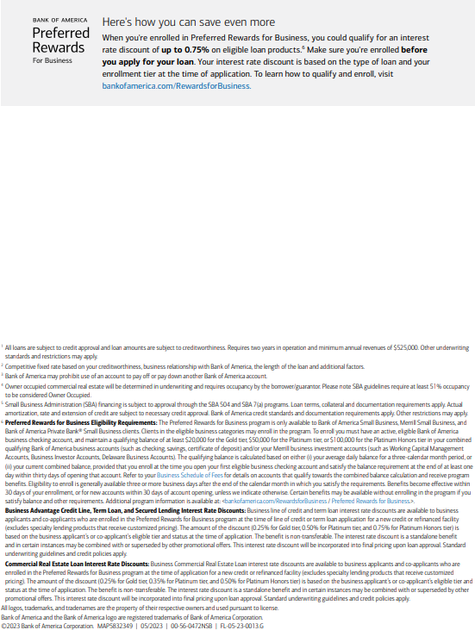

Slide 7
Thank you!
Questions?
Joel Cruz
Small Business – Franchise Solutions Business Development Officer 813.362.4732
joel_.cruz@BofA.com
Anthony Torino
Small Business – Franchise Solutions Business Development Officer 404.395.2704
anthony.torinoBofA.com

