Slide 1
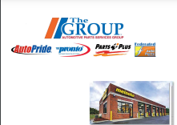
St. Louis Regional Meeting
October 2023

Slide 2
Who is Automotive Parts Services Group?
National supplier of replacement parts to the automotive industry, with major distribution centers in each state and a national delivery footprint

Slide 3
Four Organizations merged as one to provide increased national footprint and to provide
quality products for the Automotive Repair Industry!

Slide 6
