Slide 4
•
•
•
•
•
•
•
•
•
•
•
•
•

Slide 5
The unquestionable leader in creating a sense of urgency and driving traffic
The most cost- efficient channel available to engage existing customers (and prospective) to educate, motivate and convert
Mobile geofencing technology can amplify your message to the same homes that receive your mailers.
Proximity is often the difference between consideration and dismissal. So, leverage mobile geo-fencing technology to reach those in the moment of consideration

Slide 6
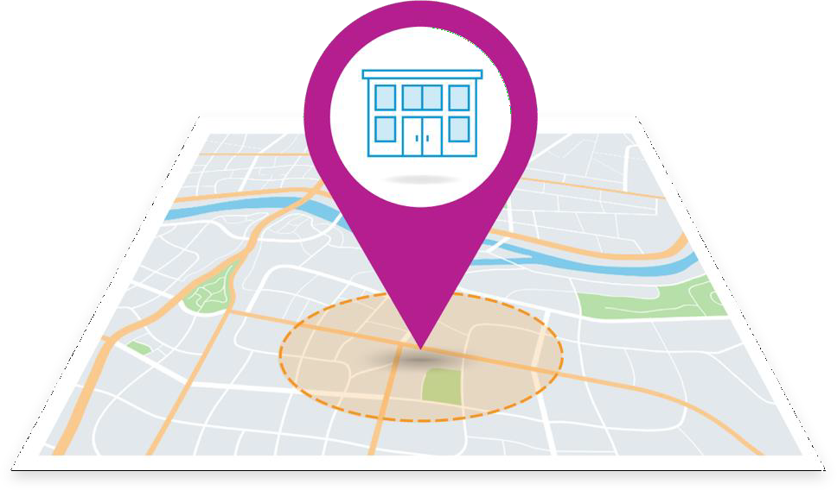
•
•
•
•
•
•
•

Slide 7
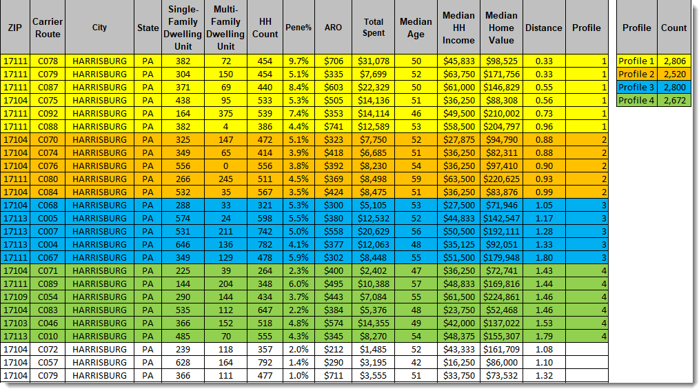

Slide 9
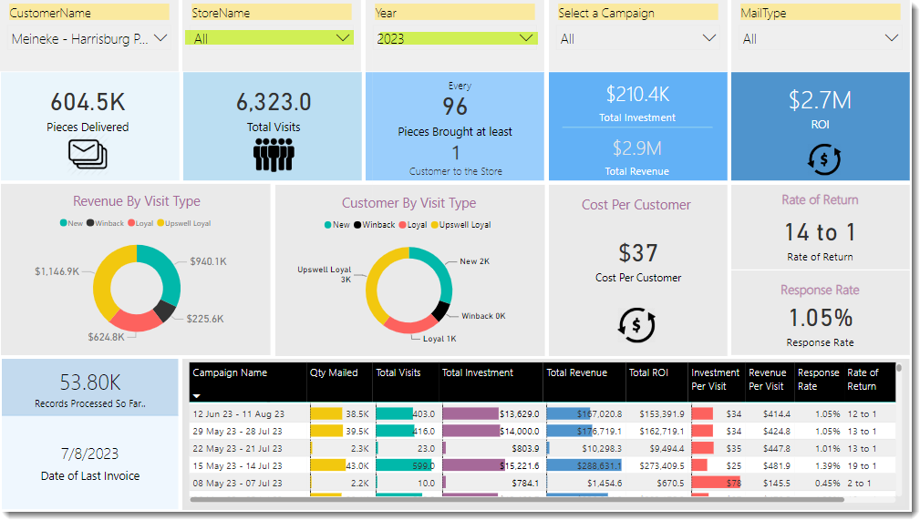
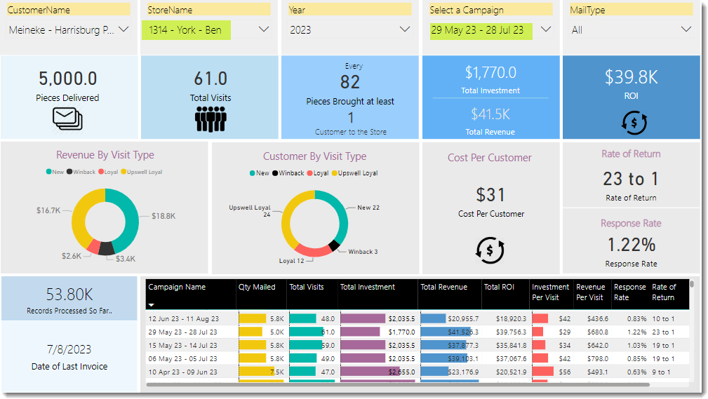

Slide 10
•
•
•
•
•
•
•

Slide 11
Geography
Home
Auto
Auto Owner
Auto Make
Household Income
Under $20,000
$20,000 - $29,999
$30,000 - $39,999
$40,000 - $49,999
$50,000 - $59,999
$60,000 - $69,999
$70,000 - $79,999
$80,000 - $89,999
$90,000 - $99,999
$100,000 - $124,999
$125,000 - $149,999
$150,000 - $174,999
$175,000 - $199,999
$200,000 - $249,999
$250,000 - $299,999
$300,000 - $399,999
$400,000 - $499,999
$500,000 Plus
State
DMA
CBSA
County
SCF
City
•
Home Value
Dwelling Type
Year Built
Mortgage Amount
Mortgage Loan Type
Home Structure
Length of Residence
Number in HH
Renters
•
Auto Model
Auto Type/Body
Number of Doors
Engine/Transmission
MSRP
Auto Intender
•
Aggregated data pulled through websites, survey and sweepstakes sites, as well as a licensed third-party data source.
Data is cleaned internally as well as via secondary partners for data hygiene to ensure
a healthy and deliverable email address.
Data overlayed to licensed postal files for further lifestyle demographic characteristics.

Slide 12
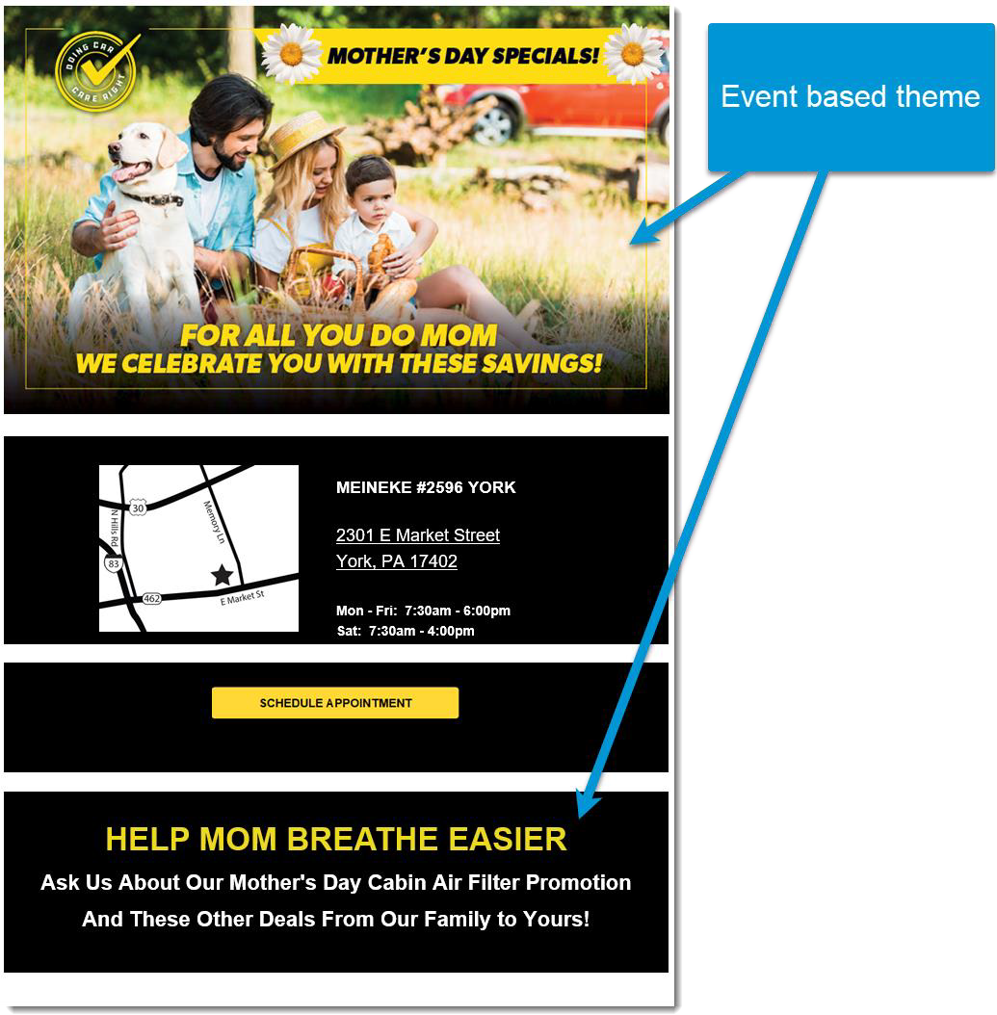
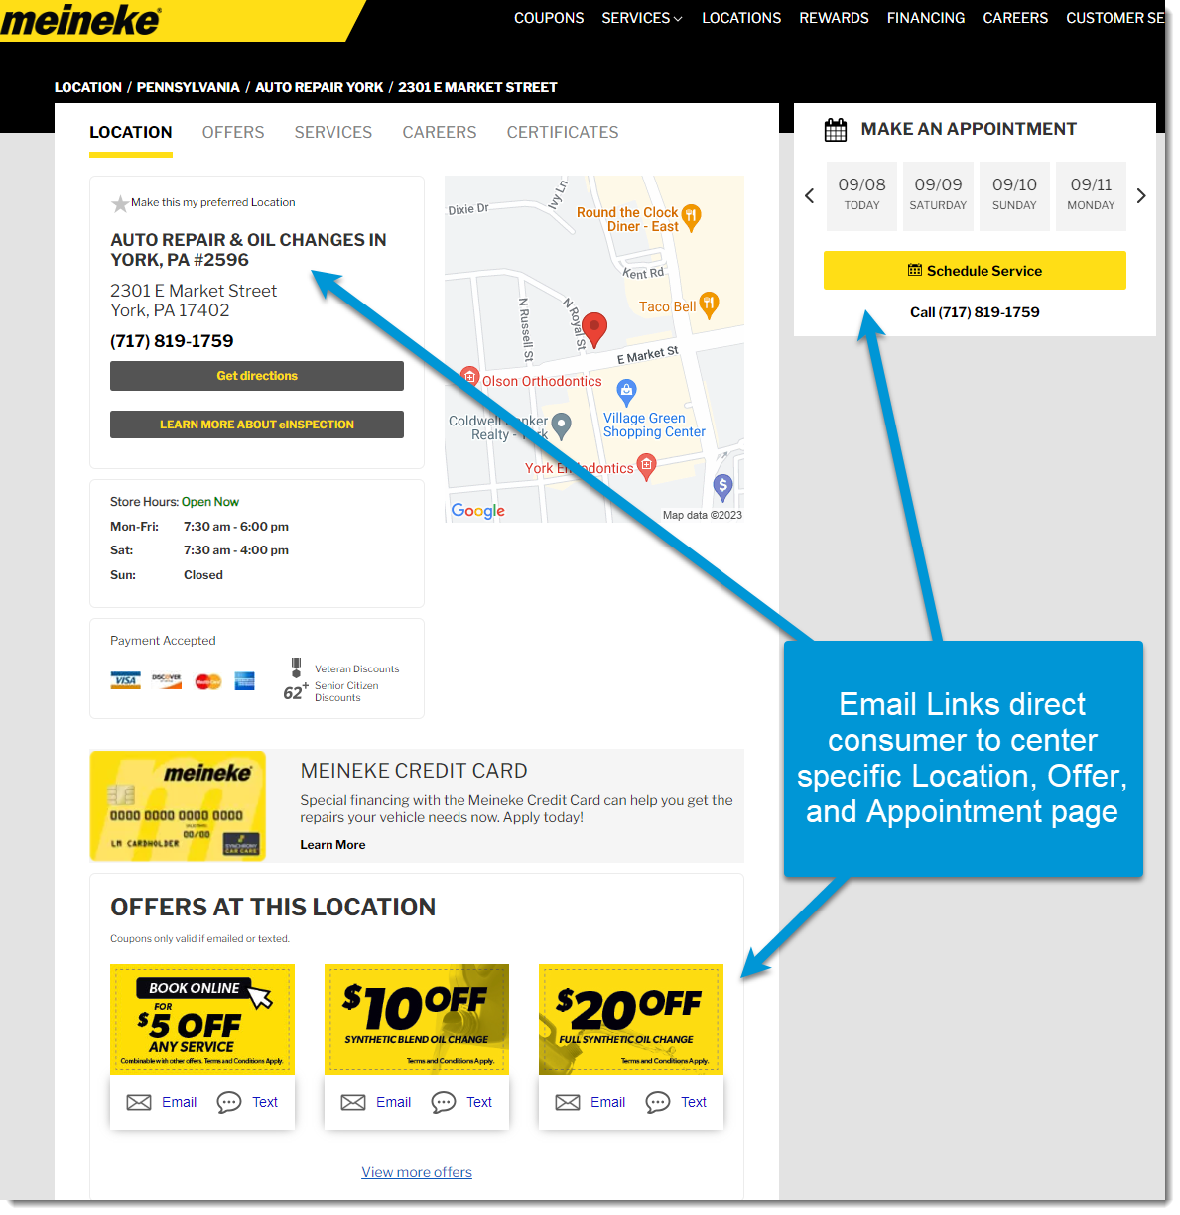

Slide 13
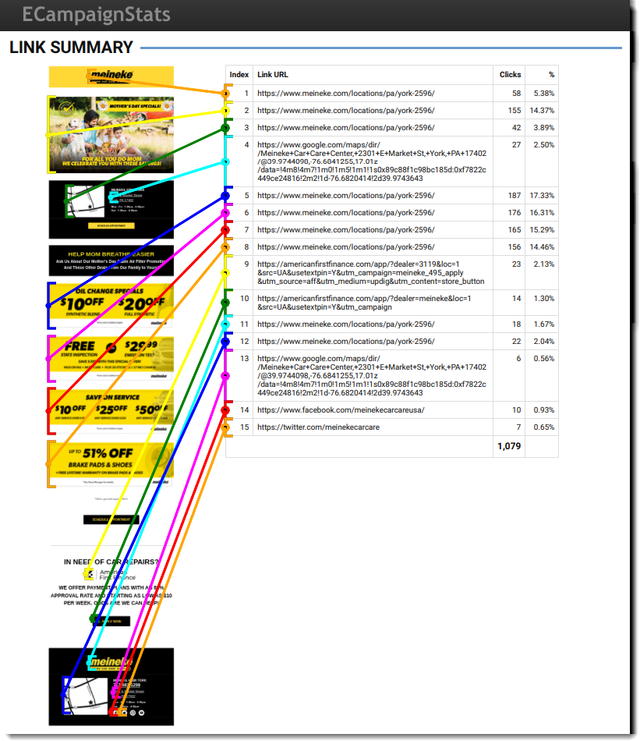
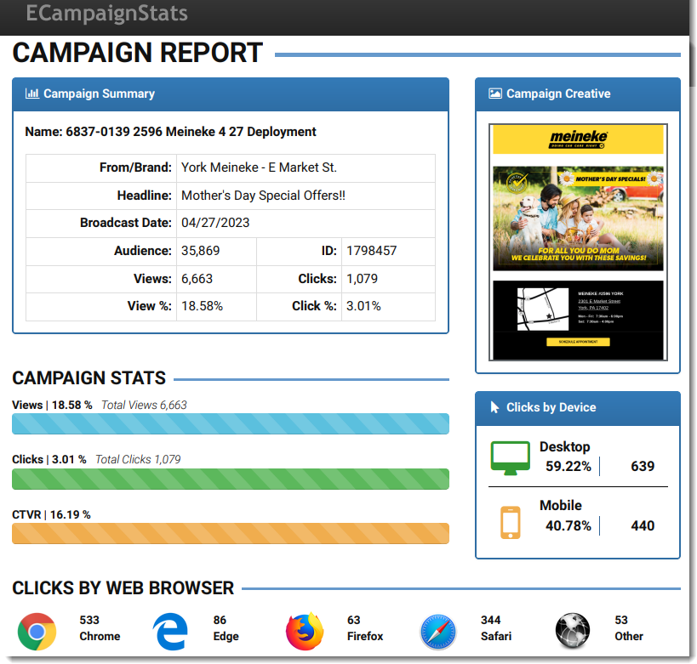
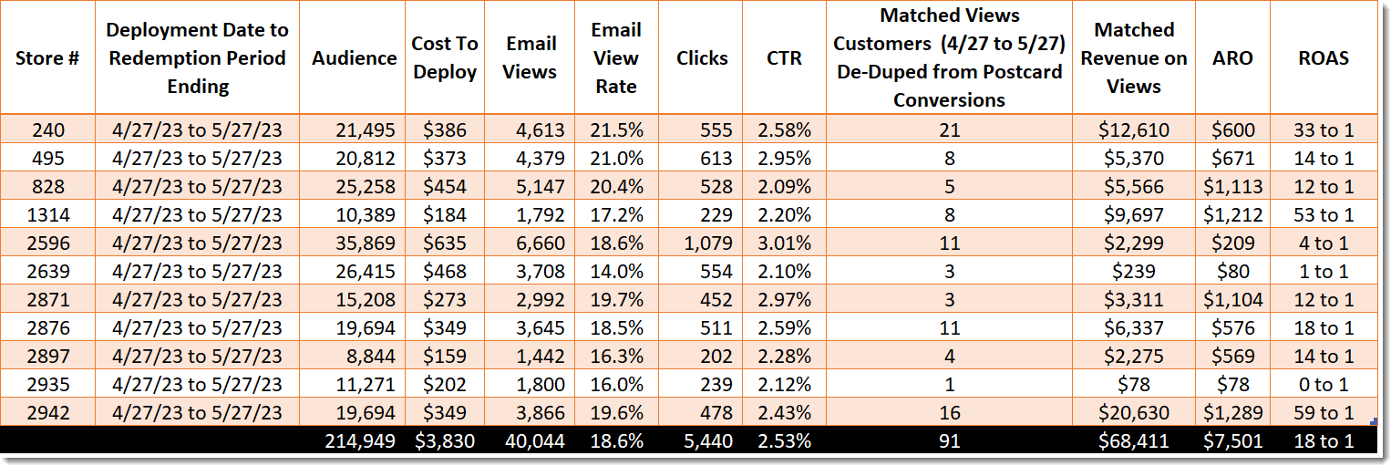

Slide 14
•
•
•
•
•
•

