Slide 1


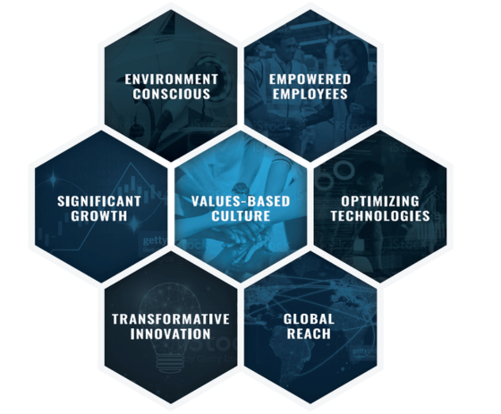

Transtar Overview
Mike Melaragno
OCT 2023 MDA Regional meeting – Denver, co

Slide 2
Agenda
  Welcome
  Transtar overview
    Who we are
    Products
    Brands
    Meineke program
  What’s New – Training videos, products and location expansion
  Q3 Results
  Transend – www.transend.us
  Transmission cores and warranty
  Contacts

Slide 3
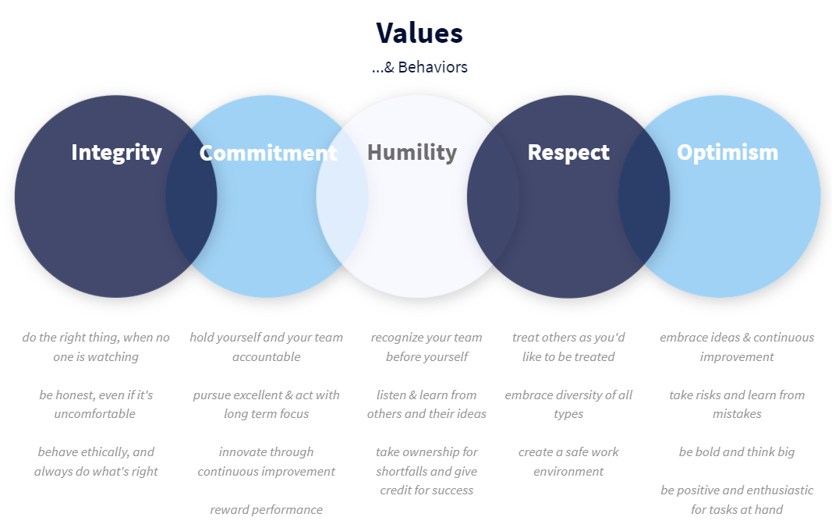





Who are we
Simplifying complex vehicle repair to keep the world moving
QUICK FACTS
Founded in 1975 in Cleveland, OH
Global leader in transmission and driveline-related solutions
70 locations in the US & Canada
PRODUCTS
Air Conditioning
Remanufactured & OE Recylced Transmissions
Specialty Fluids
Transmission Filters & Filter Kits
Remote Assisted Programming RAP® 2
Driveline

Slide 4




Company Locations and Service
Serving 20,000+ customers with same or next day deliveries.
Distribution Centers
US Branch Warehouses
Canada Branch Warehouses
Remanufacturing
All facilities operate on the same advanced ERP, forecast and demand planning systems which effectively manage branch fulfillment and inventory levels across an expansive North American footprint.

Slide 5
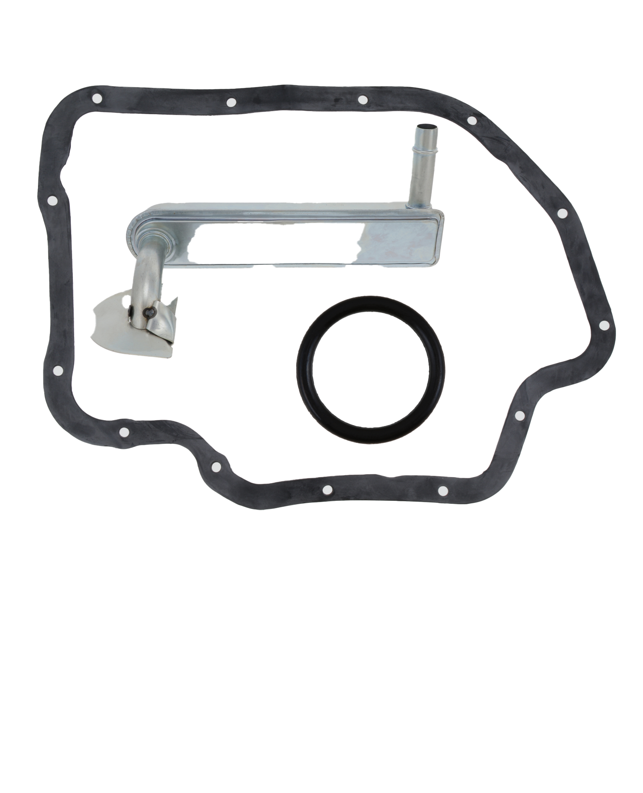
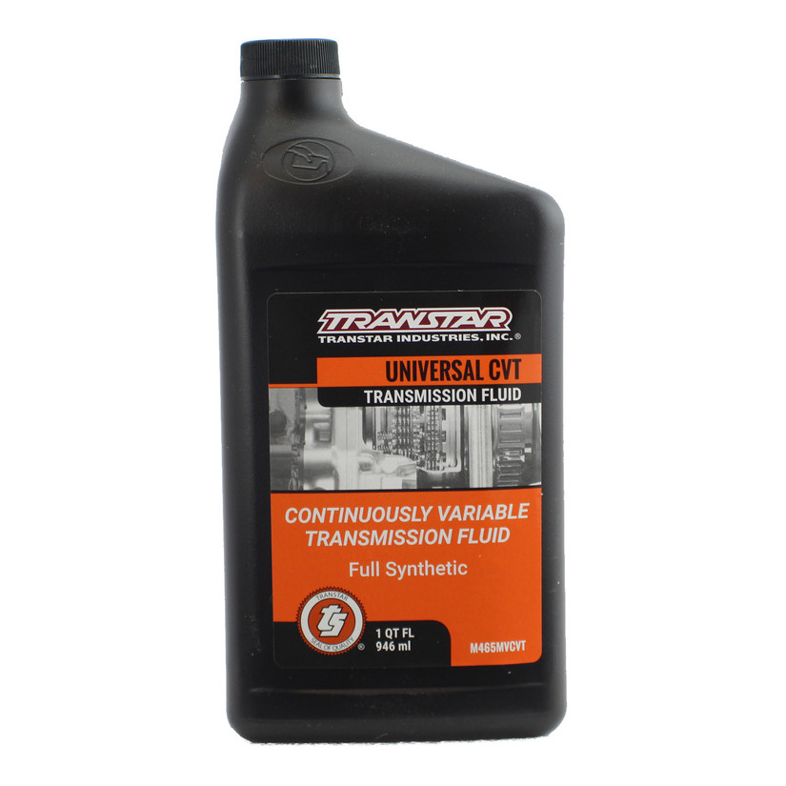
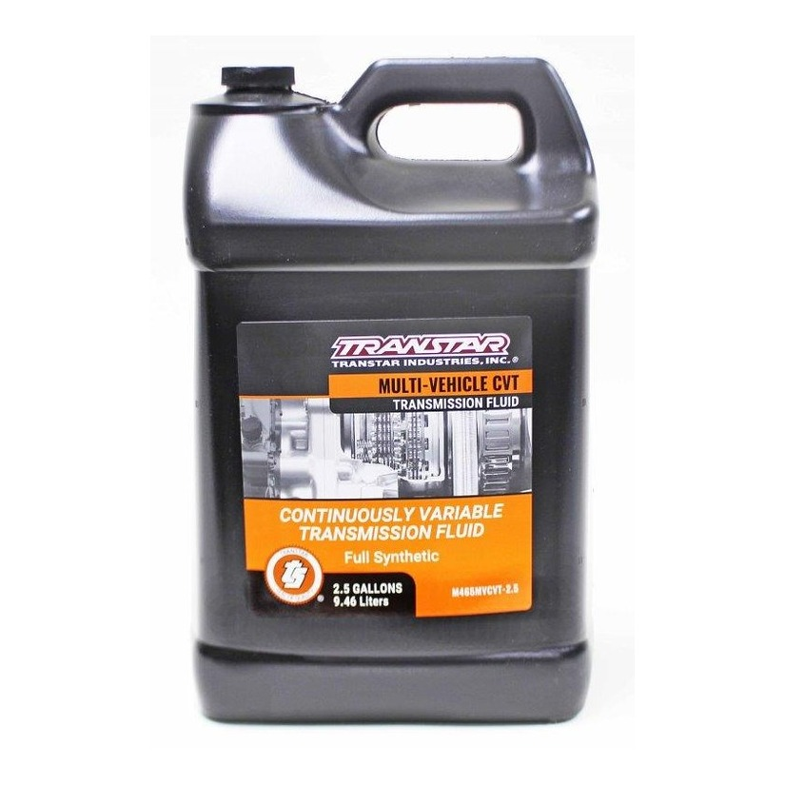
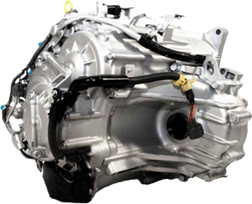
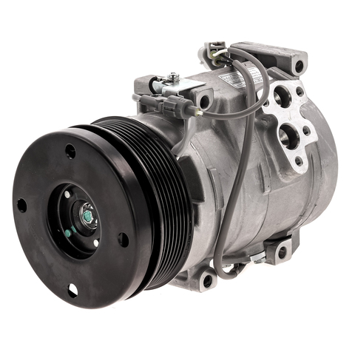
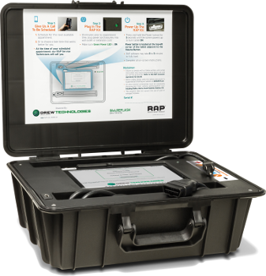
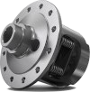
INDUSTRY LEADING PRODUCTS
Remanufactured Transmissions
Filters & Filter Kits
Fluids
Transtar's full line of OE-quality automatic and standard transmissions and transfer case units are remanufactured in the U.S.A. with the latest OE Updates and are backed by an industry leading warranty.
Transtar offers transmission filters and transmission filter kits for every budget with a line of OE quality and aftermarket quality filters across many applications.
We carry a large selection of Transtar-branded transmission fluids, which include Allison Certified. Available in quarts, 2.5 gallons, and 55-gallon drums.
Air Conditioning
Differentials
Remote Assisted Programming
Transtar’s private label AC products meet or exceed OE specifications. Coverage extends from 1970 to today.
Transtar's differential program is built on quality, with the most extensive, up-to-date and accurate coverage on our parts, with more than 7,000 items covering over 150 differential series.
With Rap2 you can flash vehicles in your shop quickly and accurately without the costs of an outside mobile programmer, subscription services, or getting the vehicle to a dealership.
Transtar offers more than 40,000 active S K U ‘ s comprising the most comprehensive transmission and driveline product offering in the world.

Slide 6
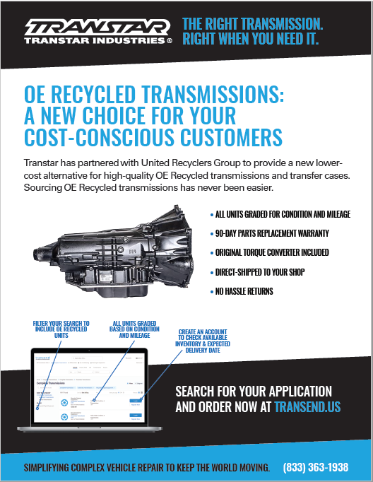
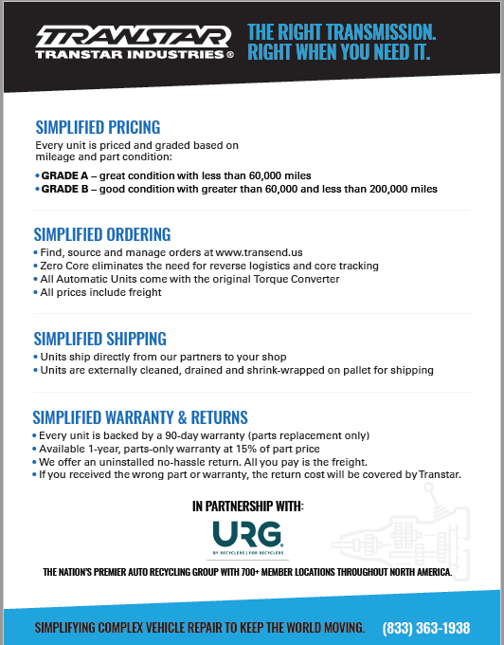
OE Recycled Transmissions
A great alternative for your cost-conscious customers!

Slide 7



































Brands you trust & know

Slide 8


Meineke Program with Transtar
3.5%
Rebate
36
Month
100,000 mile PREMIUM warranty on Reman Transmissions included with Ultimate Upgrade Available
FREE
Transmissions and Engines included!
Rap2 Kit!
Requires 2 programming events per month
Sales Mgr – J.R. (James) Reville (440) 359-7690
Dedicated Customer Service: 1-833-363-1938
jreville@Transtar1.com
GR@Transtar1.com
  Easy online ordering at www.transend.us
  Eligible for all Transtar promotions
  Credit available for all locations
  Net 30 day terms
  PROGRAM UPDATE!!

Slide 9
Transmission Removal and Replacement
Take the fear out of installing complete remanufactured transmissions!
2WD Lincoln Blackwood Transmission
Removing the transmission
https://cdn.jwplayer.com/previews/1F8gJEb8-K8fwWdbc
Replacing the transmission
https://cdn.jwplayer.com/previews/XpPZSvxD-K8fwWdbc
Once we get some feedback, we will move towards printing QR code stickers that will be placed on outside of the crates for the 2WD units.
Additional videos coming soon!

Slide 10
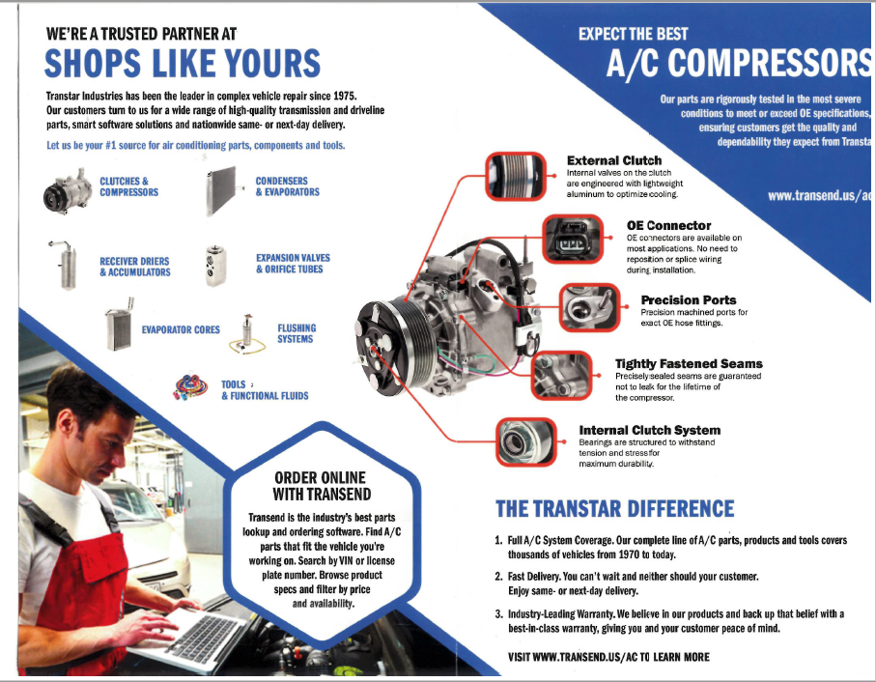
Air Conditioning
    A/C Lifetime Warranty –
    Original Purchase Invoice to ensure a Compressor purchased with Accumulator or Receiver Dryer AND Orifice Tube or Expansion Valve.
    Original Repair Invoice with proof of system flush or inline filter replacement.

Slide 11
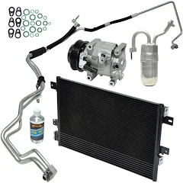
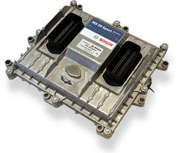
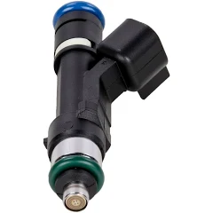
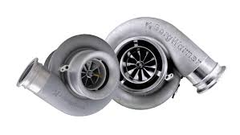
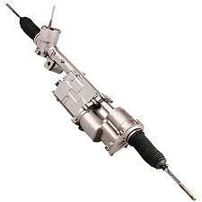
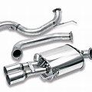
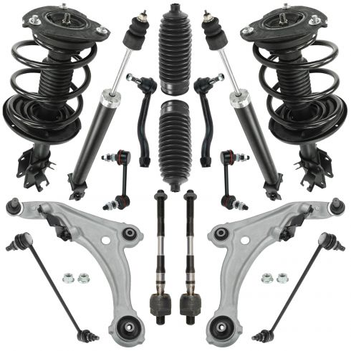
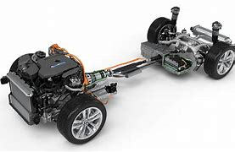
Product Category Expansion – Happening Now!!
DISTRIBUTION OF COMPLEX VEHICLE REPAIR PRODUCTS
Electronics
HVAC System
Fuel System
Turbochargers
Steering
Suspension
Exhaust
Hybrid and EV
Transtar is expanding its product offering into select complex repair categories both organically and through acquisitions. We have added 3 additional locations in the past month!

Slide 12
Q3 2023 Rebate Results
$44,555 in Transmission & Part Sales
The sales resulted in about $2,005 in rebates back to MDPCI
45 different Meineke centers contributed to the sales
Thank you!

Slide 13







Transend Online Ordering Platform
Direct integrations with the leading shop management platforms
Automated return process for parts and core
Online bill payment
Search
Select
Ship
Look up parts that match the vehicle you’re working on using its license plate number, VIN, year/make/model/engine, or transmission.
Choose parts or products – even select recommended rebuilds. Then filter by brand, price, and availability.
Customize shipping options, view previous shipments, and quickly reorder frequently purchased parts.

Slide 14
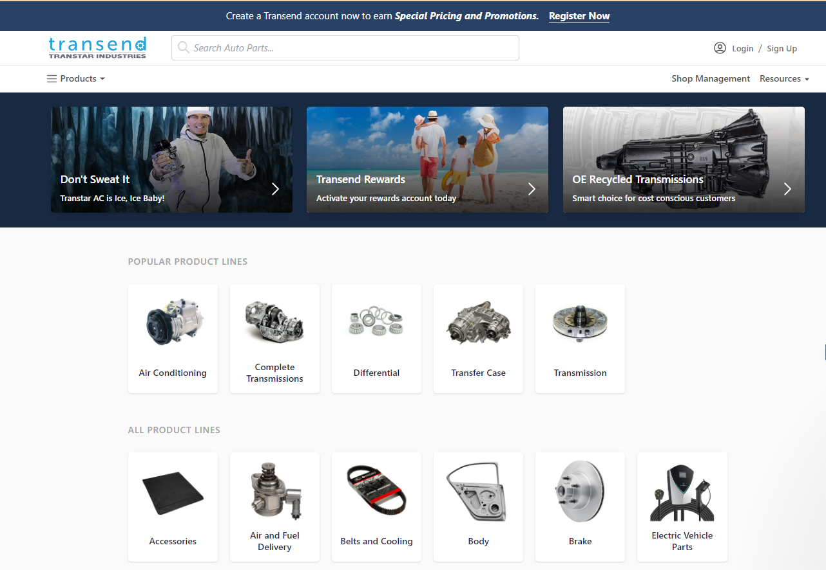
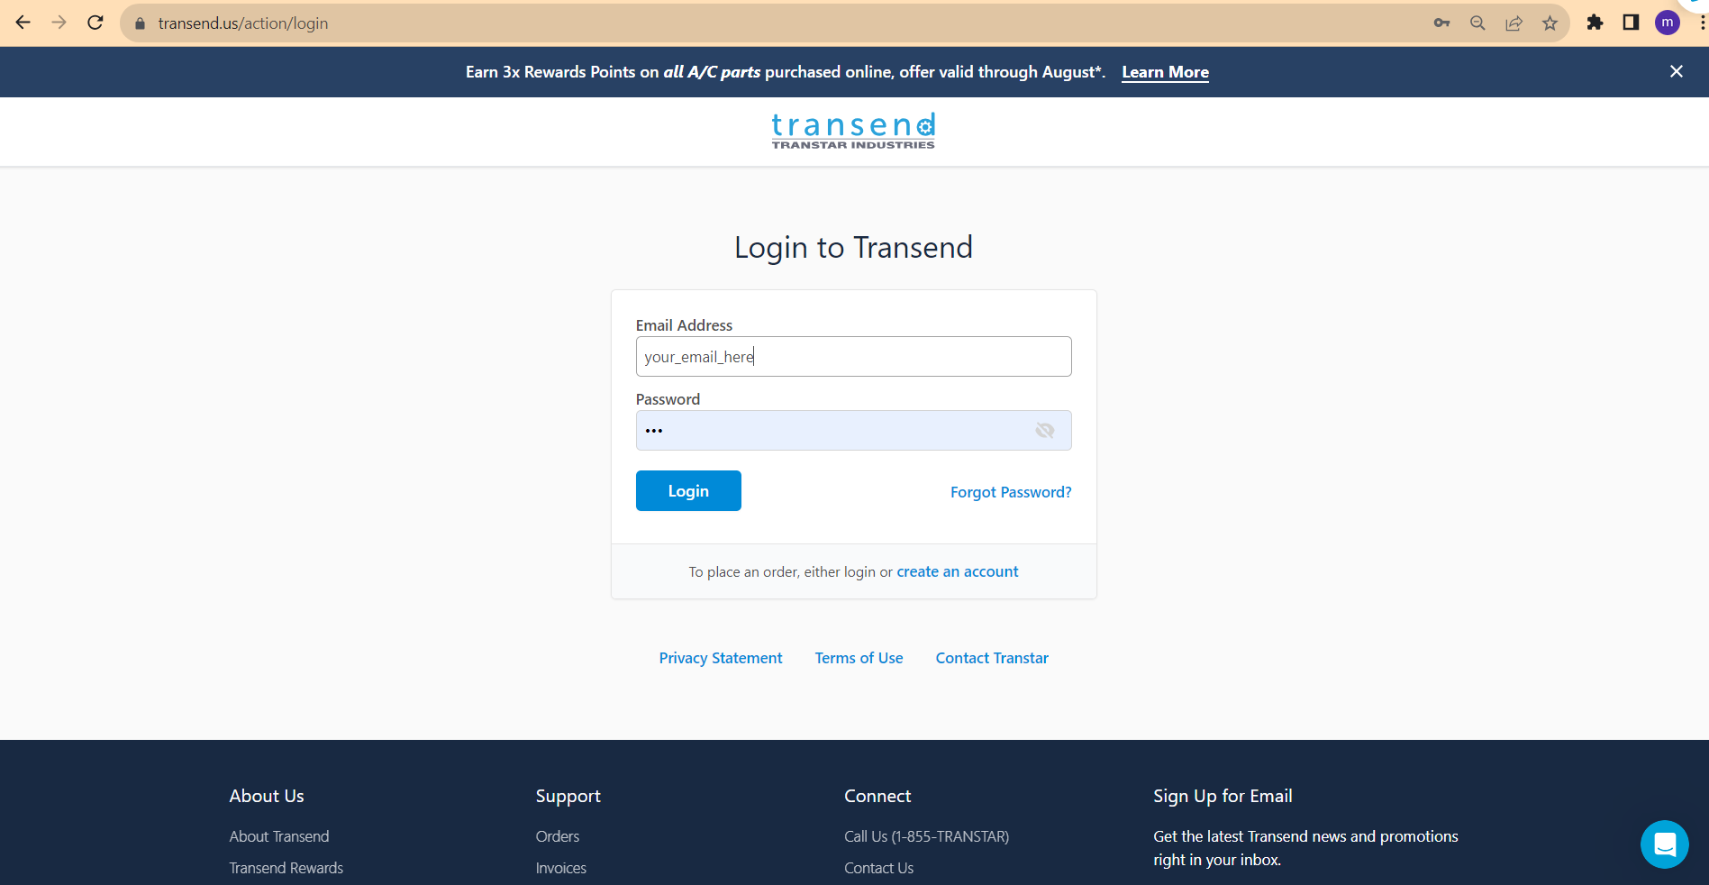
Transend.us

Slide 15
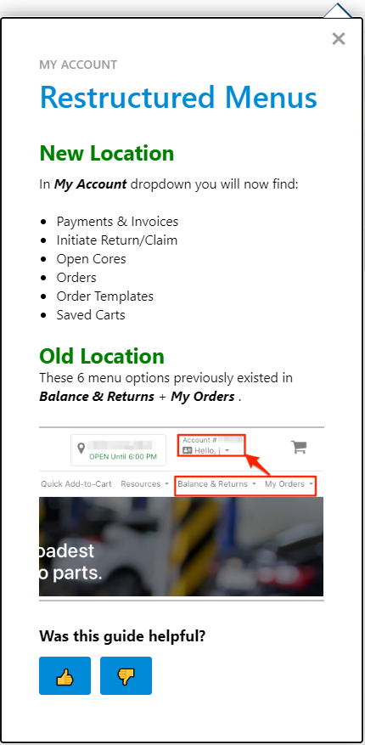
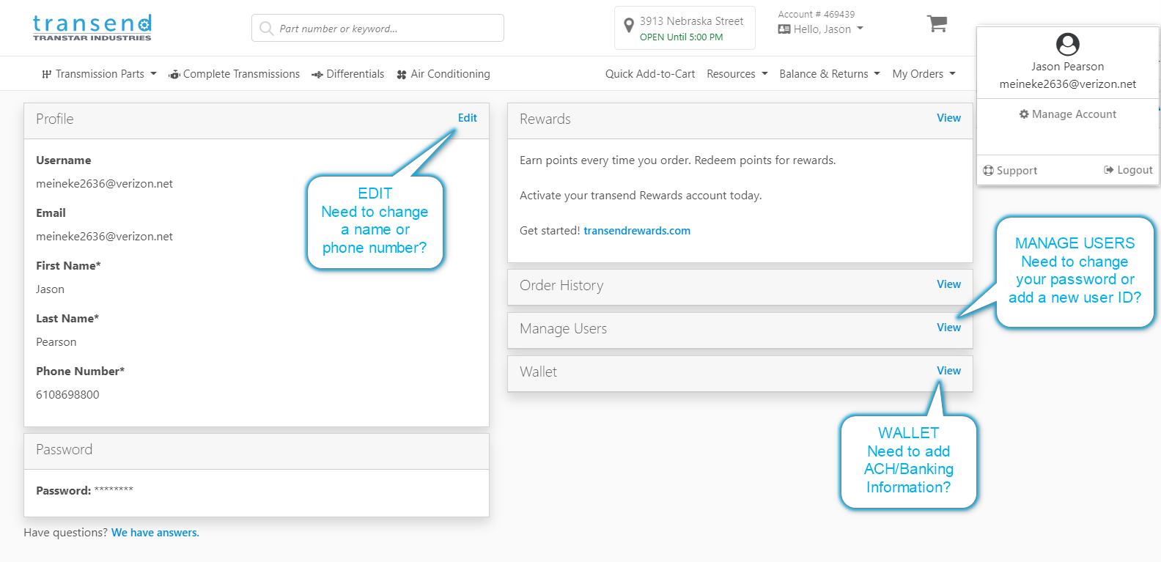
Transend – Account Management

Slide 16
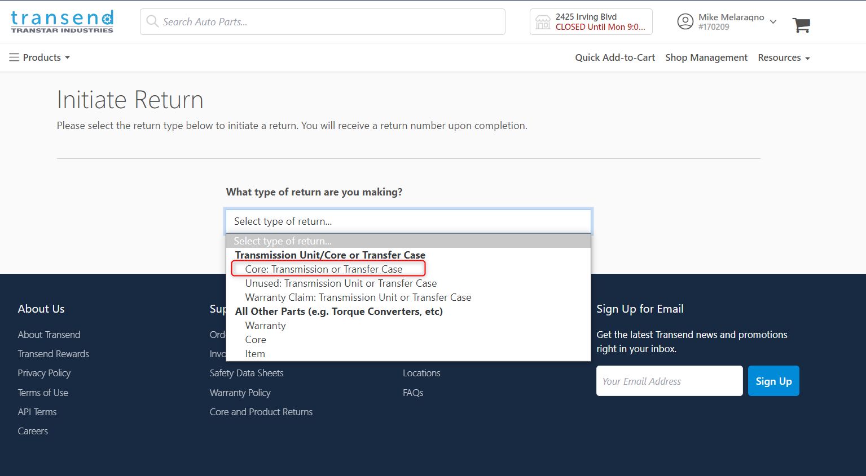
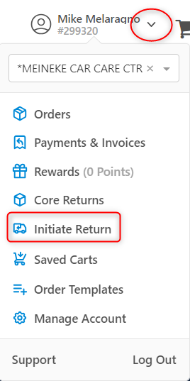
Asking for a Core Return
Return your cores within 2 weeks to get your deposit money back quickly.
Two ways to do it. The process is fast and simple!
  www.transtar1.com/core - choose the Core option.
  Complete all required information including the serial number and Transtar invoice number.
  You will be sent a Bill of Lading to have your core picked up and sent back directly to the transmission vendor.
    OR
  Log onto your Transend account, Go to your name, select Initiate Return, then choose Core: Transmission or Transfer case.
The link in Transend brings you to the same
Bill of Lading page as transtar1.com/core
Core credit will be provided within 48 hours of the
core being picked up by the carrier.

Slide 17
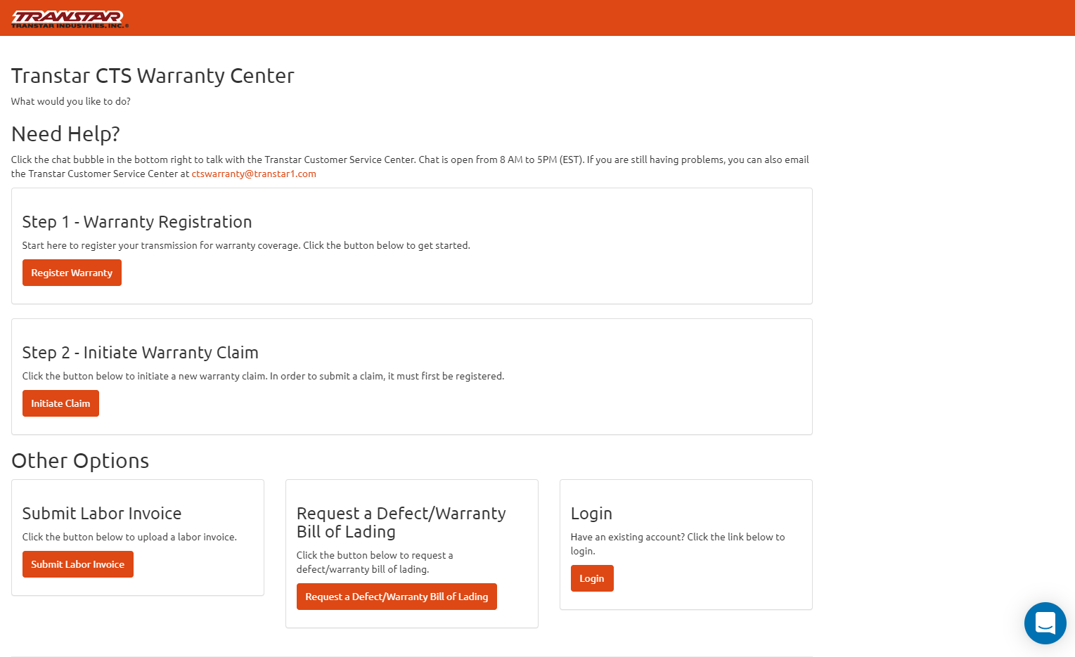
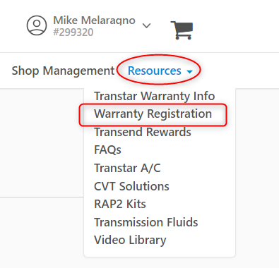
The Warranty Center – www.transtarcts.com/warranty-center
Transtar’s new warranty center offers a convenient way to:
Register your new transmission for warranty coverage by simply using your invoice information and answering installation questions
Initiate a warranty claim
Submit your labor invoice
Request a bill of lading for a warranty/defect unit
We require that warranty registrations are completed within 3 working days of installation. A warranty registration is required in order to submit a claim.
If help is needed, please click on the chat button on the bottom right of the screen or email ctswarranty@transtar1.com

Slide 18


Contact Information
JR (James) Reville – Account Manager
(440) 359-7690 – jreville@Transtar1.com
Dedicated Customer Service – 1-833-363-1938 / GR@Transtar1.com
Mike Melaragno – Director of Sales Operations
(440) 201-8252 – mmelaragno@Transtar1.com
Nick Miele – Regional Vice President
(914) 490-3638 – nmiele@transtar1.com
Need online help? M-F 8:00am to 6:00pm EST

