Slide 1
Meineke Dealers Association (MDA)
Fall 2023 Region 4&5 Meeting | October 11, 2023
Nashville, TN

Slide 2
Meeting Agenda
3:00 - 3:15 Welcome & Region 5 Chairman Vote Pete Robinson & John Coffield
3:15 - 3:45 ATD Anthony King
3:45 - 4:15 Bank of America Joel Cruz & Anthony Torino
4:15 - 5:15 MDA Business - Membership/Benefits
5:15- 5:45 Chevron Steve Collins
5:45 - 6:15 Syncrony Jerry Powers
6:15 - 6:45 Dinner
6:45 - 7:15 1st Mile Lindsey Mida
7:15 - 7:45 Advance Auto Pete Masini
7:45 - 8:15 Advertising Committee Update Ben Ramsey
8:15 Open Discussion

Slide 3
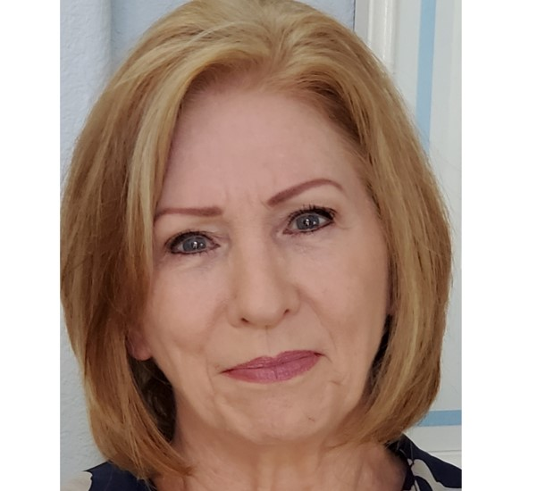
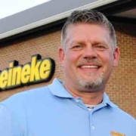
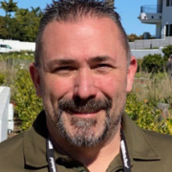
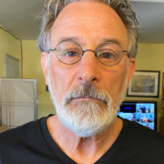
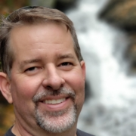
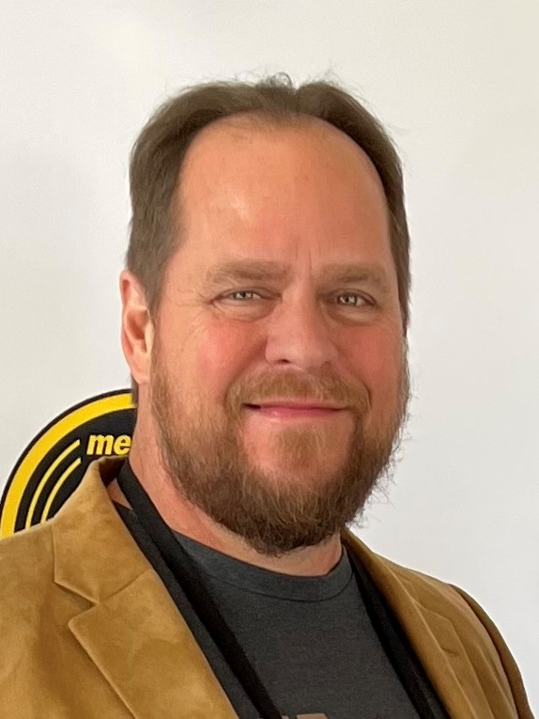
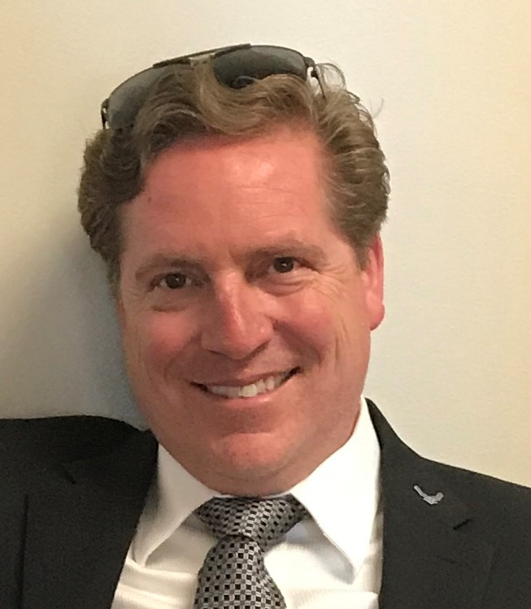
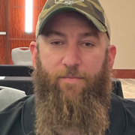
MDA Board
Janet Cummings – R7 Chair
President
Dave Repass – R3 Chairman
Vice President
Marc Arnold – R2 Chairman
Treasurer
Joe LaManna – R1 Chairman
Secretary
Pete Robinson – R4 Chairman
Board Member
John Coffield - R5 Chairman
Board Member
Chris Johnson – R6 Chairman
Board Member
Chris Dalen – R8 Chairman
Board Member
Greg Masewic
Board Member
Ben Ramsay
Board Member

Slide 4
What does the MDA Board do for you?
The MDA board of directors is a group of individuals who are elected to govern and oversee the associations operations. The board is responsible for:
setting the organization's mission, strategy, and goals
ensuring that the organization operates in compliance with legal and ethical standards.
Protecting dealer rights to ensure we maintain a >50% membership to protect our agreement with MCC!
The board is a 100% volunteer position, who dedicate their own time, on behalf of all dealers!

Slide 5
What does the Association do for you?
Normalize the Conversation
We have regular meetings with MCCC leadership to discuss issues relevant to franchisees: marketing; products and services; system-wide legal issues; facility upgrades; and training.
We continue to press MCCC for accountability to increase unit profitability while maintaining standards.
Ways to even Greater Accountability?
Survey membership on MCCC’s performance and take results to company for review and action;
Be public brand builders while getting more assertive in the Board room.

Slide 6
MDA Committees & Committee Chairs
MDA Executive Committee
Janet Cummings
Advertising Committee
Ben Ramsay
MAF Oversight
John Coffield
Operations and Training
John Coffield
Membership/Elections
Chris Johnson
Communications
John Coffield
Vendor Relations
Marc Arnold
Vendor Appreciation Event (VAE)
Marc Arnold
Redistricting
Pete Robinson
Convention
Janet Cummings
Technology
Greg Masewic
Bylaws
Janet Cummings
Fleet Services
Dave Repass

Slide 7
Advertising Committee – Ben Ramsay
Financing options
Elevate brand
Increase in car count coming into your shops
Support/collaboration from MCC
Committee Members
Greg Masewic
Chris Dalen
Pete Robinson
Mike Jackson
Bert Figearo

Slide 8
Technology Committee – Greg Masewic
Improvements on TekMetric Reporting
Over 430 centers onboarded to TekMetrics POS system
Refunds and changes to posted invoices remain posted.
Pilot program for EV Service Center
Committee Members
Mike Baden
Paul Hammond
Amol Kansagra
Kevin Leger
Scott Martin
Ben Ramsay

Slide 9
Ops & Training Committee – John Coffield
Repairify: Pilot stores are ready and for training and should be up and running by Oct.
Financing: government reviewing companies charging high finance fees to customers may impact some Meineke dealers who use these companies.
Today’s Class: Online class offered by Autozone. Program geared toward entry level techs.
Committee Members
Mich Coffield
Pete Robinson
Mike Jackson
Scott Martin
Daryl Stillman
Dirk Schaumleffel

Slide 10
Fleet Services Committee – Dave Repass
Client Programs
Prince Telelcom: Good overall sales,
Avis Budget Group: Successfully launched program to get them onto Auto Integrate, making us preferred in many markets.
Wheels: Wheels has agreed to make us a preferred national partner.
American Auto Shield: Should launch in Oct. Agreed to pay shop rates and will be direct pay.
ClaimDriver: Good adoption rate. Data Lake integration launched successfully.
Entegral Survey – working on obtaining information on a granular level to grow car count.
Operations Program
Committee Members
Jake Morrow
Pete Robinson
Kevin Leger
Brian Hooper

Slide 11
How has Dady & Gardner helped the MDA?
Creation and Maintenance of the Independence Rider
Vigilant and ongoing protection of franchisee rights
Maintained reimbursement of MCCC relo costs at $1000
Held MAF contributions related to tire and towing steady
Negotiated a penalty for comingling of funds to avoid termination as only remedy
Capped monthly tech fees for 5 years
Negotiated new cap for remodels
Plus so much more…

Slide 12
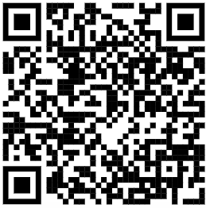
JOIN TODAY

